Slide 1
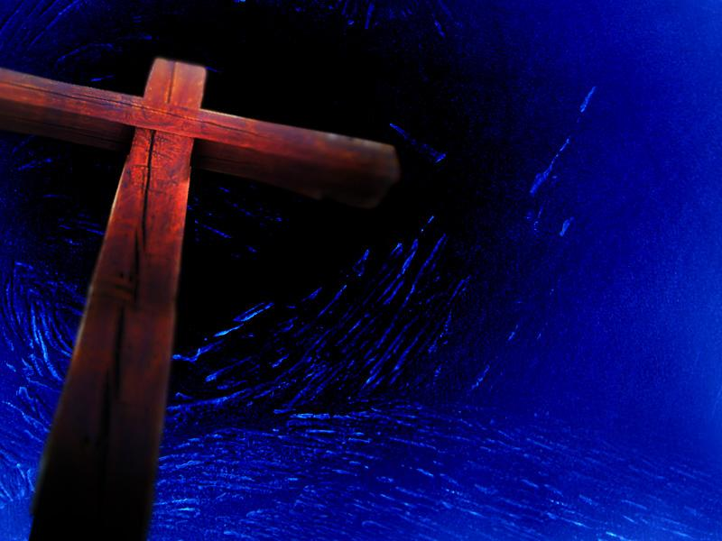
Stations of
The Cross for Our Times

Slide 2
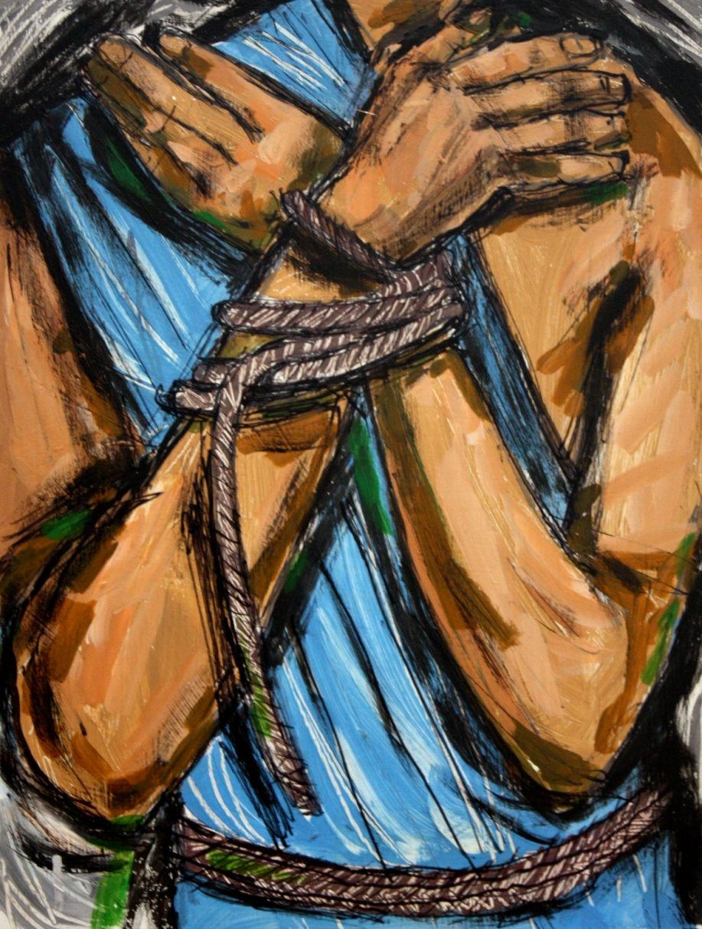

The First Station
Jesus is Condemned to Die
Were you there when Jesus was condemned?

Slide 3
We adore you, O Christ and we praise you, because by your Holy Cross, you have redeemed the world
Pilate said, ‘What shall I do with Jesus who is called Christ?’ The crowd replied, ‘Let him be crucified’. Pilate took water and washed his hands before the crowd saying, ‘I am innocent of this man’s blood; it is your concern.’
Yes, Lord, it is my concern. It is my concern that those with whom I live and work get fair play, even if that means standing against the crowd. When I have to make decisions which affect peoples’ lives, help me to make them with understanding and care.

Slide 4
We pray together….
Our Father, who art in Heaven….
Hail Mary, full of Grace….
Glory be to the Father…..

Slide 5
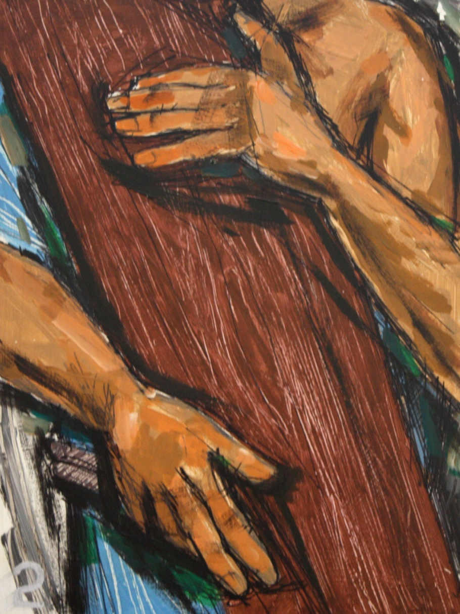
The Second Station
Jesus Takes up His Cross
Were you there
when they laid the cross on him?

Slide 6
We adore you, O Christ and we praise you, because by your Holy Cross, you have redeemed the world
The cross was heavy, a beam of solid wood; the journey, a struggle through narrow and uneven streets, with a hostile crowd looking on. Lord, we each have a cross to carry.
When life is difficult, tedious or painful we sometimes complain and look for an easy way out. Give us strength each day to carry our cross.

Slide 7
We pray together…
Our Father, who art in Heaven….
Hail Mary, full of Grace….
Glory be to the Father…..

Slide 8
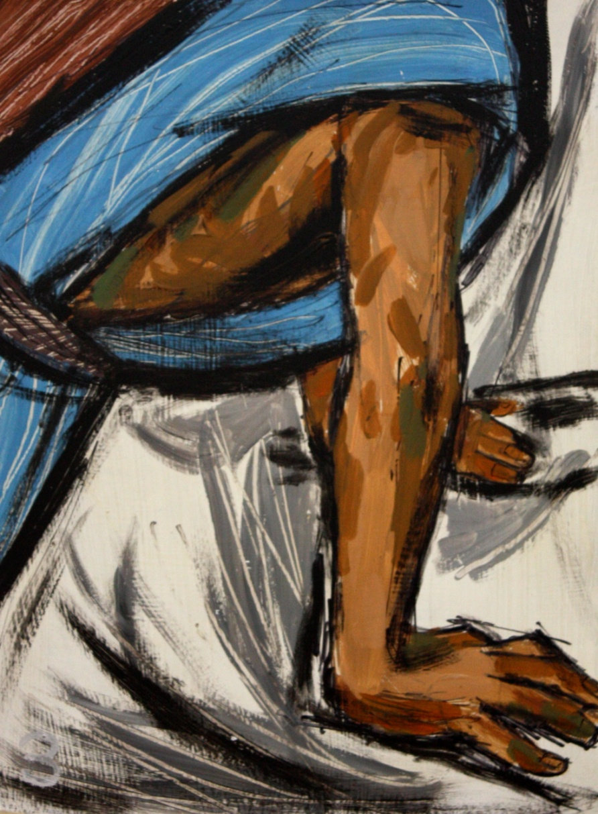
The Third Station
Jesus Falls for the First Time
Were you there
when he fell beneath the cross?

Slide 9
We adore you, O Christ and we praise you, because by your Holy Cross, you have redeemed the world
It was no wonder that he fell. Jesus had suffered so much already that he could not see properly to pick his way through the city streets.
There are times, Lord, when we cannot hide our weakness or when we have to admit our failings not only to ourselves but also to others. Give us some of your courage to accept the limitations in our lives.

Slide 10
We pray together…
Our Father, who art in Heaven….
Hail Mary, full of Grace….
Glory be to the Father…..

Slide 11
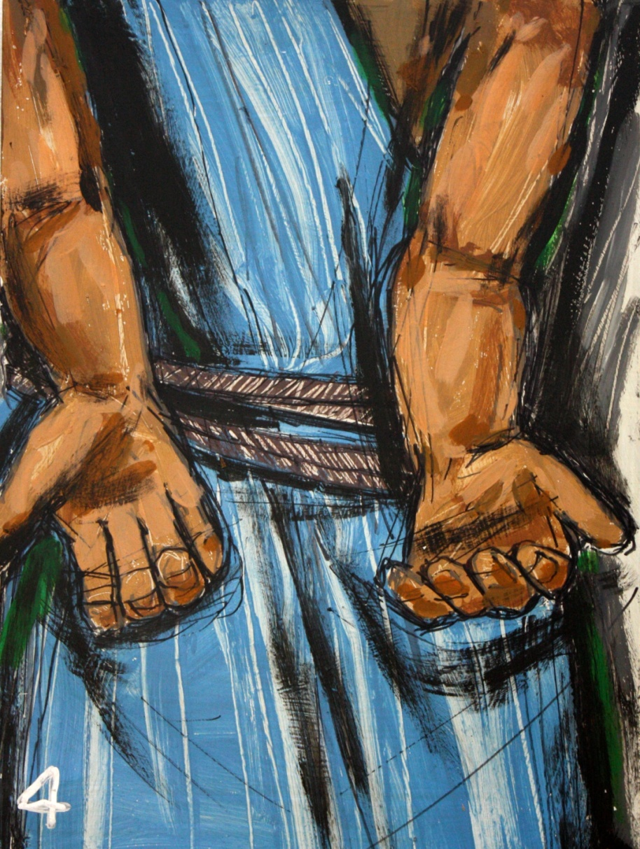
The Fourth Station
Jesus Meets His Mother
Were you there
when Mary
met her son?

Slide 12
We adore you, O Christ and we praise you, because by your Holy Cross, you have redeemed the world
It was now three years since he had left home. Mary had brought him into the world, and cared for him as a child. Now she was with him again to give him some of her strength, just by being there in his time of need.
Lord, we too can help – our families, our friends, those we love and those we do not even know very well – just by being there, by being available, by keeping in touch, by turning up in times of trouble.

Slide 13
We pray together…
Our Father, who art in Heaven….
Hail Mary, full of Grace….
Glory be to the Father…..

Slide 14
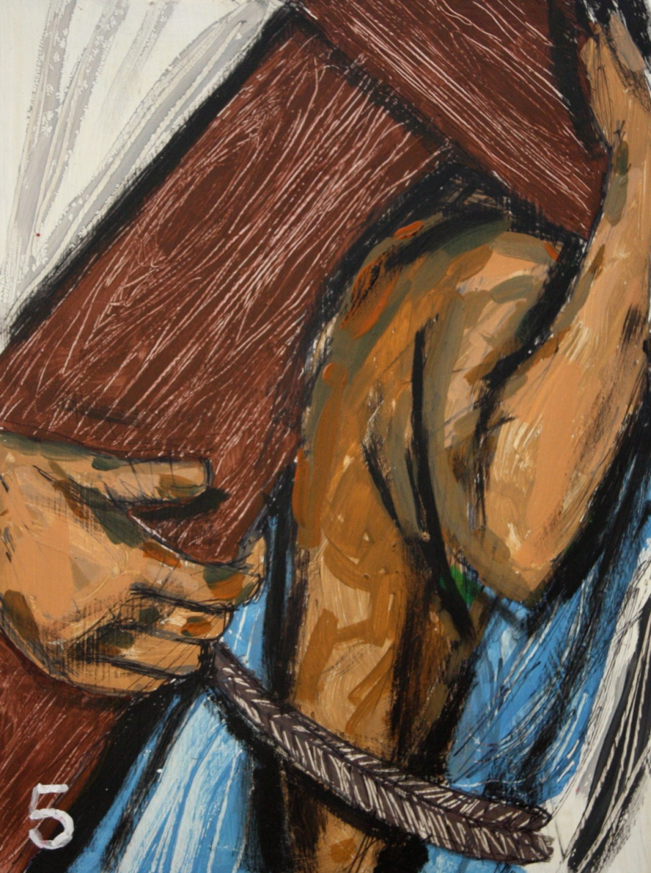
The Fifth Station
Simon Helps Jesus
Were you there
when Simon
helped the Lord?

Slide 15
We adore you, O Christ and we praise you, because by your Holy Cross, you have redeemed the world
Simon was a native of Cyrene, a foreigner in Jerusalem, perhaps a pilgrim celebrating Passover. He found himself forced to help Jesus in carrying his cross.
Lord, Simon met with you in a way he had never expected. At times we too can suddenly be faced with someone in need of our help. May we not turn away, but willingly offer whatever help we can give.

Slide 16
We pray together…
Our Father, who art in Heaven….
Hail Mary, full of Grace….
Glory be to the Father…..

Slide 17
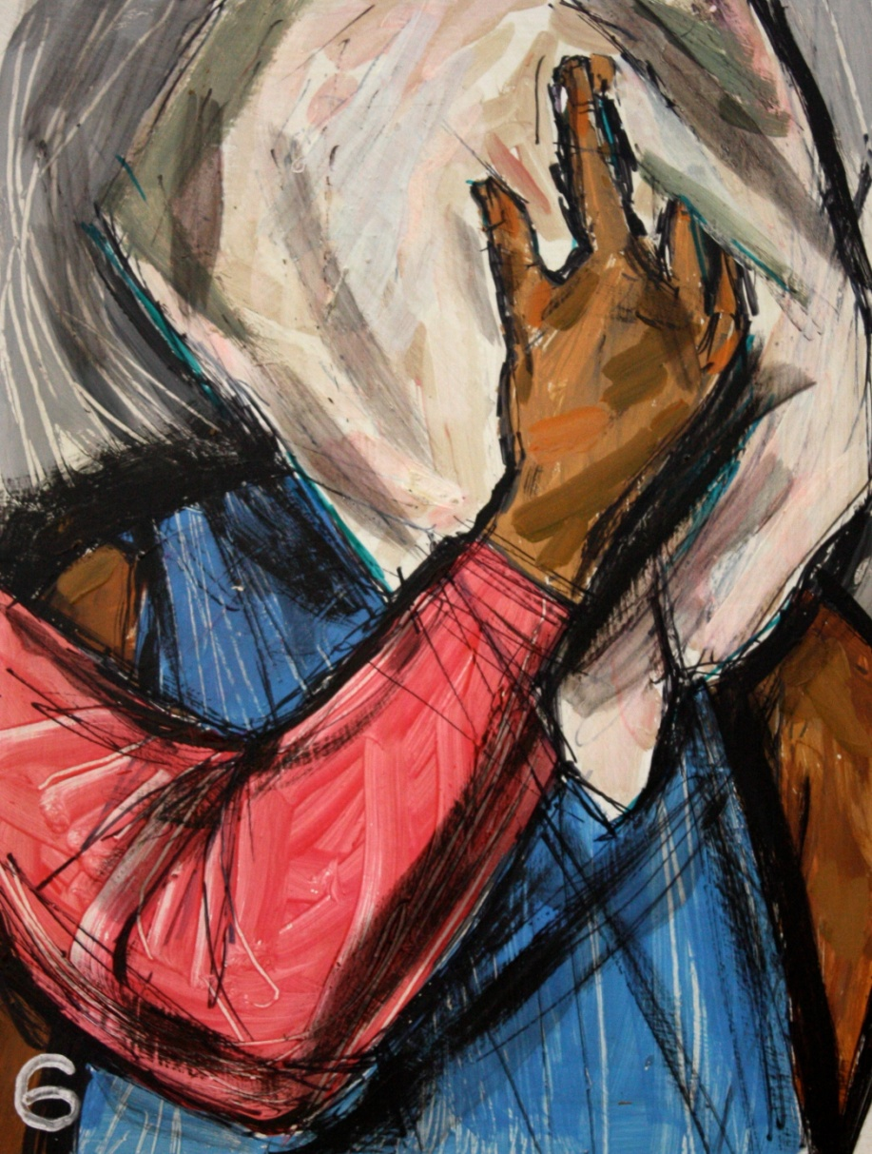
The Sixth Station
Veronica Wipes the Face of Jesus
Were you there
when the woman wiped his face?

Slide 18
We adore you, O Christ and we praise you, because by your Holy Cross, you have redeemed the world
Veronica was not like Simon; nobody asked her to help. She pushed her way in through the crowd and wiped the blood from his face with a towel.
Veronica saw your face, Lord, and your face left an impression. Your face is the face of suffering and need, the face of the aged, of the undernourished child, of the refugee. Your face today is around us if only we look. “I was sick and you visited me, naked and you clothed me.”

Slide 19
We pray together…
Our Father, who art in Heaven….
Hail Mary, full of Grace….
Glory be to the Father…..

Slide 20
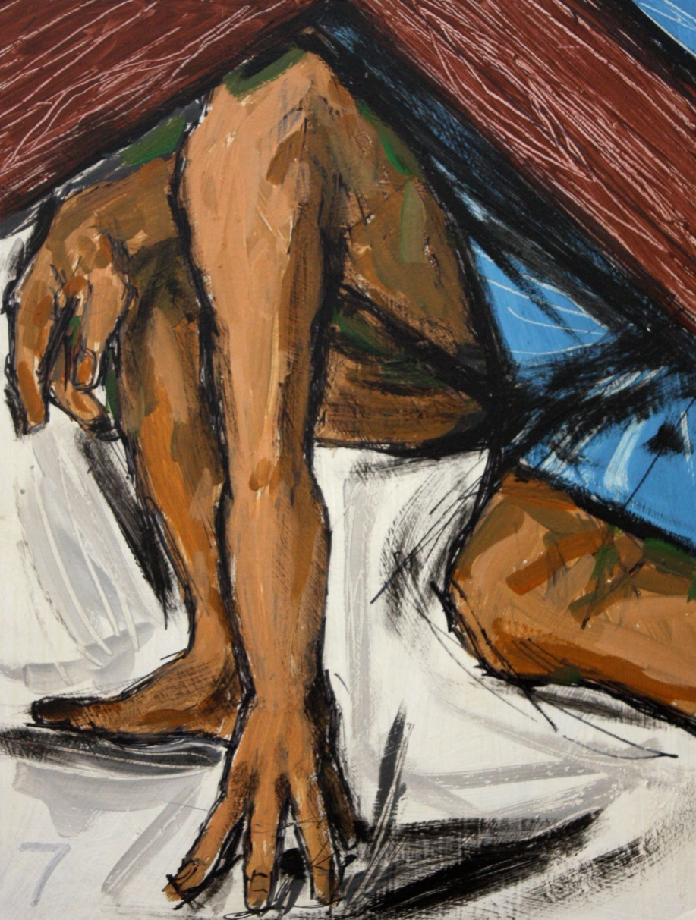
The Seventh Station
Jesus Falls for the Second Time
Were you there
when Jesus
fell again?

Slide 21
We adore you, O Christ and we praise you, because by your Holy Cross, you have redeemed the world
In spite of the help, he fell again. He was being hurried by the soldiers, the road was uphill, and his strength was failing with every step of the way.
Lord, you are always ready to lift us when we fall. May your example teach us to be understanding towards others, to help rather than to judge, to support rather than to condemn.

Slide 22
We pray together…
Our Father, who art in Heaven….
Hail Mary, full of Grace….
Glory be to the Father…..

Slide 23
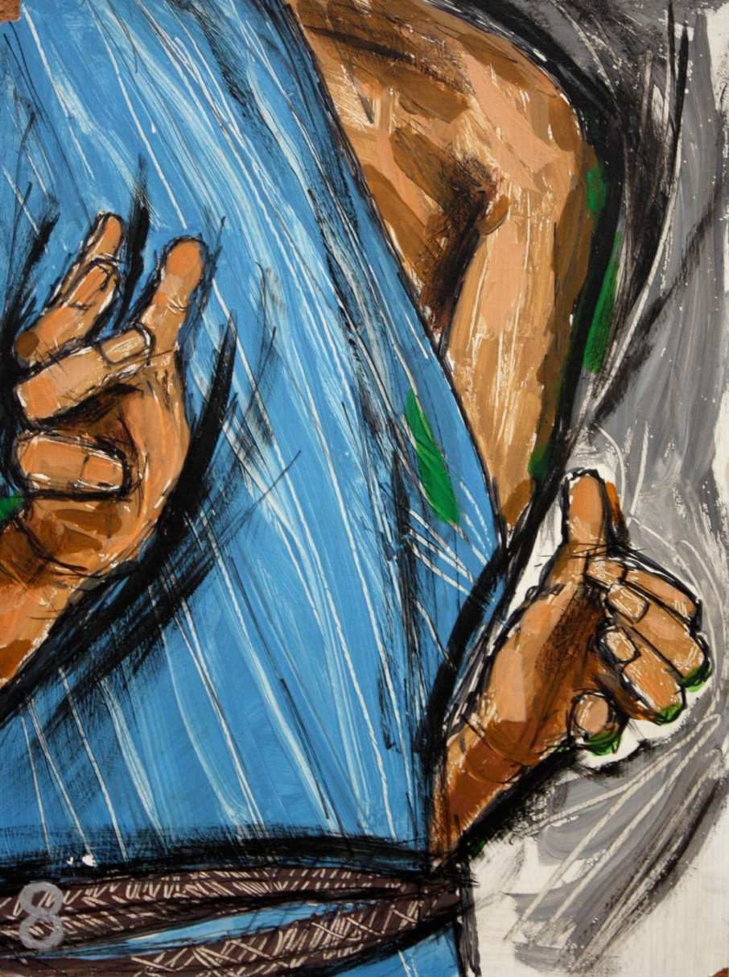
The Eighth Station
Jesus Meets the Women of Jerusalem
Were you there
when the women wept for him?

Slide 24
We adore you, O Christ and we praise you, because by your Holy Cross, you have redeemed the world
These women were moved to sympathy for Jesus. He acknowledged their tears but he knew there was nothing they could do for him now. He asked them to look to themselves and to their children.
You do not wish us, Lord, to go on weeping about what has happened in the past. We cannot change the past but we can do a great deal about the future.

Slide 25
We pray together…
Our Father, who art in Heaven….
Hail Mary, full of Grace….
Glory be to the Father…..

Slide 26
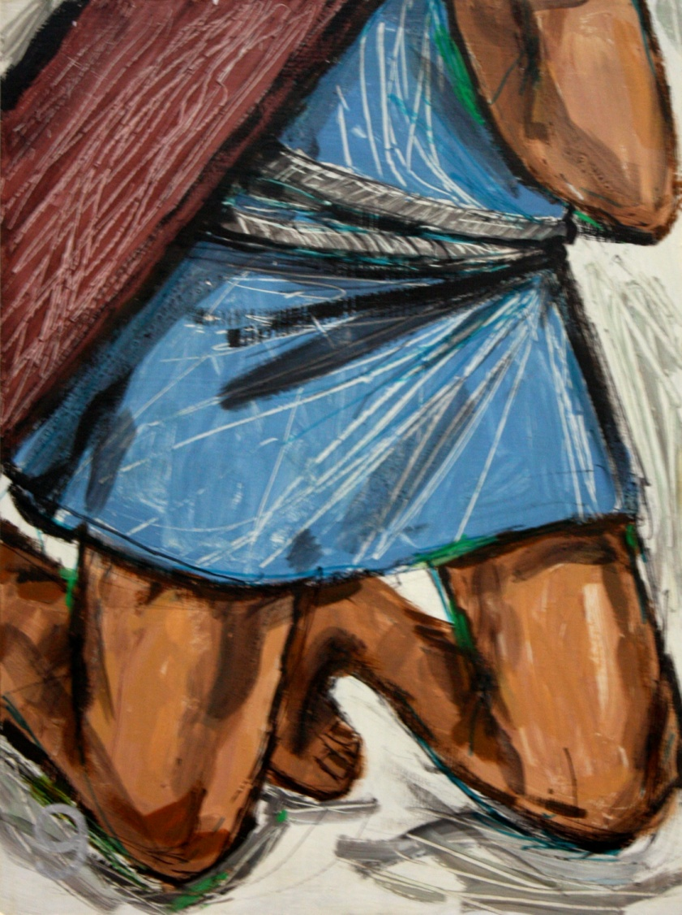
The Ninth Station
Jesus Falls for a Third Time
Were you there
when Jesus
fell again?

Slide 27
We adore you, O Christ and we praise you, because by your Holy Cross, you have redeemed the world
This was the final fall, Jesus had reached the very limit of physical endurance. And yet his spirit was not broken.
Lord, we know that you walk with us each day as we face the cares and challenges of life. Help us to keep going, especially in times of weakness, and to trust you in times of depression and despair.

Slide 28
We pray together…
Our Father, who art in Heaven….
Hail Mary, full of Grace….
Glory be to the Father…..

Slide 29
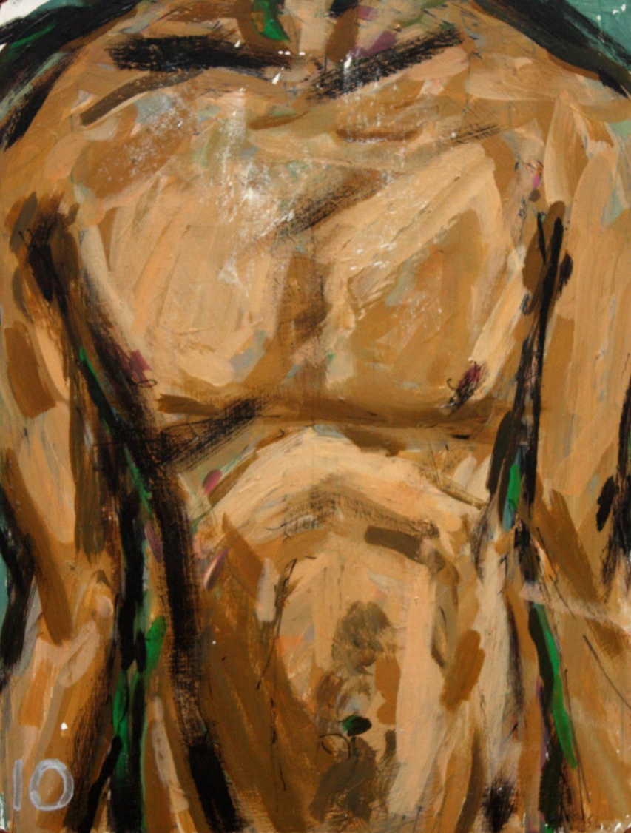
The Tenth Station
Jesus is Stripped of His Clothing
Were you there
when they stripped him of his clothes?

Slide 30
We adore you, O Christ and we praise you, because by your Holy Cross, you have redeemed the world
Now everything was taken from him, even his clothes. Although he was God he emptied himself, to become as we all are. And he was humbler yet, even to accepting death on the cross.
Lord, we worry about our life and what we are to eat, about our body and how we are to clothe it. But life means more than food, and the body more than clothing. You humbled yourself to become like us: may we become more like you.

Slide 31
We pray together…
Our Father, who art in Heaven….
Hail Mary, full of Grace….
Glory be to the Father…..

Slide 32
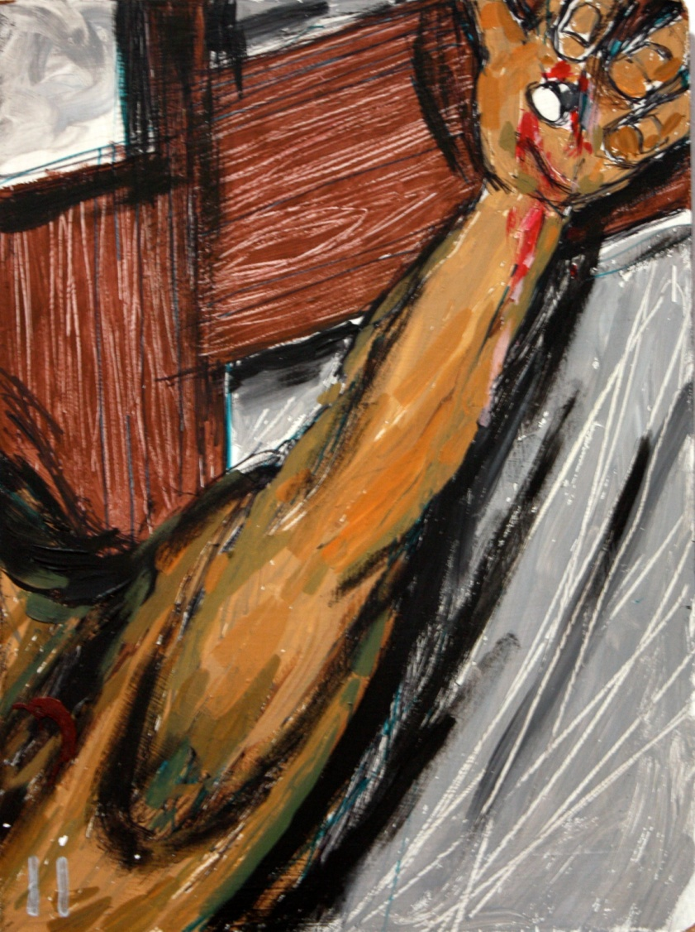
The Eleventh Station
Jesus is Nailed to The Cross
Were you there
when they nailed
him to a tree?

Slide 33
We adore you, O Christ and we praise you, because by your Holy Cross, you have redeemed the world
‘Without beauty, without majesty we saw him, a thing despised and rejected by men, a man to make people hide their faces.’ (Is 53:2-3)
It was all very cruel and barbaric, Lord. Blinded by hatred, nobody stopped to think. It is sad that we still treat people in this way, when we fail to see in them the image of God. Forgive us, Lord, for the violence in our lives and our society.

Slide 34
We pray together…
Our Father, who art in Heaven….
Hail Mary, full of Grace….
Glory be to the Father…..

Slide 35
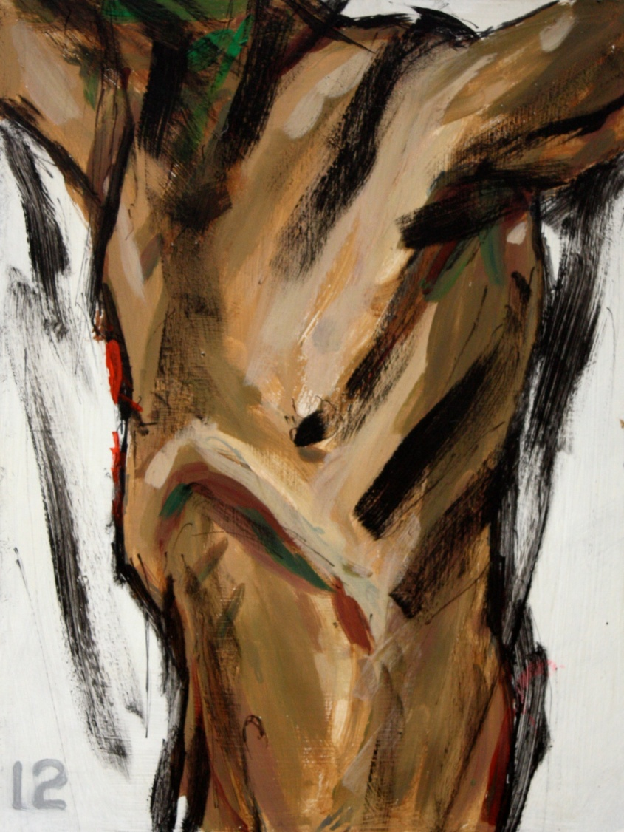
The Twelfth Station
Jesus Dies on The Cross
Were you there
when Jesus
breathed his last?

Slide 36
We adore you, O Christ and we praise you, because by your Holy Cross, you have redeemed the world
From the sixth hour there was darkness over the whole land until the ninth hour. Jesus said, ‘Father, forgive them; they do not know what they are doing. Into your hands I commend my spirit.’
Saviour of the world, you died as you lived, with a heart close to God and open to everyone. You have shown us how to live a full life; you have given us a reason to live and a reason to die. Soften our hearts towards those who make us suffer. Save us from self-pity and despair. At the thought of dying we place all our trust in you.

Slide 37
We pray together…
Our Father, who art in Heaven….
Hail Mary, full of Grace….
Glory be to the Father…..

Slide 38
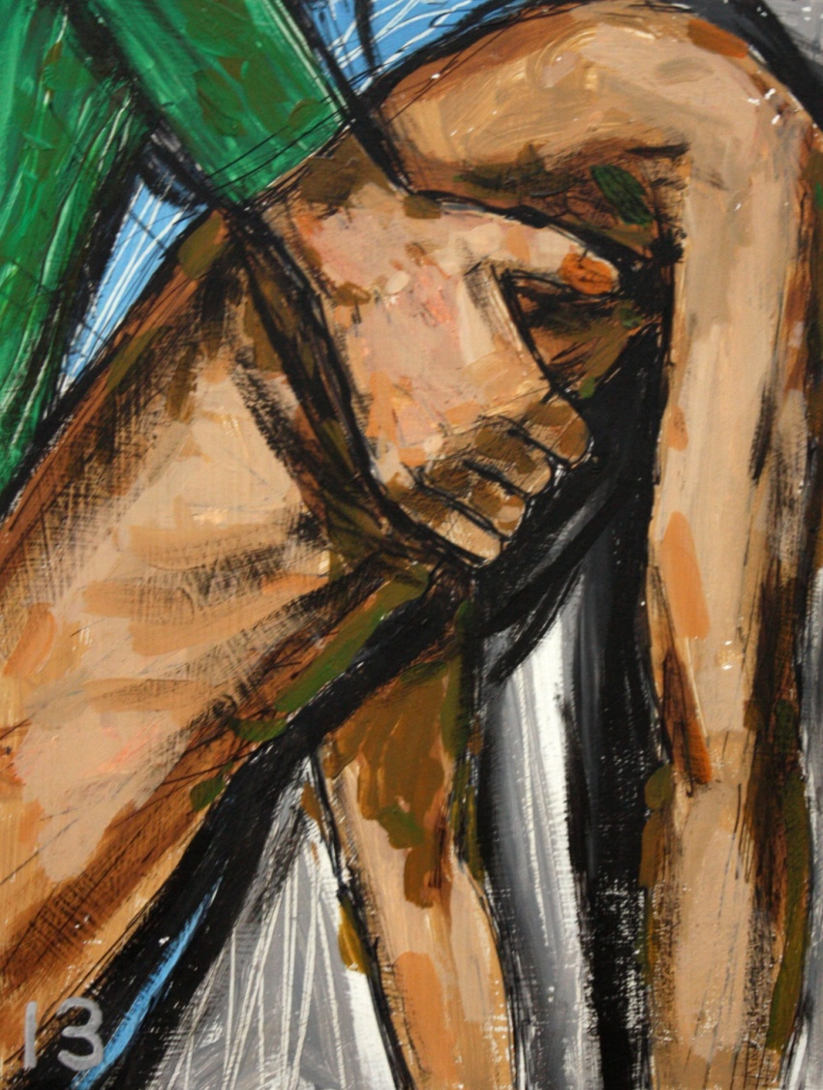
The Thirteenth Station
Jesus is Taken Down from The Cross
Were you there
when Mary
held her Son?

Slide 39
We adore you, O Christ and we praise you, because by your Holy Cross, you have redeemed the world
The crowd had left the hill. A few friends remained, to mourn the dead and to keep vigil.
They placed the body in the arms of his mother.
Lord, your mother felt the sadness that we all feel when we lose our loved ones in death.
Help us to bear our bereavements with dignity, courage and hope.

Slide 40
We pray together…
Our Father, who art in Heaven….
Hail Mary, full of Grace….
Glory be to the Father…..

Slide 41
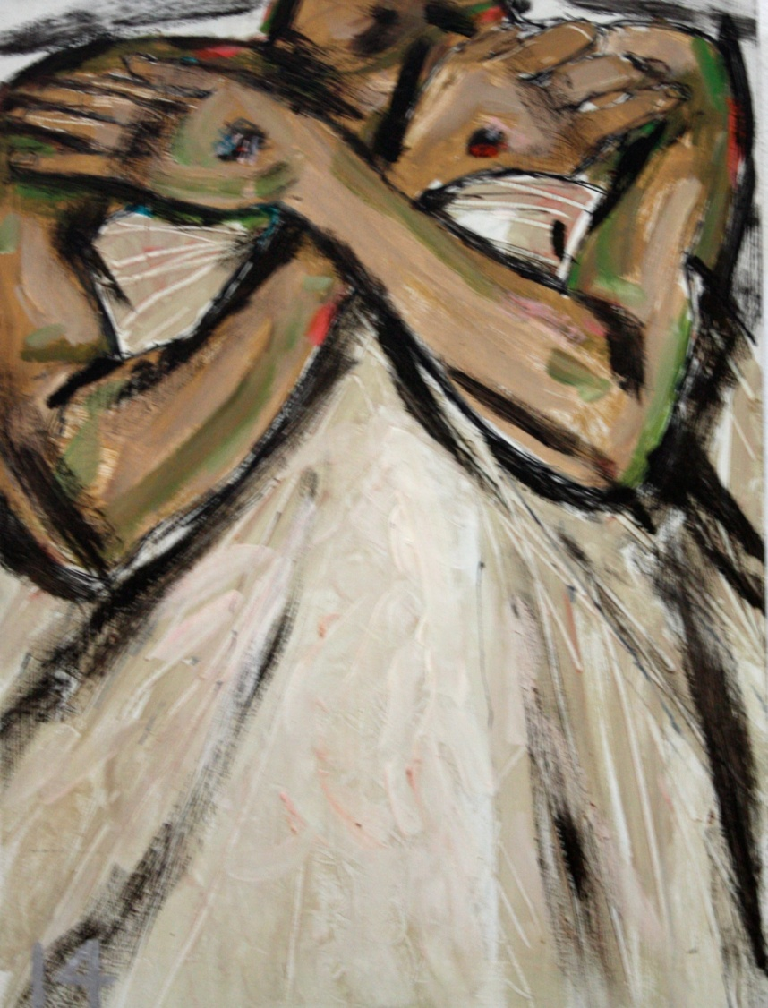
The Fourteenth Station
Jesus is Laid in The Tomb
Were you there
when they laid
him in the tomb?

Slide 42
We adore you, O Christ and we praise you, because by your Holy Cross, you have redeemed the world
It was now evening; the long day of suffering was over. The disciples prepared the body for burial and laid it to rest in a tomb. They closed up the tomb and went away.
Lord, you alone give us rest after toil; you give us life after death. If I should walk in the valley of darkness no evil would I fear: you are there. Give eternal life, Lord, to our relatives and friends who have died; and may the souls of the faithful departed through the mercy of God rest in peace.

Slide 43
We pray together…
Our Father, who art in Heaven….
Hail Mary, full of Grace….
Glory be to the Father…..

Slide 44
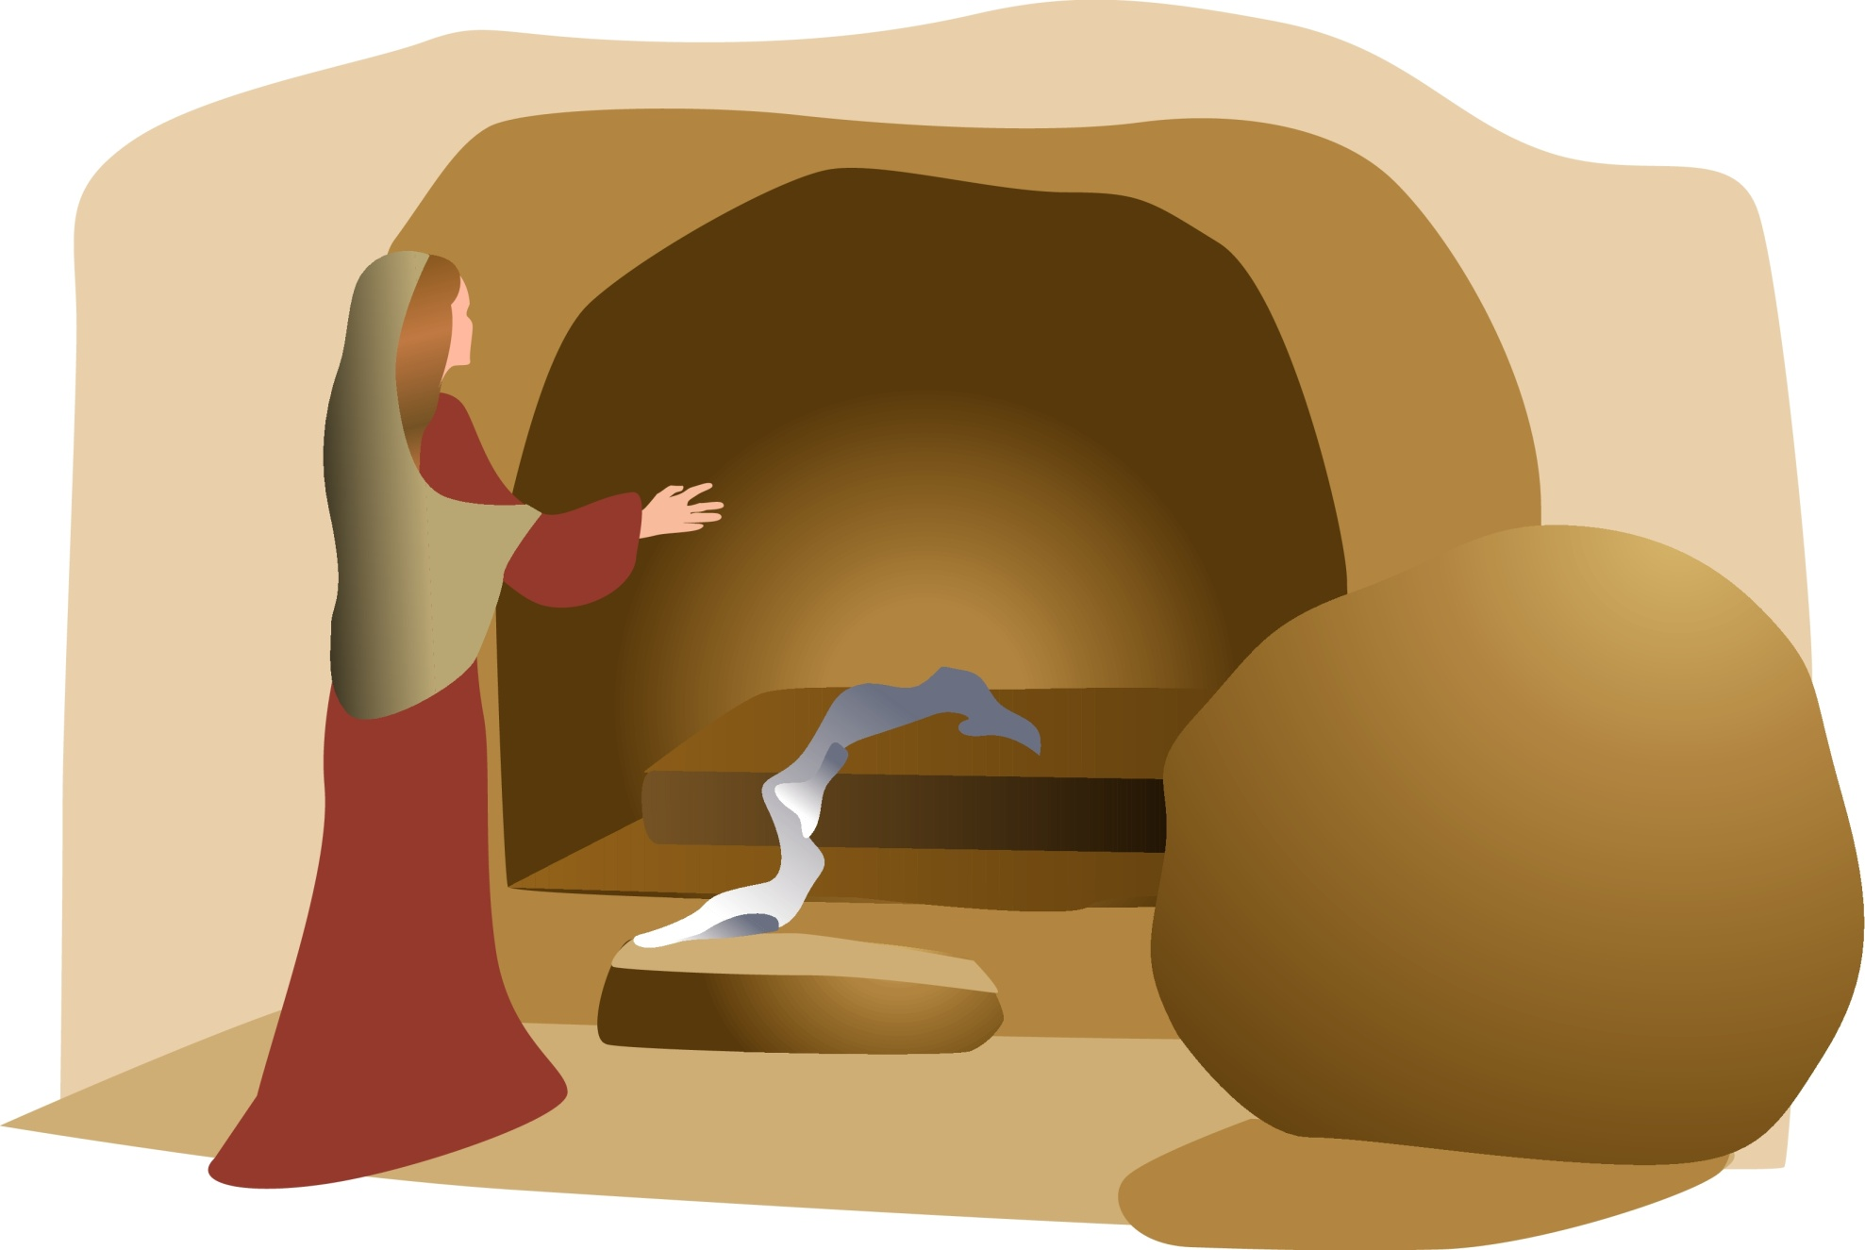
Jesus is Raised from The Dead
Were you there when they rolled the stone away?

Slide 45
Jesus is Raised from The Dead
Guided Meditation

Slide 46
Jesus is Raised from The Dead
Closing Prayer
Lord God, when our world lay in ruins you raised it up again through your passion and death. O king of Good Friday, whose limbs were stretched on the cross, O Lord, who suffered the bruises, the wounds, the loss, we lay ourselves open to the loving kindness of your Sacred Heart. May some fruit from the tree of your passion fall upon us on this evening, through Christ, Our Lord, Amen

