Slide 1
Meaning and Significance
of Lent for Christians
Luke O’Connor – D. A. Killaloe Diocese

Slide 2
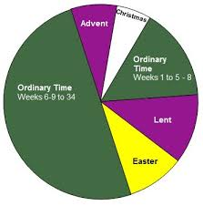
Christian Liturgical Year
Lent within the context of Liturgical Year.
Lent as preparation for Easter
Easter is the most important feast in Christian calendar!

Slide 3
Lent comes form old English- Spring
Lent, in the Christian church, a period of penitential preparation for Easter.
In Western churches it begins on Ash Wednesday, six and a half weeks before Easter, and provides for a 40-day fast (Sundays are excluded), in imitation of Jesus Christ’s fasting in the wilderness before he began his public ministry.

Slide 4
A period of preparation and fasting likely has been observed before the Easter festival since apostolic times, though the practice was not formalized until the First Council of Nicaea in 325 CE.
It was a time of preparation of candidates for baptism and a time of penance for sinners. In the early centuries fasting rules were strict, as they still are in Eastern churches.
In the Anglican churches The Book of Common Prayer prescribes that Lent be observed with fasting. In Lutheran and many other Protestant churches Lent is observed with various services and practices, though Lent is not formally observed in many Evangelical or nondenominational churches.

Slide 5
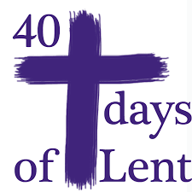
Lent as preparation for Easter
Why 40 days?
40 has huge significance for the Jewish people.

Slide 6
Why 40?
Jews wandered in the desert for 40 years
Jesus fasted for 40 days in the desert.
Figures have a special significance for Jewish people

Slide 7
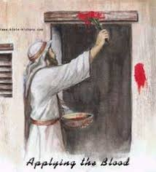
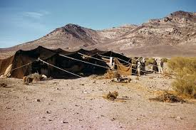
Exodus marked the beginning of Israelites sense of being saved by God

Slide 8
Passover -Pesach
The Passover Feast commemorates the liberation of the Israelites from slavery in Egypt, as recorded in the book of Exodus
On Passover, Jews also celebrate the birth of the Jewish nation after being freed by God from captivity.
Today, the Jewish people not only remember Passover as a historical event but also celebrate in a broader sense, their freedom as Jews.
The Hebrew word Pesach means "to pass over." During Passover Jews take part in a meal known as the Seder, which incorporates the retelling of the story of Exodus and God's deliverance from bondage in Egypt.

Slide 9
Each participant of the Passover Seder experiences in a personal way, a national celebration of freedom through God's intervention and deliverance.
The Christian Holy Week can only be fully understood within the wider Jewish faith context of celebrating Pesach/Passover.

Slide 10
In Human and Spiritual Life
Important role of:
Ritual Repeated pattern of behaviour
Gathering We live in social contexts
Memory We re-member, because we forget!
Celebration- Important moments of life

Slide 11
Understanding Holy Week
Understand the life, teachings, death and resurrection of Jesus.
Palm Sunday to Easter Sunday.
Spy Wednesday.
Easter Tridium
Holy Thursday
Good Friday
Holy Saturday/Easter Sunday

Slide 12
Understanding Lent as Preparation
Traditional understanding of Lent as ;
Time for Prayer
Time for Fasting
Time for Alms-giving ( helping others)

Slide 13
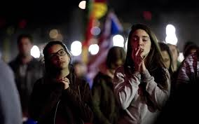
Time of Prayer
Lent is a time to stop and spend some time in the presence of God.
Lent challenges Christians to remember that we are made in the image of God

Slide 14
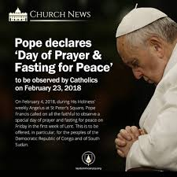
Fasting
Ash Wednesday and Good Friday are Fast Days, days of abstinence.
Traditionally Christians do not eat meat on these days
In the Christian tradition fasting can only be understood properly in the context that everything comes form God.
We fast to remind ourselves of this truth.
Fasting and Prayer are always linked.
‘We do not live on bread alone!’

Slide 15
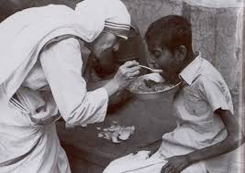
Alms- Giving
The 3rd pillar of Lent is Alms-giving or helping our neighbour.
One of the core messages of the Gospel teaching is that love of God and love of neighbour are inseparable.
Lent is a time to reach out to others, especially those most in need of support and help.
(Trocaire’s work linked to Lent)

Slide 16
Lent as preparation for Easter
Palm Sunday
Spy Wednesday
Holy Thursday
Good Friday
Holy Saturday
Easter Sunday

Slide 17
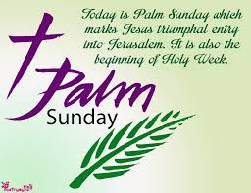
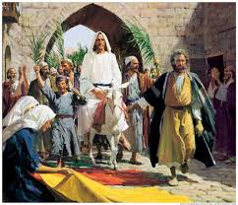
Palm Sunday
Palm Sunday marks the beginning of the end for Jesus!
Going to Jerusalem signifies facing up to his inevitable arrest and death.
The glorious entry to Jerusalem is in stark contrast to Good Friday
Marks the beginning of Easter Week

Slide 18
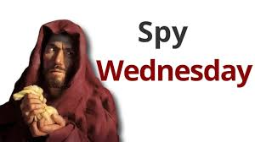
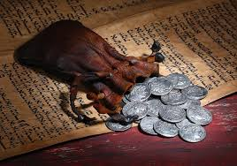
Spy Wednesday
Spy Wednesday is about betrayal.
Judas pointed out Jesus to the Jewish authorities for a small sum of money.
Some commentators say that he was a Zealot, part of a secret Jewish grouping and that Judas was disappointed that Jesus was not getting rid of the Romans.

Slide 19
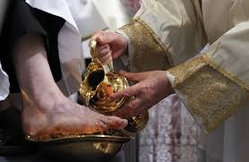
Holy Thursday
The washing of the feet is a powerful message about how Jesus sees
his role in terms of service.
In turn leadership within the Christian community is seen in terms of Service.

Slide 20
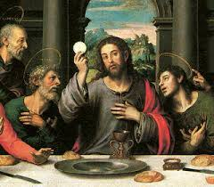
Eucharist
Jesus takes the bread and wine from the Passover meal and transforms then into his Body and Blood.
Do this in memory of me!

Slide 21
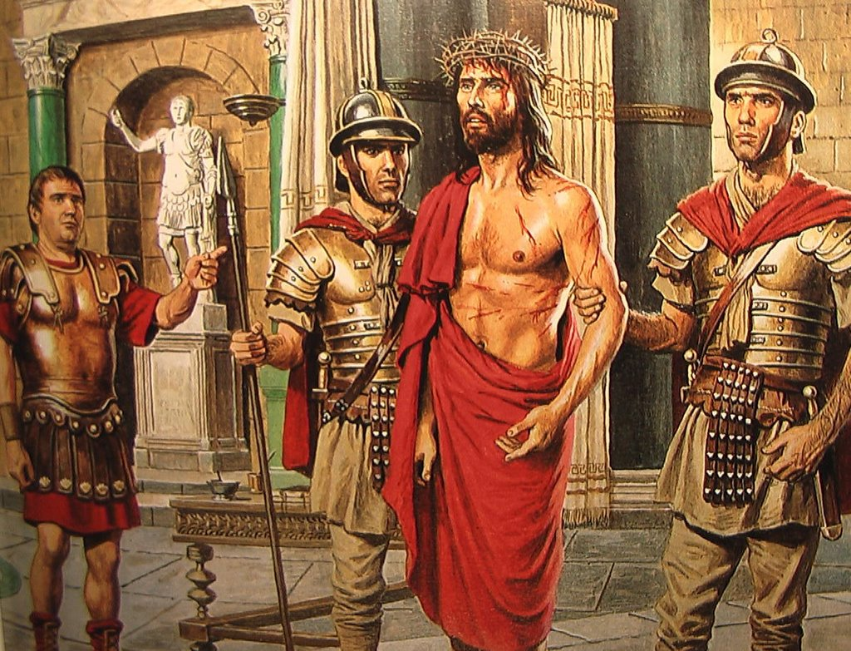
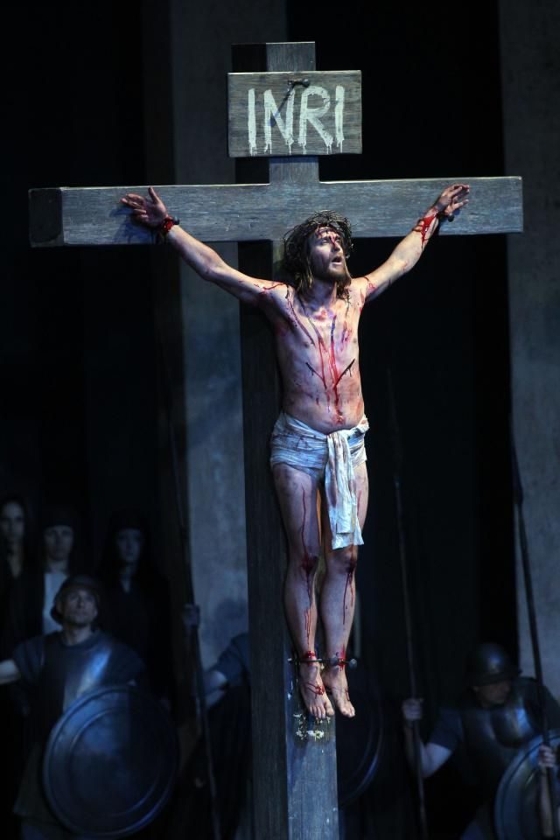
Good Friday Trial and Death of Jesus

Slide 22
Why was Jesus crucified?
The Jewish authorities handed Jesus over to the Romans because he was claiming to be the Messiah, Son of God.
Crucifixion was type of death for a criminal in Roman law.
Pontius Pilate offered to free Barabbas instead.
Crowds shouted- Crucify Him! Crucify Him!
At about 3.00 in Golgotha, Jesus died on Cross.
He was taken down and placed in the tomb before sunset.

Slide 23
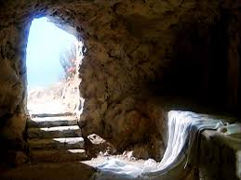
Sunday Morning! Resurrection
Early Sunday Morning the women went to the tomb to anoint the body of Jesus.
He tomb was empty.
Then they meet Jesus in the garden.
The rush to the Upper Room to tell the other Apostles who initially don’t believe them.
Then in the coming days Jesus appears to the various groups of Disciples.
They recognise and believe!

Slide 24
Resurrection Texts New Testament
4 Evangelists all have Apparition Stories of Risen Jesus.
Common structure in most narratives;
Jesus presents to his Disciples;
Not initially recognised;
Sign is given
Disciples move from doubt to Believing

Slide 25
Jesus appears to Mary
Now when she had said this, she turned around and saw Jesus standing there, and did not know that it was Jesus.
Jesus said to her, 'Woman, why are you weeping? Whom are you seeking?’
She, supposing him to be the gardener, said to him, 'Sir, if you have carried him away, tell me where you have laid him, and I will take him away.’
Jesus said to her, 'Mary!' She turned and said to him, 'Rabboni!' (which is to say, Teacher) (John 20:14-16).

Slide 26
Proof of Resurrection?
They either saw Jesus Christ alive-and-well after His death or they did not.
If it was all just a lie, why would so many perpetuate it given their circumstances? Why would they all knowingly cling to such an unprofitable lie in the face of persecution, imprisonment, torture, and death?
The Apostles underwent an undeniable change following the alleged post-resurrection appearances of Christ. They took to the streets, boldly proclaiming the resurrection despite intensifying persecution. Why the dramatic change? It certainly was not financial gain. The Apostles gave up everything they had to preach the resurrection, including their lives.

Slide 27
Beginning of Christian Community
Resurrection changes everything for Disciples
They now fully believe that Jesus was the Messiah.
They commit their lives to spreading the Good News

Slide 28
In Summary
The lines of evidence for believing in Resurrection?
The demonstrable sincerity of the eyewitnesses and the compelling, inexplicable change in their lives-to the point of death!
The conversion and demonstrable sincerity of key antagonists- and sceptics-turned-martyrs- St Paul
The fact of the empty tomb, enemy attestation to the empty tomb,
The testimony of the women and the significance of such testimony given the historical context;
All of these strongly attest to the historicity of the resurrection.
But ultimately rests on the Faith of each believer!

Slide 29
Jesus’ Life Death and Resurrection
Christians accept that Jesus Christ is the Messiah, the Son of God.
That he preached the Kingdom of God in word and deed.
That he preformed miracles.
That he was crucified, died and rose again.
That everything that he said about Life and God the Father was true.
Easter is a celebration of that life, death and resurrection.
Lent is a preparation for Easter.

Slide 30
In Summary!
For Christians Lent is a preparation for the most important time of the liturgical year- Easter.
It is 40 days of Prayer
Fasting
Helping others
It is a special time when we call to mind God’s gift of his Son to the world!

Slide 31
In Summary! For Christians Lent is……….
Lent is a time of personal renewal through
Prayer Fasting Helping others
A time of personal reflection on one’s life, direction, priorities
A time of re-commitment to Christ and Christian vision.
A time of preparation for the celebration of Easter

Slide 32
Christ is Risen!
Alleluia!

