Slide 1

Preparing for First Reconciliation with your Child
At Home

Slide 2
At School
Sign of the Cross
The Confiteor
The Act of Sorrow
The story of Zacchaeus
Differentiate between good & bad choices
Know that a bad choice is a sin
Know that God always forgives & always loves us
Know the 5 Steps to Reconciliation
Participate in the Penitential Service
Participate in celebrating the sacrament of reconciliation with the priest

Slide 3

At Home

Slide 4
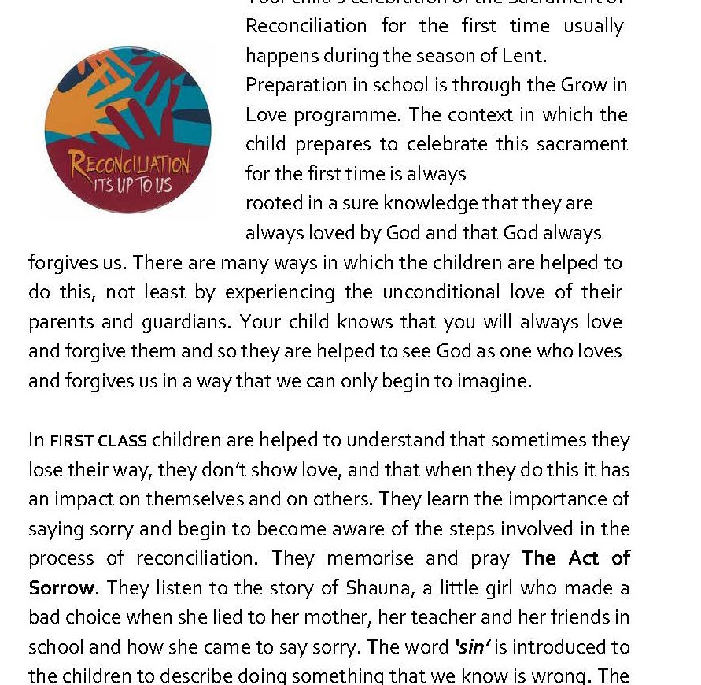
Read
‘Parent’s Guide to Celebrating the Sacrament of Reconciliation

Slide 5

Practice & Pray
The Sign of the Cross
Act of Sorrow
The Confiteor
Our Father

Slide 6
Talk About
Good and Bad Choices
Being Sorry
Forgiving & Being Forgiven
The Story of Zacchaeus

Slide 7
5 Steps Children’s Book p32
1. I realise that I have done wrong and I feel sorry.
2. I say sorry.
3. I accept penance and pray the Act of Sorrow.
4. I am forgiven.
5. I try again.

Slide 8

Recap
Read ‘Parent’s Guide’
Practice and Pray
Make Sorry Box & discuss times when we do wrong

