Slide 1

ADVENT Today

Slide 2
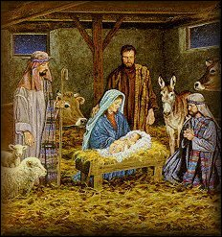
Advent means ‘the coming’ of something.
Advent is a period lasting FOUR Sundays (not weeks!) preparing for the celebration of Jesus’ birth.
The first Sunday of Advent also marks the beginning of the Christian Church's year.
Because the celebration is such an important event, Christians want to make themselves completely ready.

Slide 3
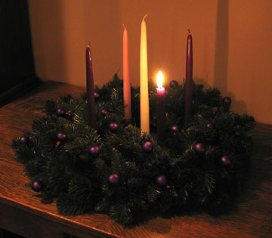

Slide 4
Why is the Advent Wreath so special to Christians?
The circle of the wreath reminds Christians of God, His eternity and endless mercy, which has no beginning or end.
The green of the wreath speaks of the hope that Christians have in God, the hope of newness, of renewal, of eternal life.

Slide 5
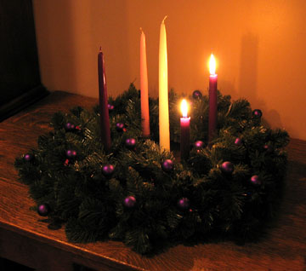

Slide 6
Why have four candles on the Advent Wreath?
The four outer candles represent the period of waiting during the four Sundays of Advent
The green of the wreath speaks of the hope that Christians have in God, the hope of newness, of renewal, of eternal life.

Slide 7
The four traditional advent themes
The Candle of HOPE
The Candle of PEACE
The Candle of LOVE
The Candle of JOY
A fifth candle is sometimes lit in the middle to celebrate the birth of Jesus

Slide 8
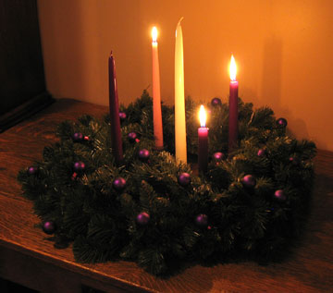

Slide 9

When you are doing your
Christmas
shopping!

Slide 10

Use the spaces to …
“Still the inner
chatter”
Timothy Radcliffe O.P.

Slide 11
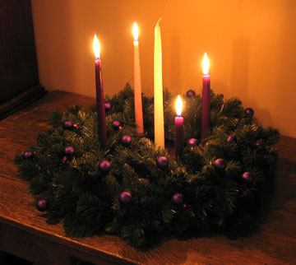

Slide 12
CLASS ADVENT WREATH
In pairs think about what your themes or preparations could be for this time/season write a list…..
Draw around your hand on the green card
Along each finger write one of your advent themes/preparations
Cut out and hand in/stick on card circle to make a big class advent wreath

Slide 13
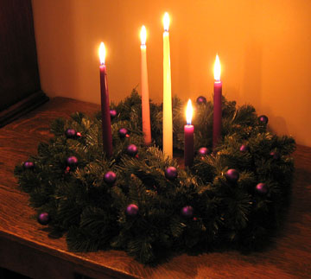

Slide 14
