Slide 1
Acts of Love for the Season of Creation
“Rivers do not drink their own water;
trees do not eat their own fruit;
the Sun does not shine on itself and
flowers do not spread their
fragrance for themselves.
Living for others is a rule of nature.
We are all born to help each other.
No matter how difficult it is….
Life is good when you are happy;
but much better when others
are happy because of you.”
Pope Francis.
One for each day of the Season of Creation 2021
Our lives will not be measured by the big things we do but rather by the little steps we take to make a difference. Each day during the Season of Creation take a step with us and together we will change the world.

Slide 2
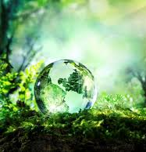
Renewing Our Common Home
The Season of Creation is the annual Christian celebration of prayer and action for our common home. Together, the ecumenical family around the world unites to pray and protect God’s creation.
The season starts 1 September, the World Day of Prayer for the Care of Creation, and ends 4 October, the Feast of St. Francis of Assisi, the patron saint of ecology beloved by many Christian denominations.
We hope that this Season of Creation renews our baptismal call to care and sustain this ecological turning so that life may flourish, and all creatures may find their place to flourish in our common home.

Slide 3
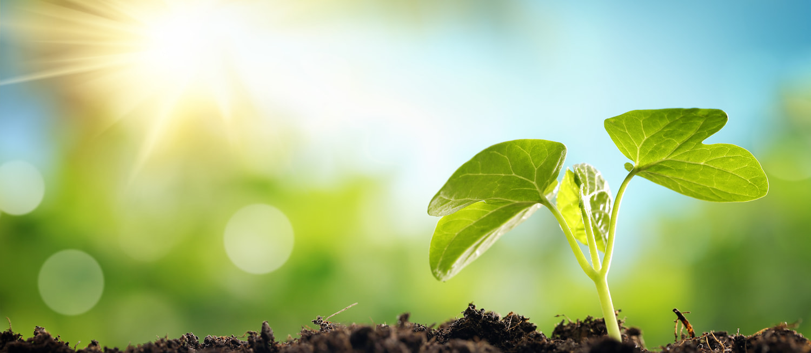
Creator of All,
We are grateful that from your communion of love you created our planet to be a home for all. By your Holy Wisdom you made the Earth to bring forth a diversity of living beings that filled the soil, water and air. Each part of creation praises you in their being, and cares for one another from our place in the web of life.
Enlighten us with the grace to respond to your covenant and call to care for our common home. In our tilling and keeping, gladden our hearts to know that we participate with your Holy Spirit to renew the face of your Earth, and safeguard a home for all.
In the name of the One who came to proclaim good news to all creation, Jesus Christ. Amen.
Prayer for the Season of Creation 2021
Day 1 World Day of Prayer for Creation – September 1st
Take a small step and together
we will change the world.

Slide 4
We are caretakers of God’s creation
Enjoy the world that God has entrusted to us and enjoy yourself. God created each of us in his image and didn’t make any mistakes.
Say to yourself today,
‘I am fearfully and wonderfully made.’
Psalm 139:14
World Day of Prayer for Creation September 1st
Take a small step and together
we will change the world.

Slide 5
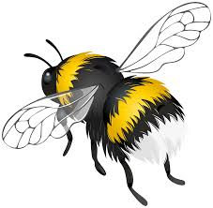
When planning for your garden,
tubs or window box choose
plants attractive to pollinators
(bees, hoverflies, etc.).
We rely on bees to ensure the pollination of crops. They are now an endangered species in the wild due to pesticides, and loss of habitat.
Day 2 Thursday
Take a small step and together
we will change the world.

Slide 6
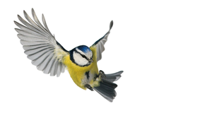
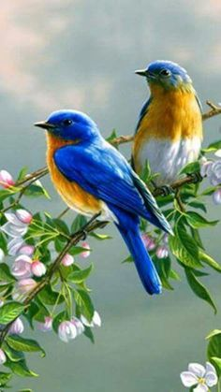
Go for a long walk and enjoy the beauty of God’s Creation
Listen to the birds – enjoy the wonder of God’s creation around you. Take in the scent of the flowers you see. Look for the bees as they pollinate the flowers giving us the gift of seed and food.
“Soil, water, mountains, everything is, as it were, a caress of God.” (Laudato Si’, 84)
Day 3 Friday
Take a small step and together
we will change the world.

Slide 7
You can’t heal the world
in a day but you can
make a start.
Pick up litter.
Clear a stream.
Sign a petition.
Plant a tree.
Pam Brown 1928 - 2014
Day 4 Saturday
Take a small step and together
we will change the world.

Slide 8
THIS WEEK - FOCUS ON ENERGY
Every day, the Earth receives an amount of solar energy equal to 30 years of world fossil fuel energy use.
Turn off lights and unplug appliances not in use. Appliances on standby can use up to 20% of the electricity used when they are turned on.
Day 5 Sunday
Take a small step and together
we will change the world.

Slide 9
SUNDAY
This year we have an opportunity like no other! Two vital UN Conferences take place this Autumn: COP15 on Biodiversity & COP26 on Climate Change!
Just as we need world leaders to take bold action to address the ecological crisis, Pope Francis is inviting all Catholics to sign this petition calling on global leaders to act!
This is a key action for Catholics during the Season of Creation.
Please go to: www.thecatholicpetition.org and sign today.
Your parish, diocese, school can also sign.
“Truly, much can be done!”(LS, 180).
Notes:
This petition is inspired directly by the Pope’s Laudato Si and COVID response teachings, and the incredible work done by the Dicastery for IHD who have lifted up the issue of biodiversity. The Dicastry have endorsed the petition and highlighted it as a key action Catholics should take during Season of Creation all across the world.

Slide 10
Only fill the electric kettle with the amount of water you need.
The energy wasted in boiling a full kettle of water when it is not required is enough to run an energy saving bulb for 9 hours.
Day 6 Monday
Take a small step and together
we will change the world.

Slide 11
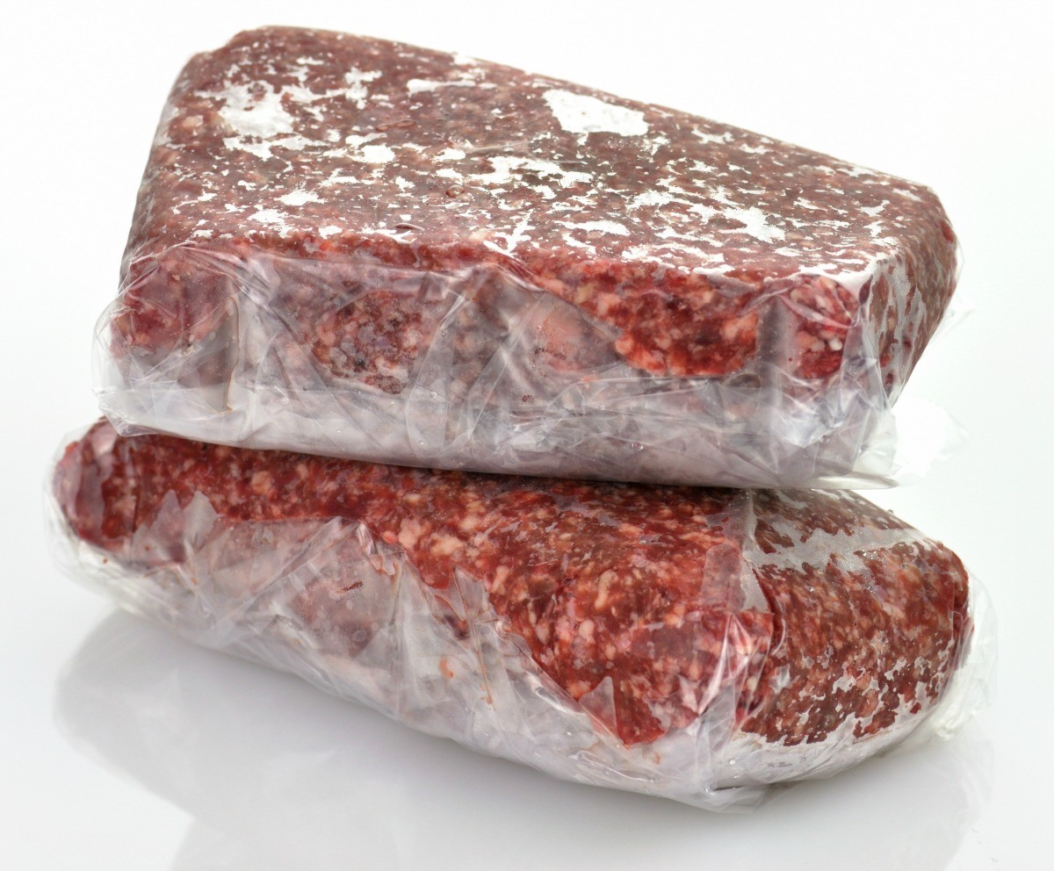
If defrosting something from your freezer, try moving it from the freezer to the fridge the night before.
The cooling energy invested in the frozen item is recycled in the fridge reducing the energy needed to cool the fridge.
Day 7 Tuesday
Take a small step and together
we will change the world.

Slide 12
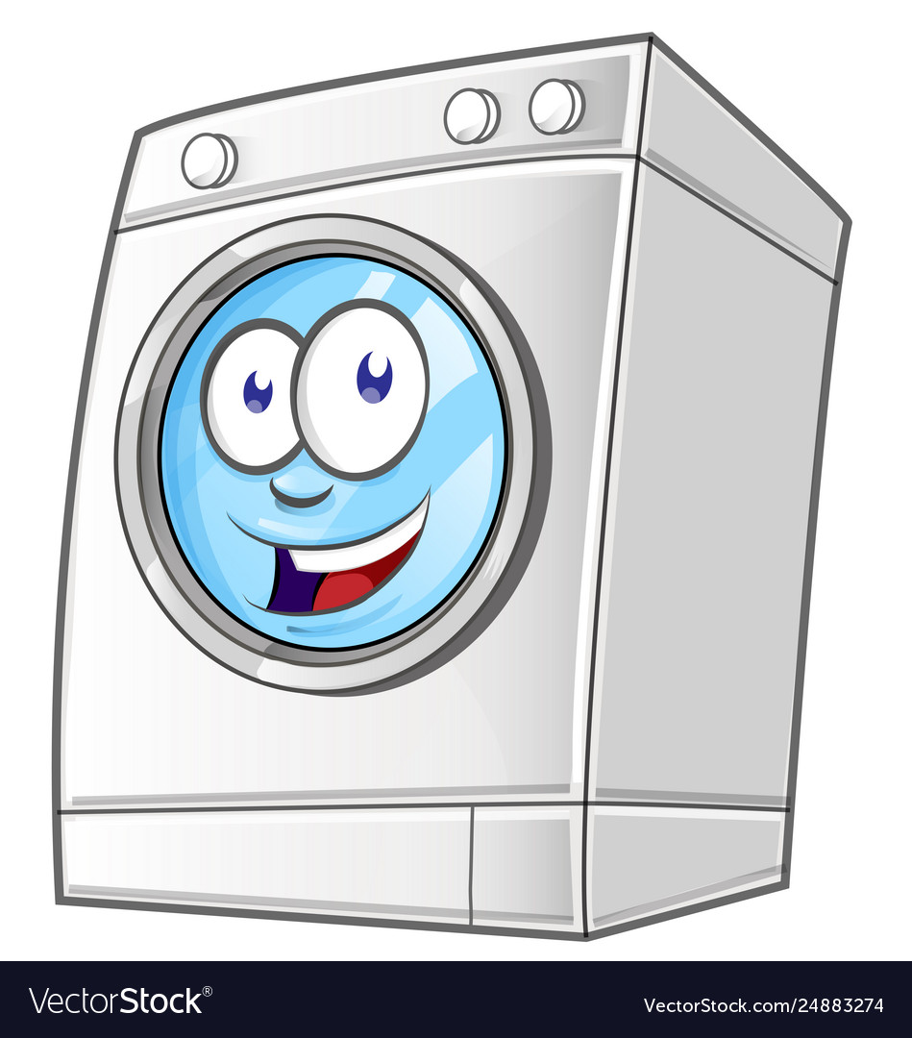
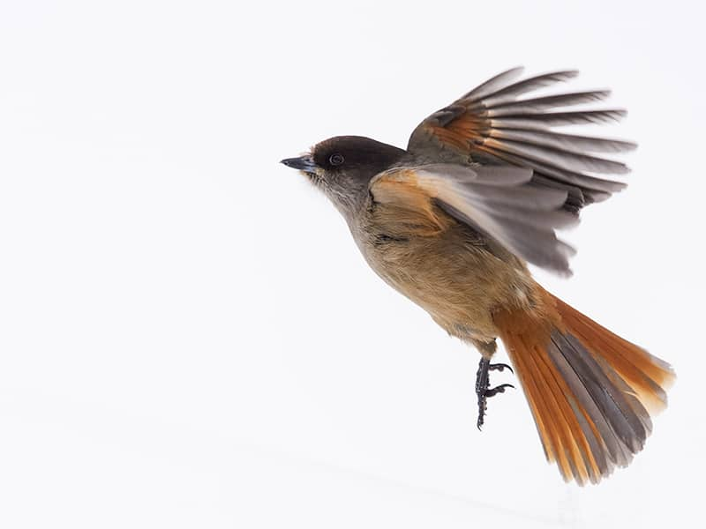
Set your washing machine at
30 degrees celsius.
You use less energy and modern washing powders work just as efficiently at lower temperatures so, unless you have very dirty washing keep the temperature down.
Take a small step and together
we will change the world.
Day 8 Wednesday

Slide 13
Use natural option for drying clothes rather than a tumble dryer if at all possible.
Tumble dryers are one of the highest energy consumers among domestic appliances.
Take a small step and together
we will change the world.
Day 9 Thursday

Slide 14
Reduce unnecessary energy use during the peak hours 5.00 – 7.00pm
(e.g. delay putting on the dish washer, etc., until after 7.00pm)
When peak demand puts pressure
on the national grid extra more expensive power stations are
brought into operation.
Day 10 Friday
Take a small step and together we will change the world in which we live.

Slide 15
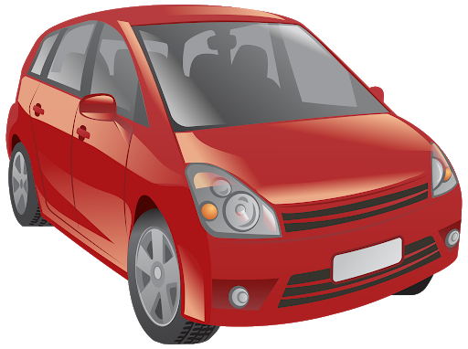
SAVING ENERGY IN YOUR CAR.
Switch the rear screen demister off when the window is clear because when it is switched on your fuel consumption rises by 3% - 5%.
Close the widows and use the vents instead because when your front window is half open your fuel consumption increases by 5% at 80 km (or 10% if you are driving at 110 km).
When your sunroof is open fuel consumption rises by approximately 4%. When it is half open it increases by approximately 3%.
Use air-conditioning sparingly – running air-conditioning continuously increases fuel consumption significantly.
Day 11 Saturday
Take a small step and together we will change the world in which we live.

Slide 16
SUNDAY
This year we have an opportunity like no other! Two vital UN Conferences take place this Autumn: COP15 on Biodiversity & COP26 on Climate Change!
Just as we need world leaders to take bold action to address the ecological crisis, Pope Francis is inviting all Catholics to sign this petition calling on global leaders to act!
This is a key action for Catholics during the Season of Creation.
Please go to: www.thecatholicpetition.org and sign today.
Your parish, diocese, school can also sign.
“Truly, much can be done!”(LS, 180).
Notes:
This petition is inspired directly by the Pope’s Laudato Si and COVID response teachings, and the incredible work done by the Dicastery for IHD who have lifted up the issue of biodiversity. The Dicastry have endorsed the petition and highlighted it as a key action Catholics should take during Season of Creation all across the world.

Slide 17
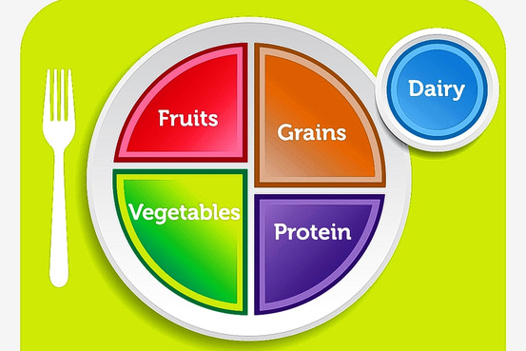
THIS WEEK - FOCUS ON FOOD / SHOPPING
Plan carefully for grocery shopping and buy only what you know you will use within its ‘best before’ date.
The average household throws away a quarter of a ton of food every year.
Day 12 Sunday
Take a small step and together
we will change the world.

Slide 18
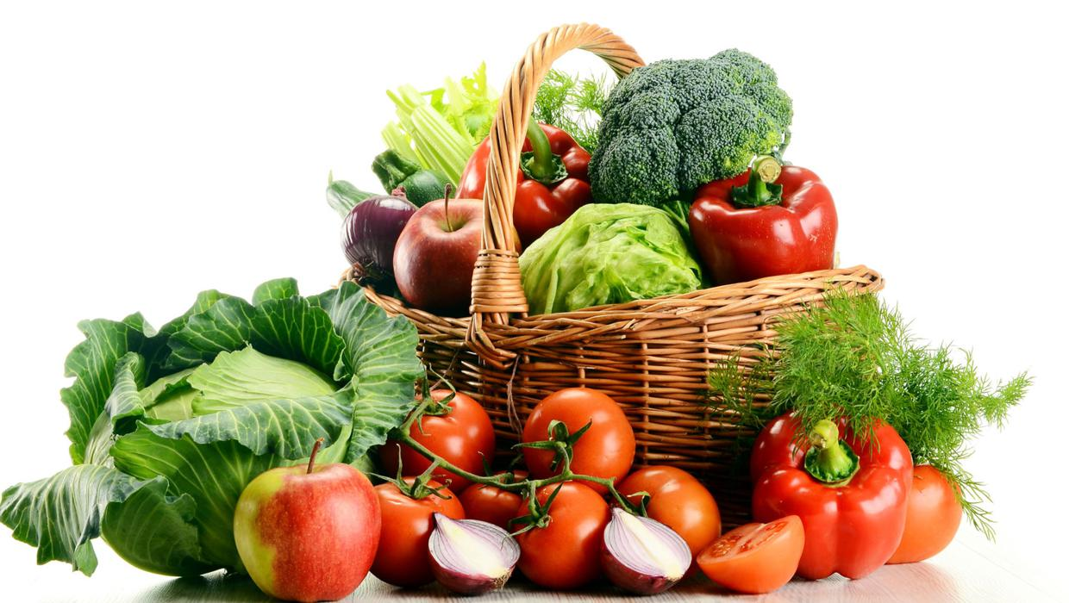
Support organic and sustainable farming by buying local organic produce on a regular basis.
By avoiding the use of artificial fertilisers, herbicides and pesticides, organic farming reduces the amount of harmful toxic
compounds released into the
environment. (Studies show that
pesticides are among the five worst environmental threats to children’s health.)
Day 13 Monday
Take a small step and together
we will change the world.

Slide 19
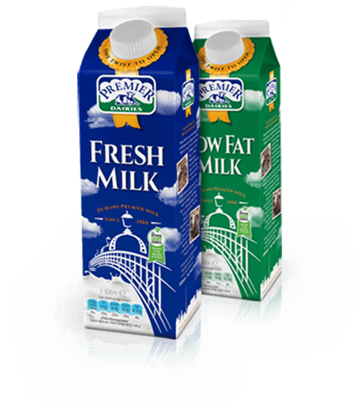
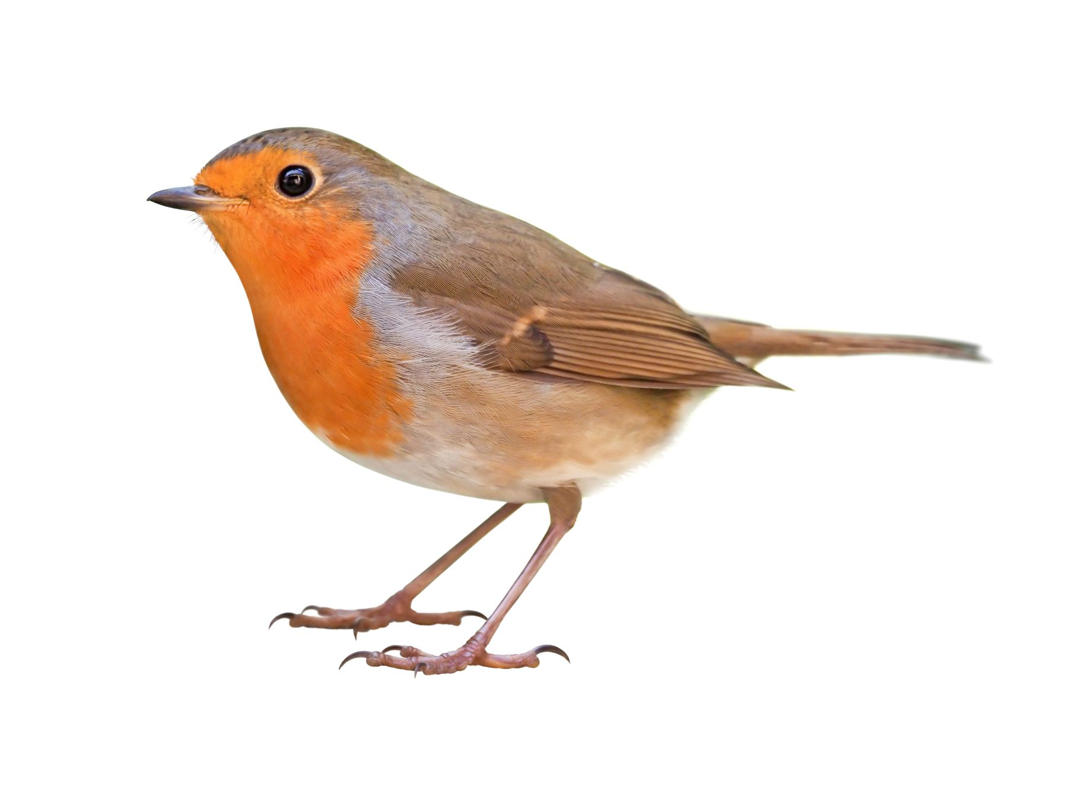
Buy milk in cardboard (Tetra Pak) containers rather than plastic ones.
Milk and fruit juice cartons biodegrade in 2 - 3 months, whereas plastic takes from
450 to 1,000 years to decompose.
Day 14 Tuesday
Take a small step and together
we will change the world.

Slide 20
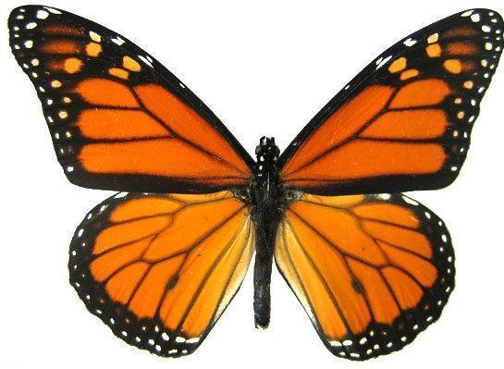
Use your consumer power: ask your local supermarkets to stock environmentally-friendly products.
There is nothing as persuasive as consumer demand in getting a store manager to make changes.
Day 15 Wednesday
Take a small step and together
we will change the world.

Slide 21
Choose durable goods in preference to disposable items.
Buying single or limited use items only supports the manufacturers’ policy of in-built obsolescence and their desire for profit and at the same time uses up earth’s resources unnecessarily.
Day 16 Thursday
Take a small step and together
we will change the world.

Slide 22
Purchase Fair Trade items when they are available.
These goods guarantee a just price for the producers and that no child or
forced labour is used.
Take a small step and together
we will change the world.
Day 17 Friday

Slide 23
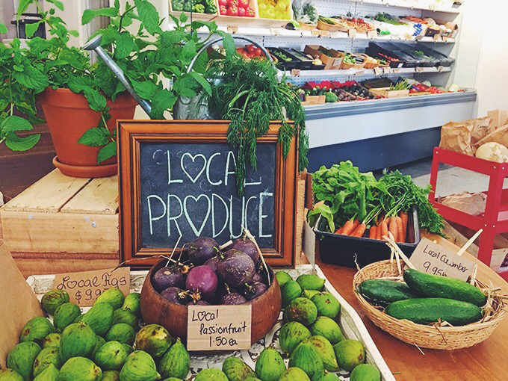
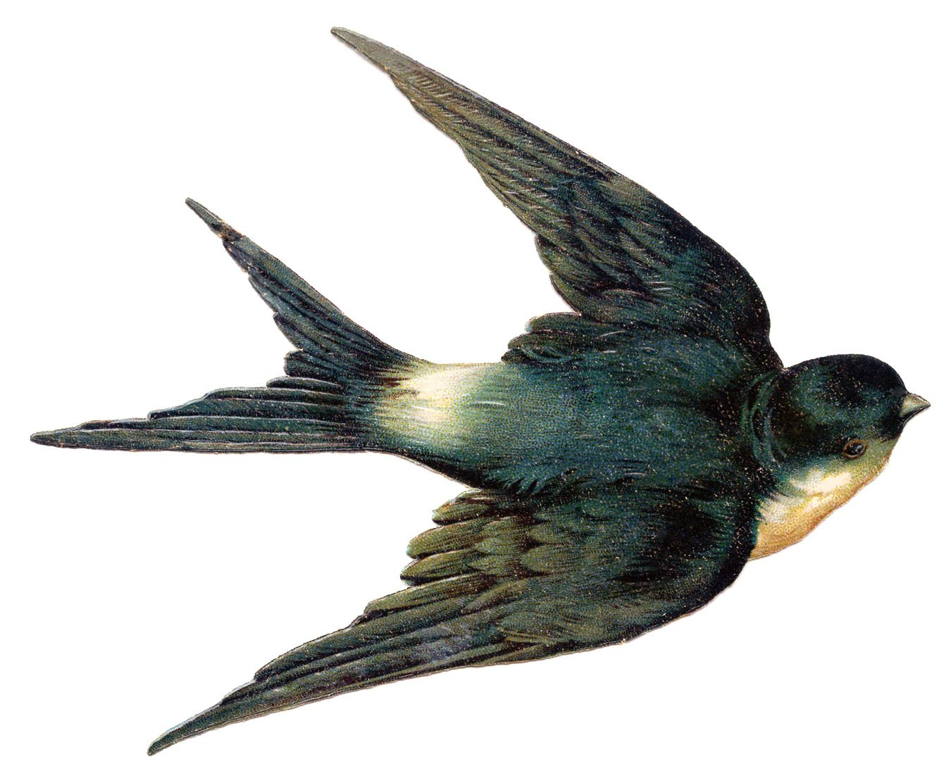
When grocery shopping
be guided by the L.O.A.F. principle.
Locally produced
Organically grown
Animal friendly
Fairly traded.
Day 18 Saturday
Take a small step and together
we will change the world.

Slide 24
SUNDAY
This year we have an opportunity like no other! Two vital UN Conferences take place this Autumn: COP15 on Biodiversity & COP26 on Climate Change!
Just as we need world leaders to take bold action to address the ecological crisis, Pope Francis is inviting all Catholics to sign this petition calling on global leaders to act!
This is a key action for Catholics during the Season of Creation.
Please go to: www.thecatholicpetition.org and sign today.
Your parish, diocese, school can also sign.
“Truly, much can be done!”(LS, 180).
Notes:
This petition is inspired directly by the Pope’s Laudato Si and COVID response teachings, and the incredible work done by the Dicastery for IHD who have lifted up the issue of biodiversity. The Dicastry have endorsed the petition and highlighted it as a key action Catholics should take during Season of Creation all across the world.

Slide 25
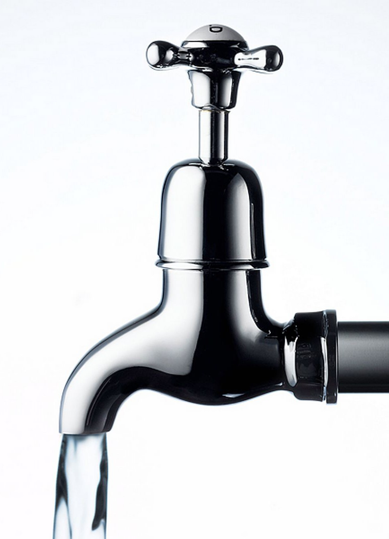
THIS WEEK - FOCUS ON WATER
For every minute the water is running,
you are wasting at least two gallons of water,
and all the electricity involved in pumping it.
Turn the water off as you brush your teeth. Or fill a glass up and use that. Don’t just leave it running for the odd second that you actually use it.
Day 19 Sunday
Take a small step and together
we will change the world.

Slide 26
If your tap water is safe to use,
drink tap water instead of bottled water.
Bottled water, which is no healthier than tap water, is having devastating effects on the environment because of the huge resources required to extract it from the ground, package it and ship it.
Day 20 Monday
Take a small step and together
we will change the world.

Slide 27
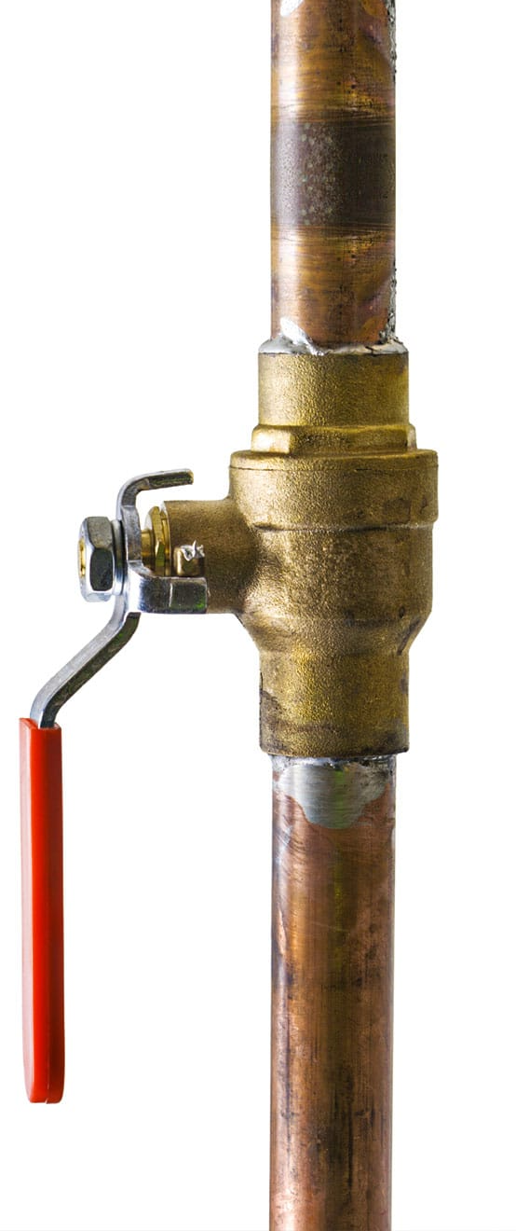
Know how to turn off your main water supply.
This is important if, for example, there is a burst pipe/boiler in your home. By turning off the water, you not only save hundreds of gallons of this precious resource, but you also safeguard your home from serious damage.
Day 21 Tuesday
Take a small step and together
we will change the world.

Slide 28
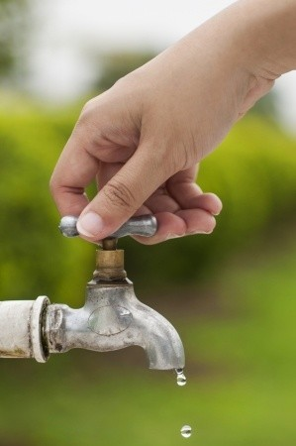
Always turn taps off fully.
Check regularly for drips or leaks and replace worn tap washers. Just one drop of water per second wastes 1,200 litres per month.
Day 22 Wednesday
Take a small step and together
we will change the world.

Slide 29
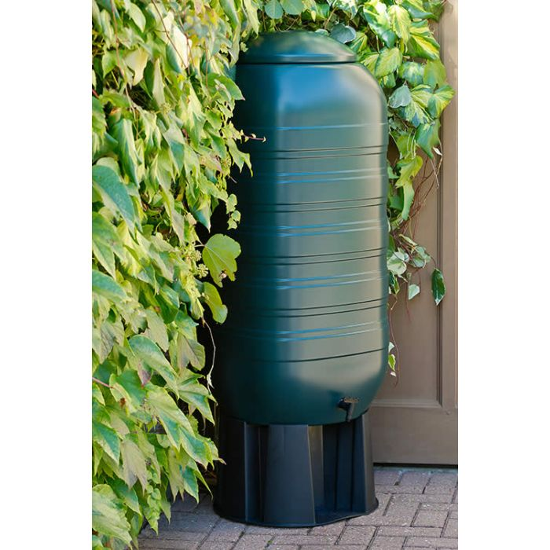
Invest in a Water Butt
to harvest rainwater and
water your garden with
a watering can.
A watering can uses about
nine litres of water whereas a sprinkler uses up to 500 litres per hour.
Day 23 Thursday
Take a small step and together
we will change the world.

Slide 30
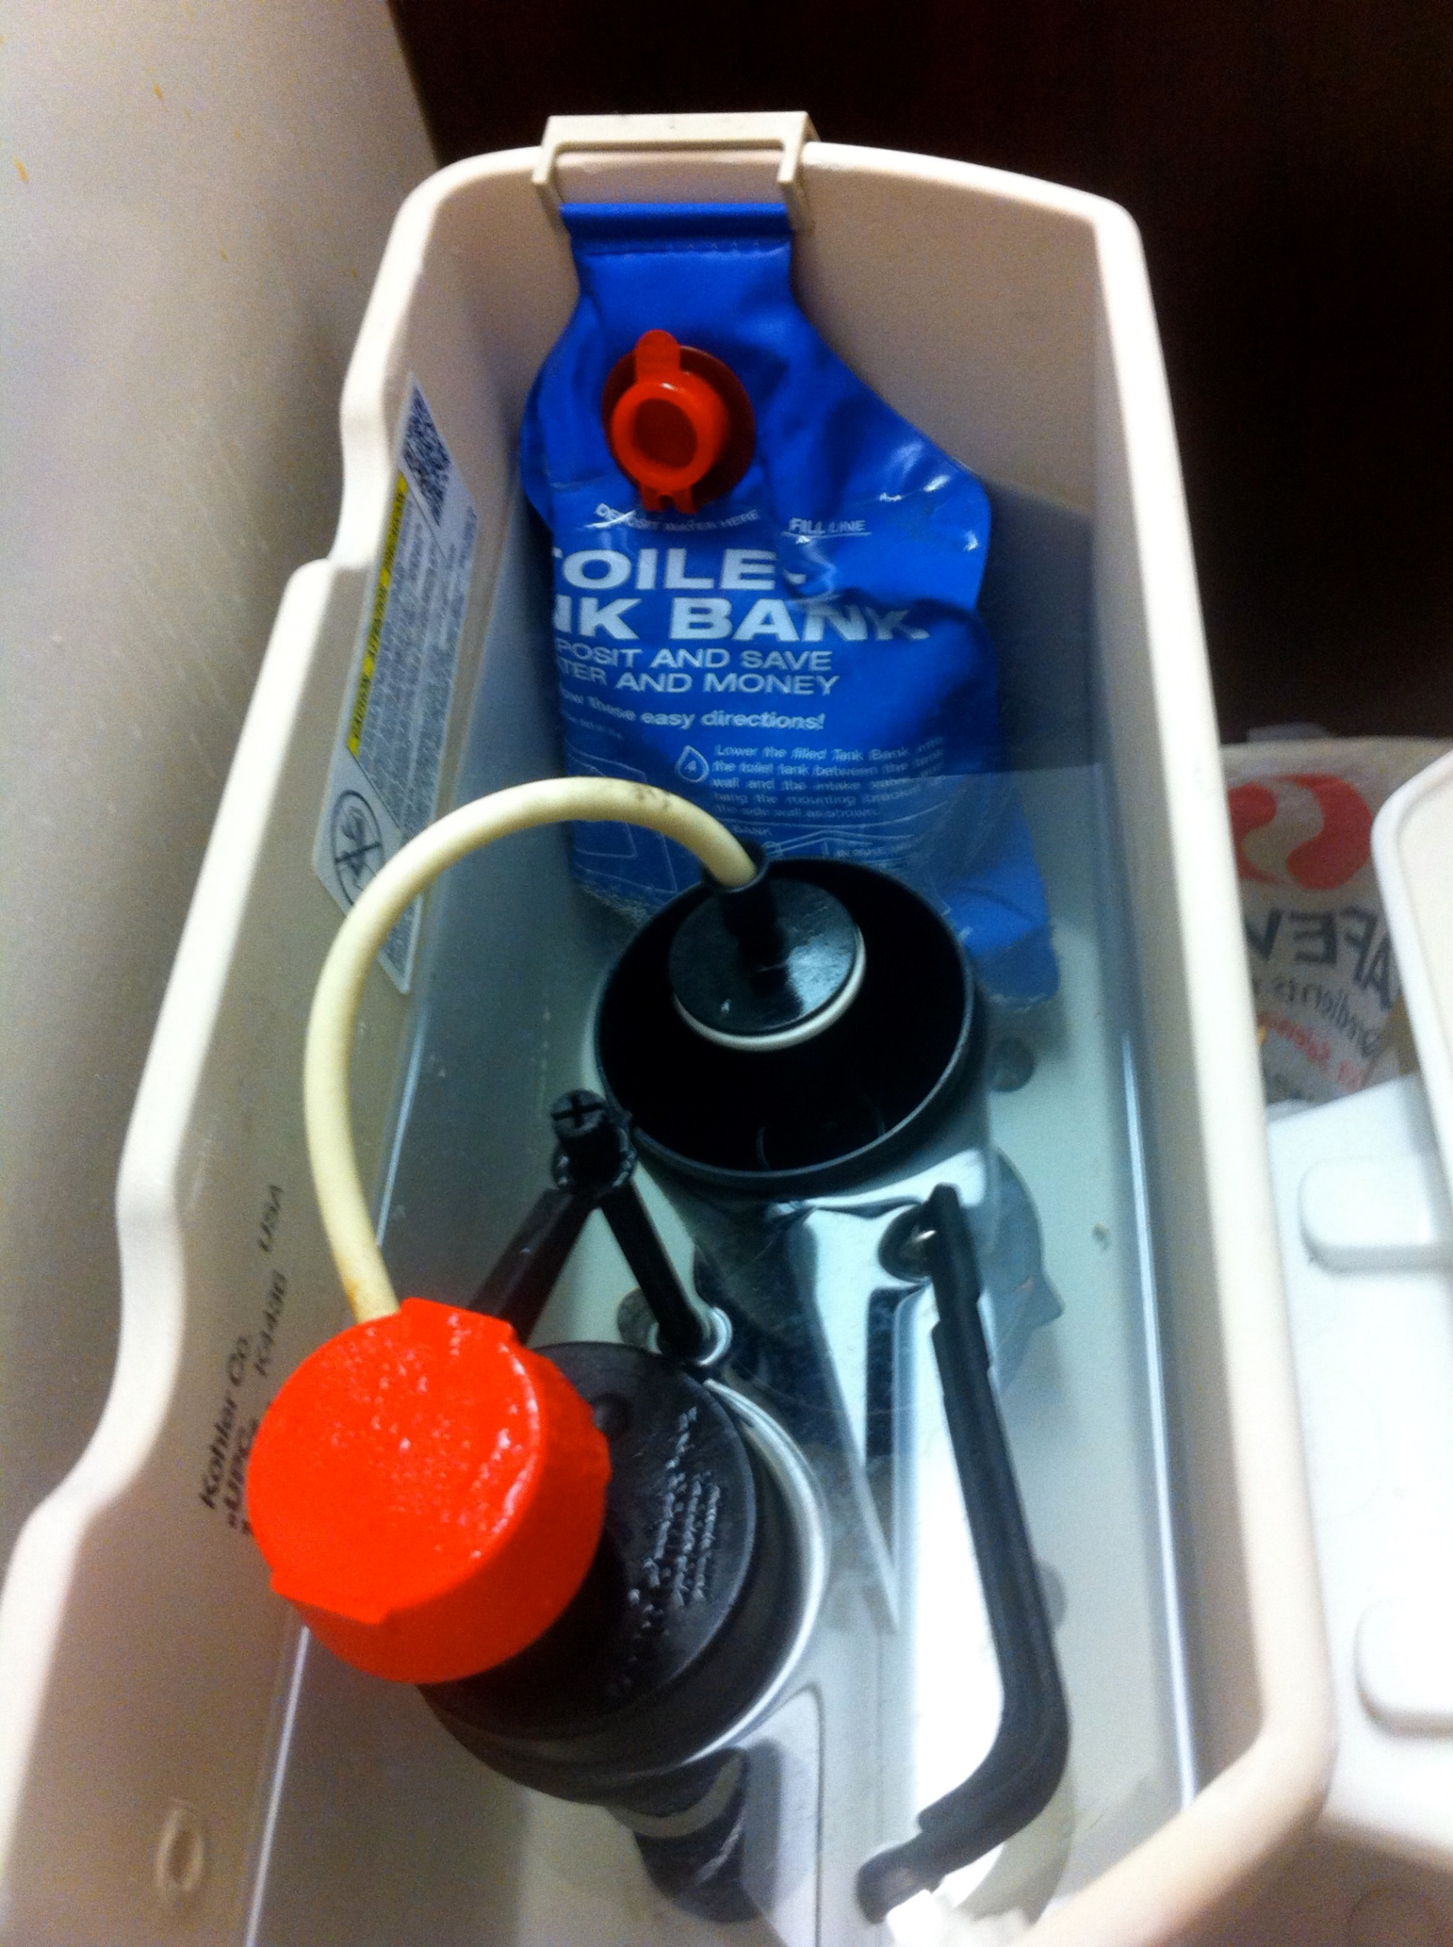
Think about using a displacement device in the toilet cistern to reduce
the amount of water used per flush.
One third of all water used in the home is used for flushing the toilet. Each flush uses up to nine litres of water.
A simple way to reduce this amount is
to place a one litre container filled
with water inside the cistern.
Day 24 Friday
Take a small step and together
we will change the world.

Slide 31
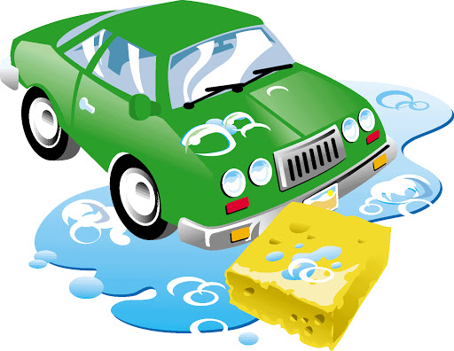
Avoid using a hose
for washing your car.
Per average wash, a hose uses over 30 buckets of water whereas you can do a very good job manually with 3 – 5 buckets.
Day 25 Saturday
Take a small step and together
we will change the world.

Slide 32
SUNDAY
This year we have an opportunity like no other! Two vital UN Conferences take place this Autumn: COP15 on Biodiversity & COP26 on Climate Change!
Just as we need world leaders to take bold action to address the ecological crisis, Pope Francis is inviting all Catholics to sign this petition calling on global leaders to act!
This is a key action for Catholics during the Season of Creation.
Please go to: www.thecatholicpetition.org and sign today.
Your parish, diocese, school can also sign.
“Truly, much can be done!”(LS, 180).
Notes:
This petition is inspired directly by the Pope’s Laudato Si and COVID response teachings, and the incredible work done by the Dicastery for IHD who have lifted up the issue of biodiversity. The Dicastry have endorsed the petition and highlighted it as a key action Catholics should take during Season of Creation all across the world.

Slide 33
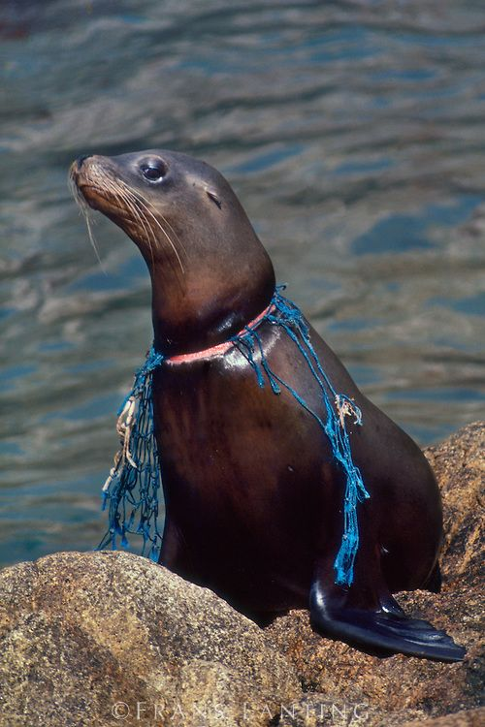
THIS WEEK - FOCUS ON PLASTIC
Plastics that end up in the ocean contribute to the habitat destruction and kill millions of marine animals every year.
Minimise the use of products that are
made from or packaged with plastic.
Plastic is unfriendly to the environment. It is produced from our limited non-renewable oil reserves and it does not bio-degrade. It is estimated that it takes up to 500 years for plastic to break down in a landfill.
Day 26 Sunday
Take a small step and together
we will change the world.

Slide 34
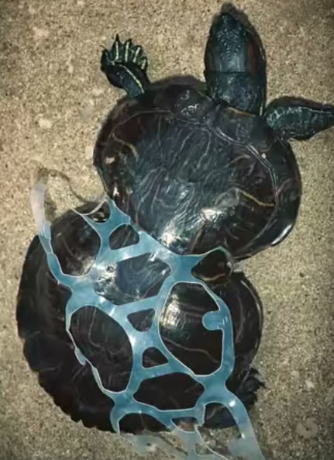
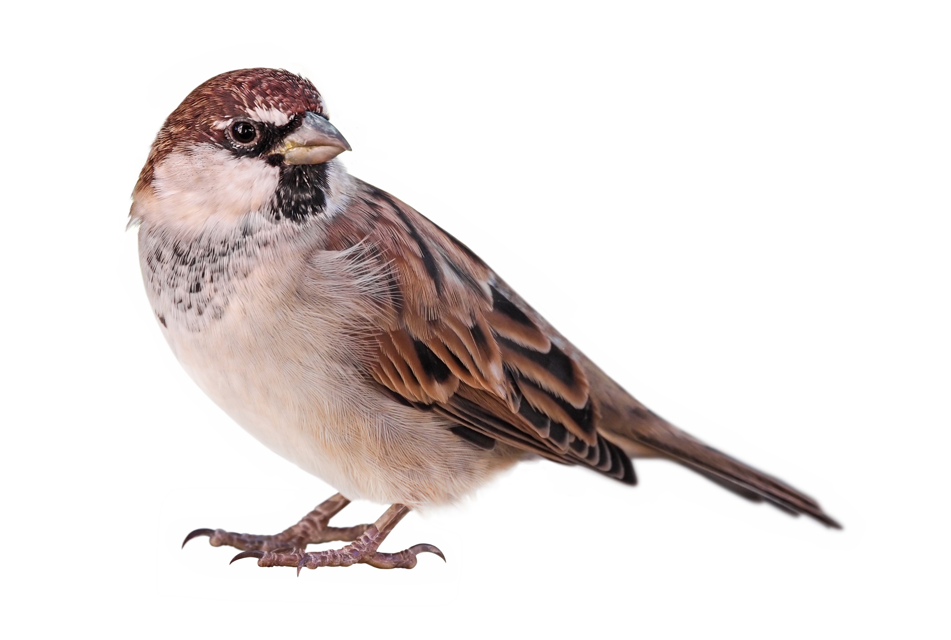
Rip up plastic rings from packs of beers.
These plastic rings can trap birds, seals, tortoises and other wild life. They can get caught up in the plastics and be trapped in them. Rip the rings in two and recycle them. If you can, avoid buying them.
If you can’t, at least deal with the waste as best you can.
Day 27 Monday
Take a small step and together
we will change the world.

Slide 35
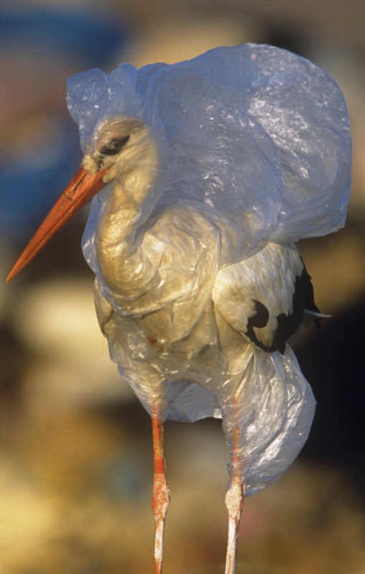
REFUSE
REDUCE
REUSE
RECYCLE
REBUY
Day 28 Tuesday
Take a small step and together
we will change the world.

Slide 36
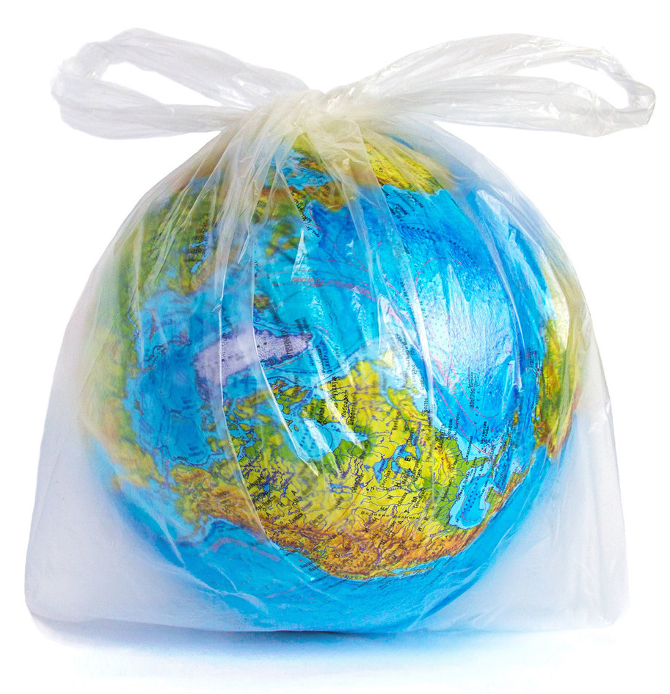
Reduce your use of plastic pollution
Wean yourself off disposable plastics. 90% of the plastic items we use are single-use and inherently wasteful, like grocery bags, coffee cups, plastic packaging, disposable cutlery, straws and so on.
Day 29 Wednesday
Take a small step and together
we will change the world.

Slide 37
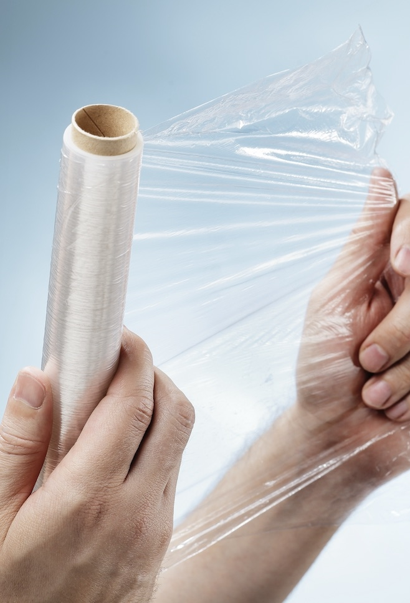
Be sparing in using Cling Film.
Considering the raw materials and energy needed for the manufacture of cling film,
along with the fact that it
cannot be recycled and is rarely reused, cling film is definitely not environmentally friendly.
Day 30 Thursday
Take a small step and together
we will change the world.

Slide 38
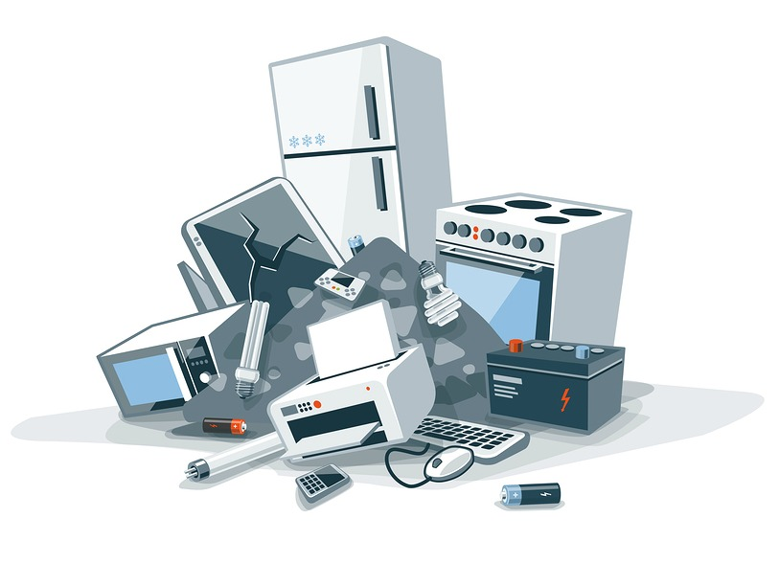
Batteries, light bulbs, paint tins, electronic equipment and any hazardous items should be taken to a recycling centre where they can be disposed of safely.
This avoids toxic chemicals ending up in a landfill and leaking into the water table.
Oct 1st - Friday
Take a small step and together
we will change the world.

Slide 39
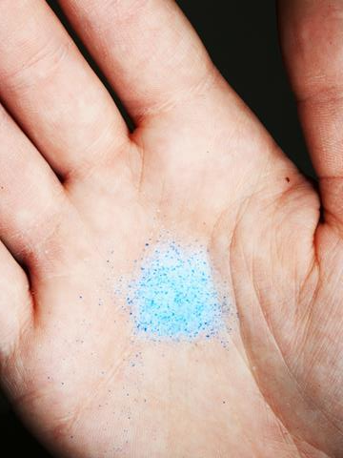
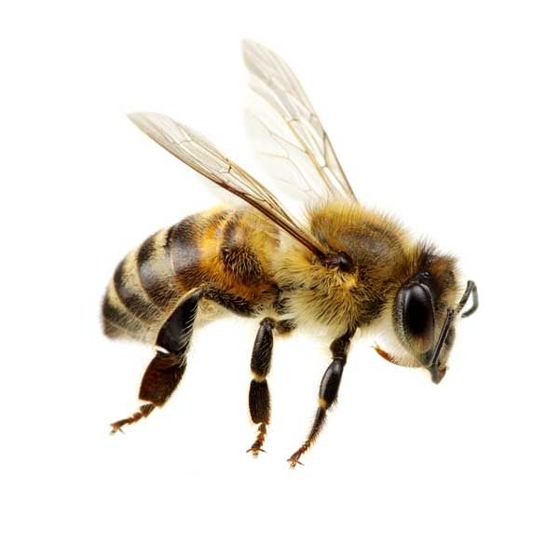
Many cosmetic products – soaps, shower gels, facial scrubs – contain microbeads (tiny plastic balls).
Microbeads have the potential to get into the waterways and be eaten by fish, thus getting into the food chain and eventually into products eaten by humans.
October 2nd Saturday
Take a small step and together
we will change the world.

Slide 40
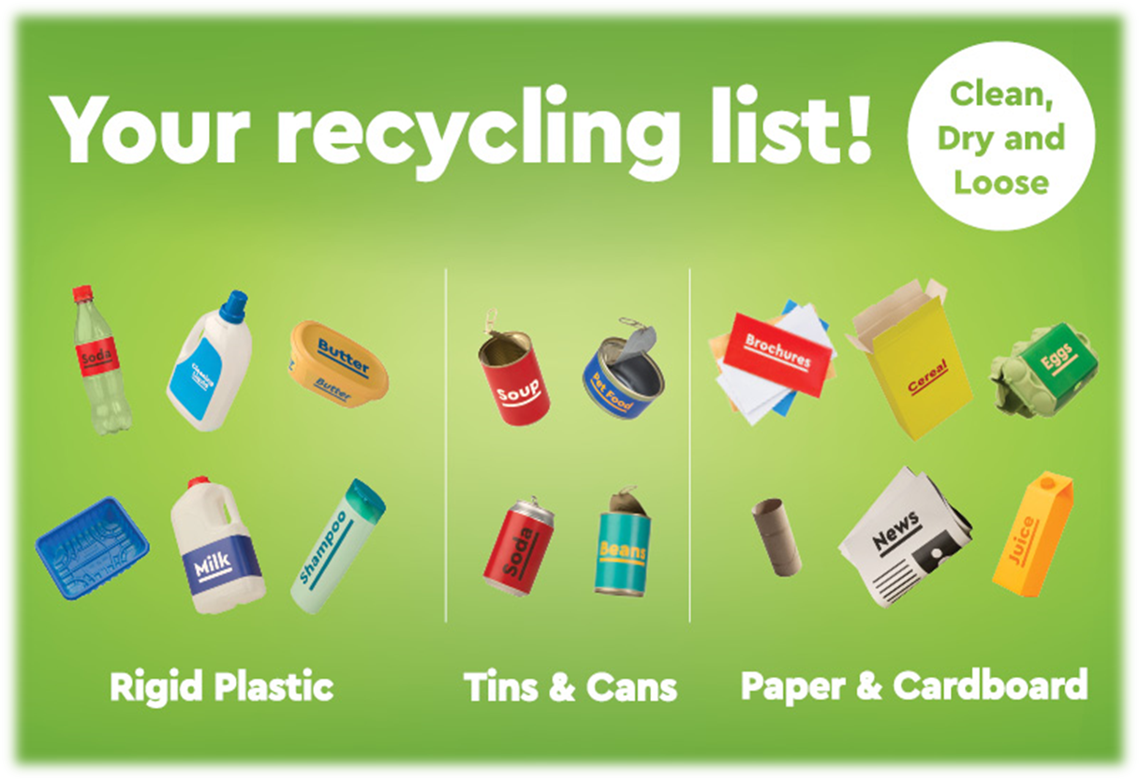
“There is no such thing as ‘away’ when we throw anything away it must go somewhere.”
Annie Leonard.
Make sure you know what to RECYCLE.
Articles in your Green Bin should be clean,
dry and loose. For tip see: www.mywaste.ie
October 3rd Sunday
Take a small step and together
we will change the world.

Slide 41
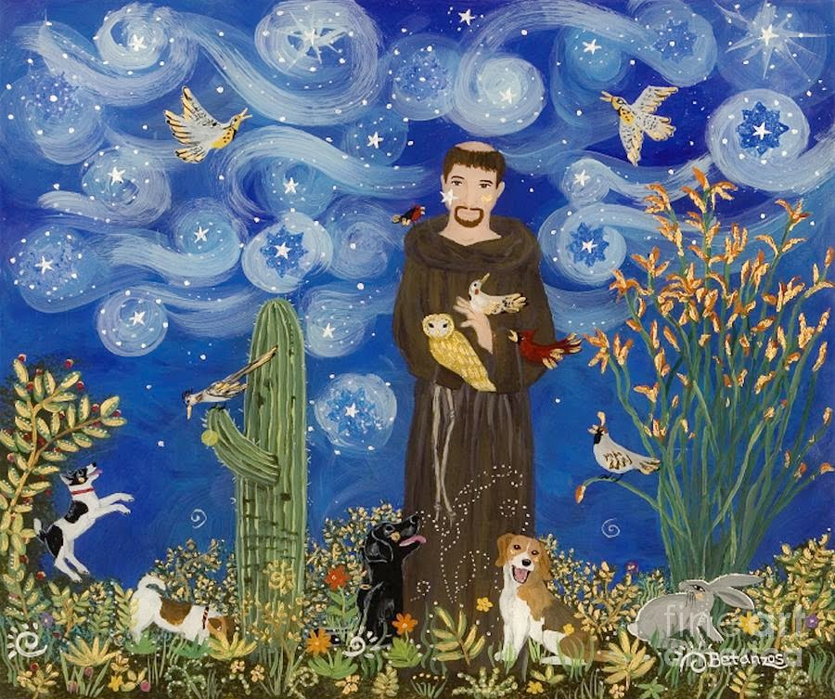
“Saint Francis of Assisi reminds us that our common home is like a sister with whom we share our life, and a beautiful mother who opens her arms to embrace us….”
(Laudato Si’, 1)
Plant a native Irish Tree / fruit trees www.easytreesie.com
Host a blessing for pets
October 4th Feast of St. Francis of Assisi
Take a small step and together
we will change the world.

Slide 42
Season of Creation 2021
This year we have an opportunity like no other! Two vital UN Conferences take place this Autumn: COP15 on Biodiversity & COP26 on Climate Change!
Just as we need world leaders to take bold action to address the ecological crisis, Pope Francis is inviting all Catholics to sign this petition calling on global leaders to act!
This is a key action for Catholics during the Season of Creation.
Please go to: www.thecatholicpetition.org and sign today.
Your parish, diocese, school can also sign.
“Truly, much can be done!”(LS, 180).
Notes:
This petition is inspired directly by the Pope’s Laudato Si and COVID response teachings, and the incredible work done by the Dicastery for IHD who have lifted up the issue of biodiversity. The Dicastry have endorsed the petition and highlighted it as a key action Catholics should take during Season of Creation all across the world.

Slide 43
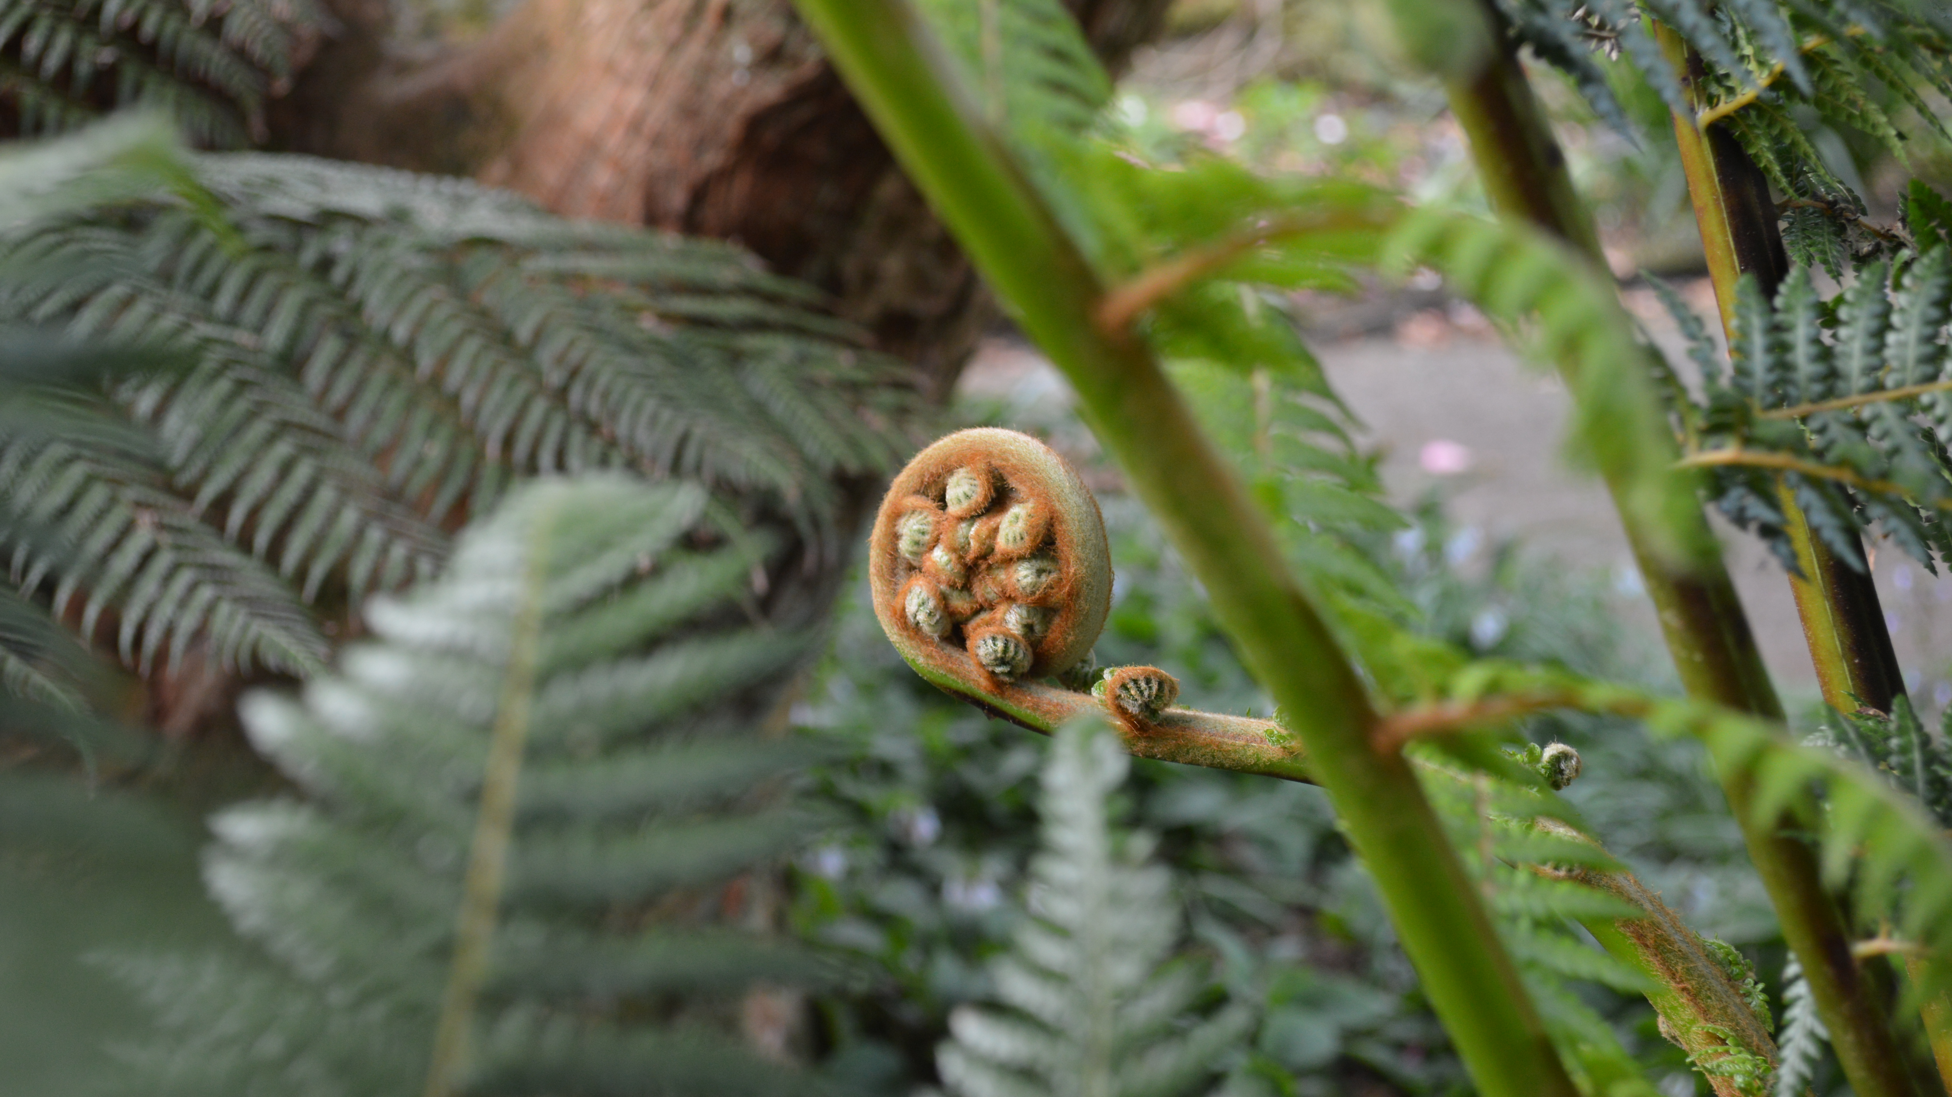
You’ve just completed
Acts of Love for the Season of Creation
Together we can make
this world a better place.
Today read:
John 20:1-18
Special thanks to Bonnybrook Parish, Dublin for sharing this beautiful resource with everyone.
Take a small step and together
we will change the world.

