Slide 1
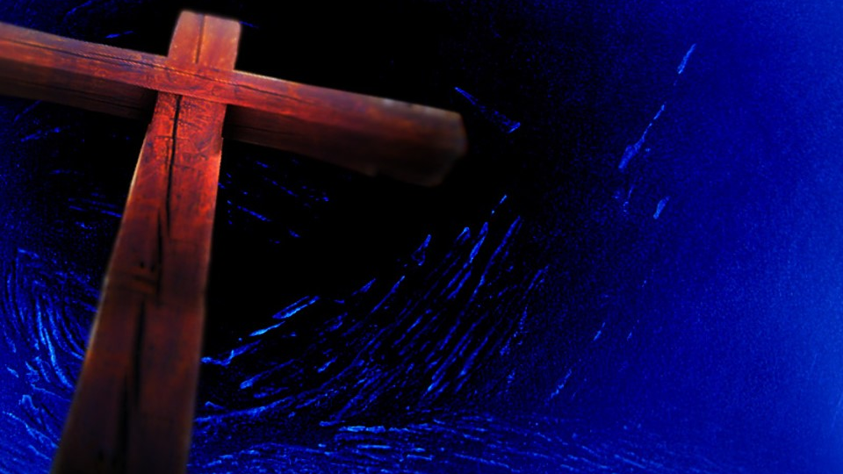
Stations of the Cross
Pray in the Classroom

Slide 2
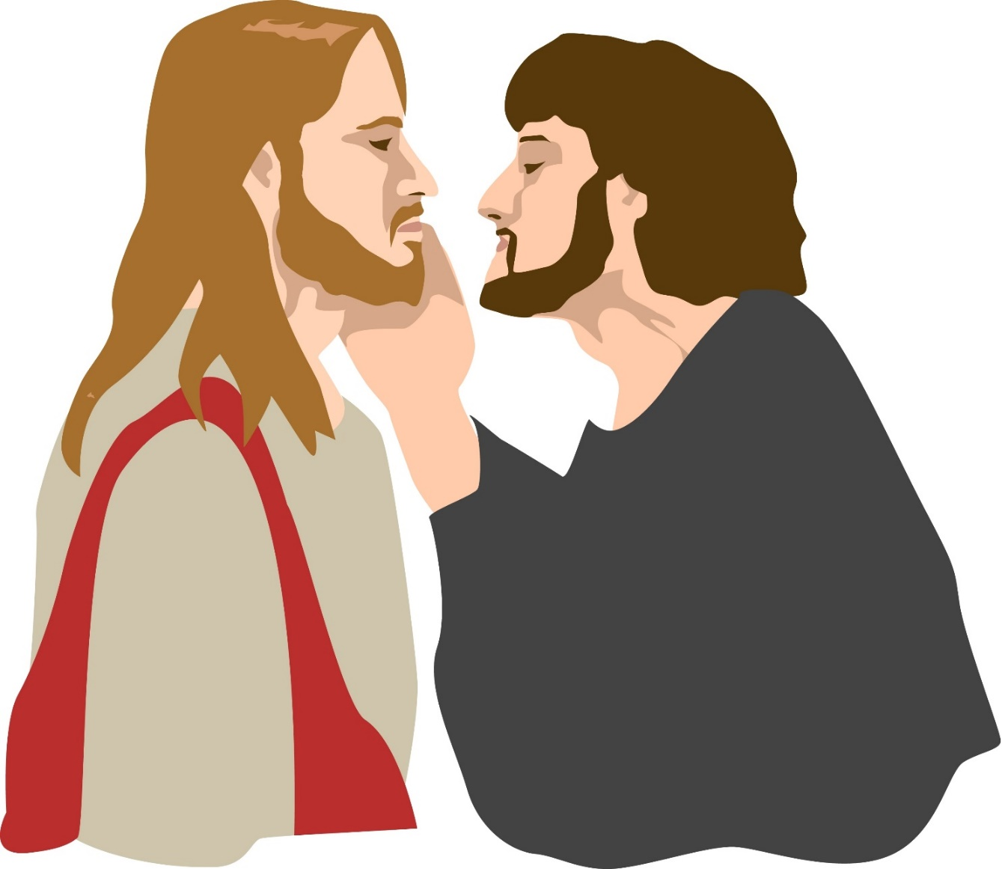
Station 1
Jesus is Condemned to Death
We adore you, O Christ, and we praise you, because,
by your holy cross you have redeemed the world

Slide 3
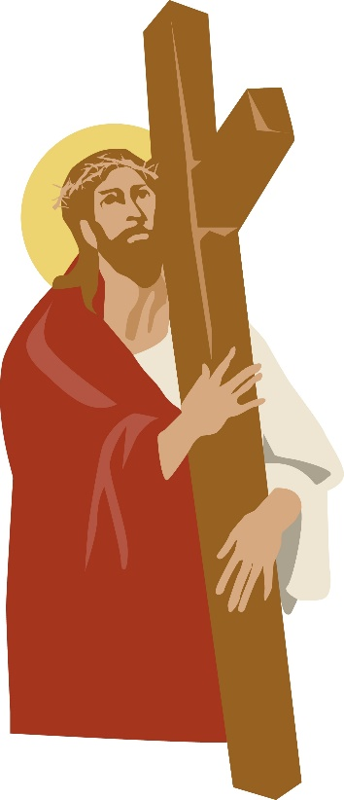
Station 2
Jesus Receives his Cross
We adore you, O Christ, and we praise you, because,
by your holy cross you have redeemed the world

Slide 4
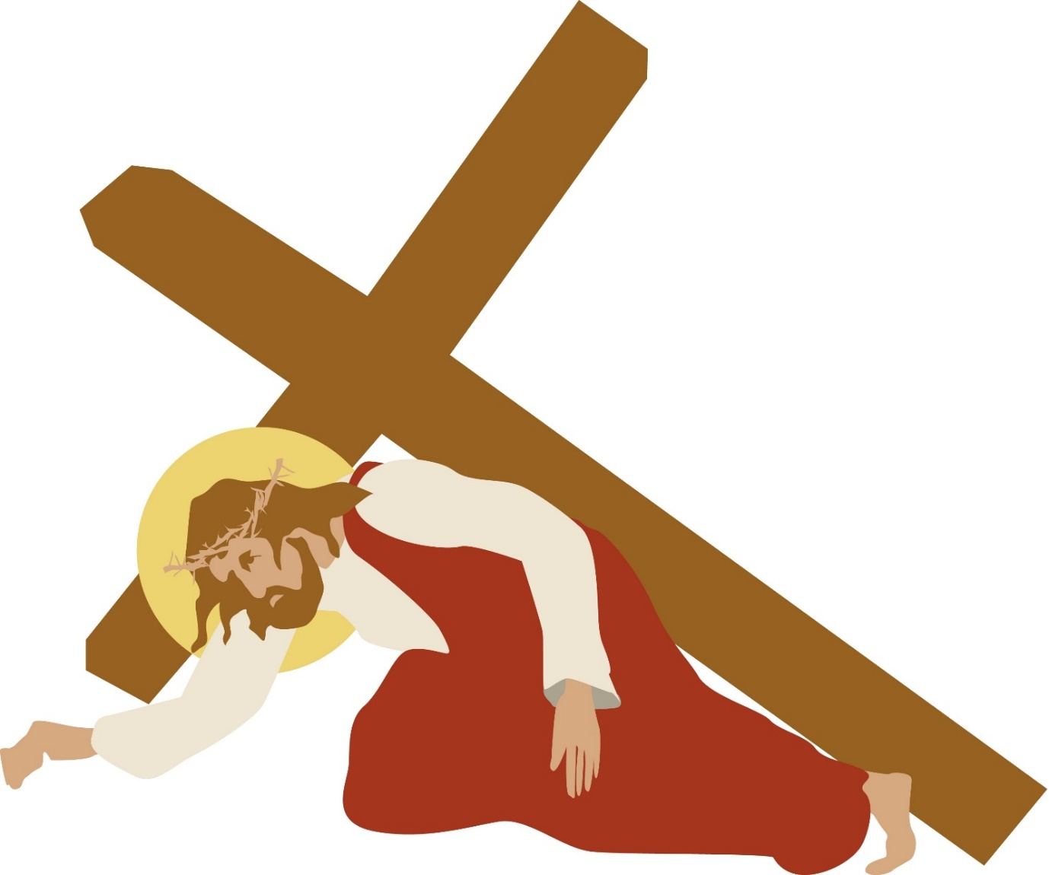
Station 3
Jesus Falls the First Time
We adore you, O Christ, and we praise you, because,
by your holy cross you have redeemed the world

Slide 5
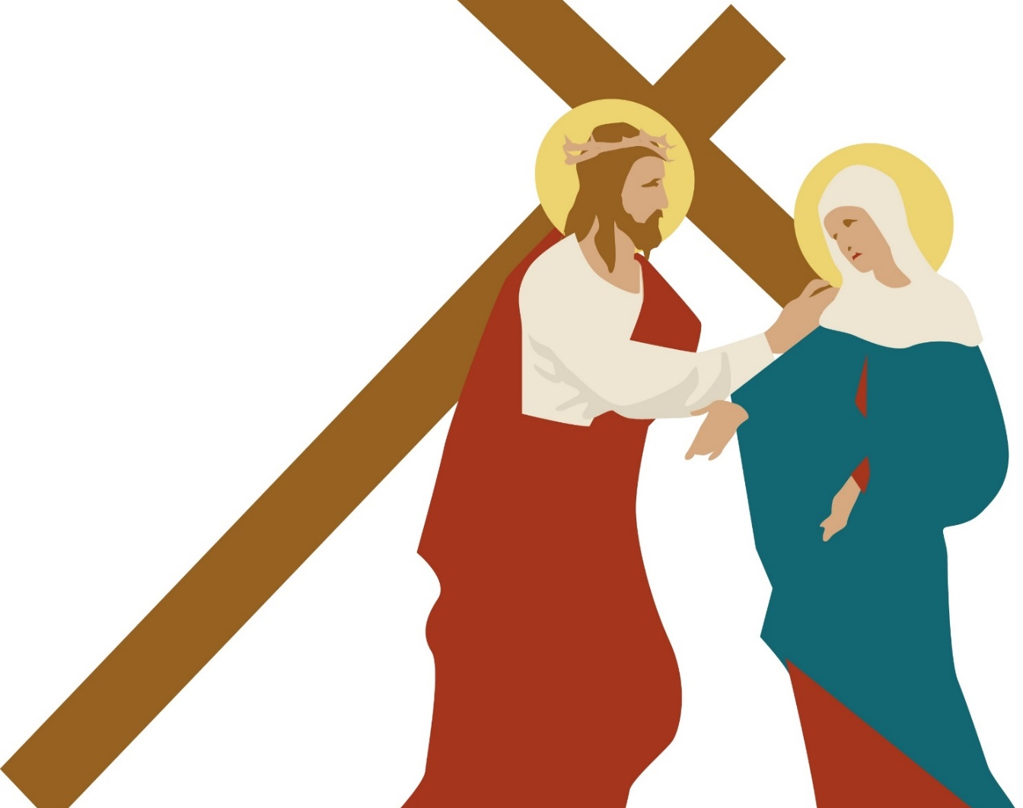
Station 4
Jesus meets his mother
We adore you, O Christ, and we praise you, because,
by your holy cross you have redeemed the world

Slide 6
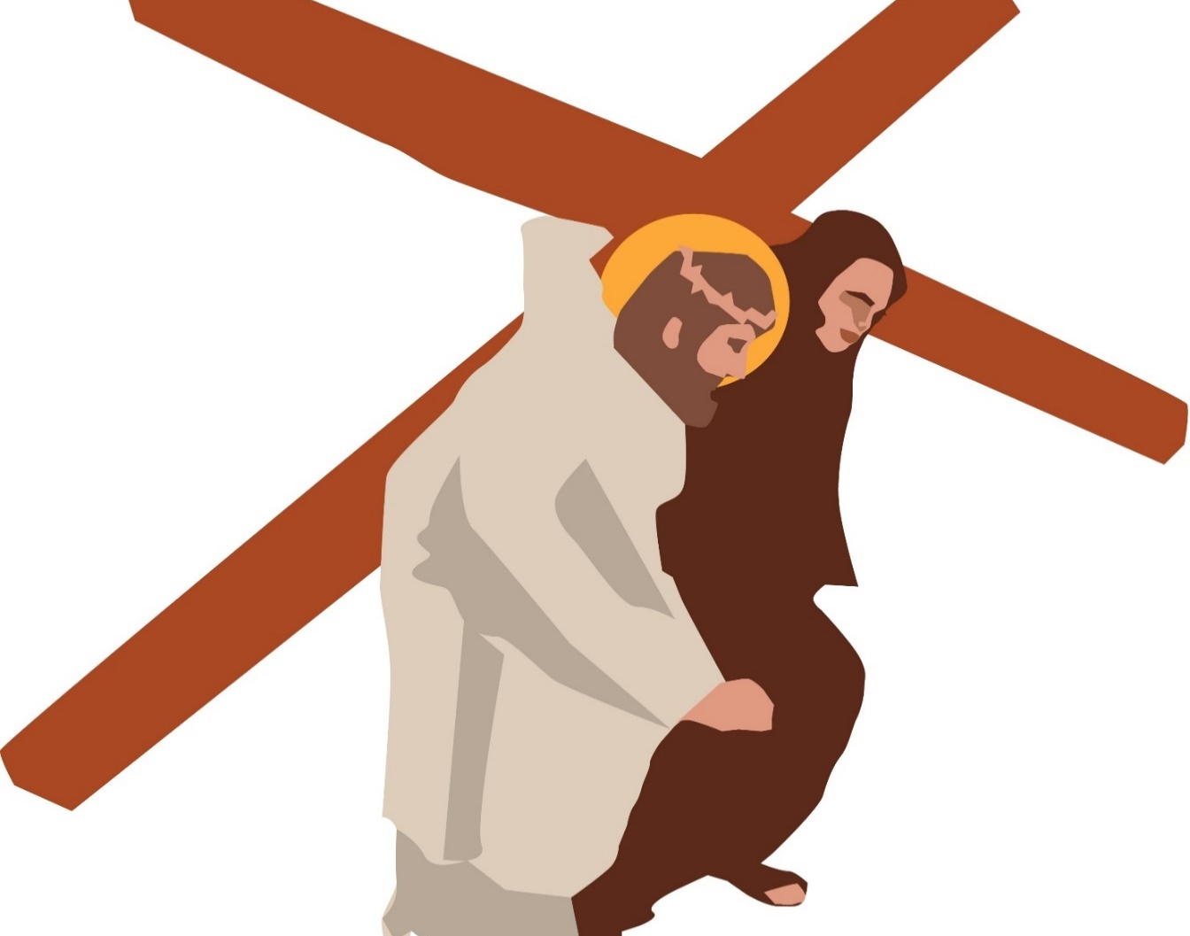
Station 5
Simon of Cyrene helps Jesus to carry his cross
We adore you, O Christ, and we praise you, because,
by your holy cross you have redeemed the world

Slide 7
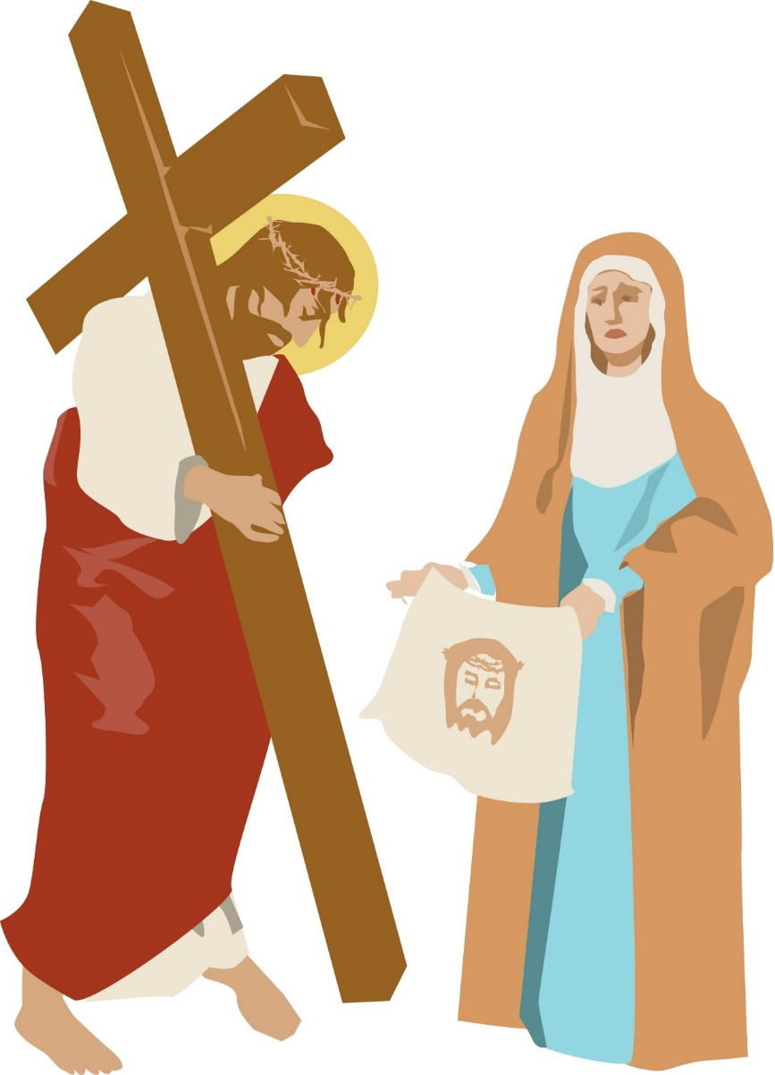
Station 6
Veronica wipes the face of Jesus
We adore you, O Christ, and we praise you, because,
by your holy cross you have redeemed the world

Slide 8
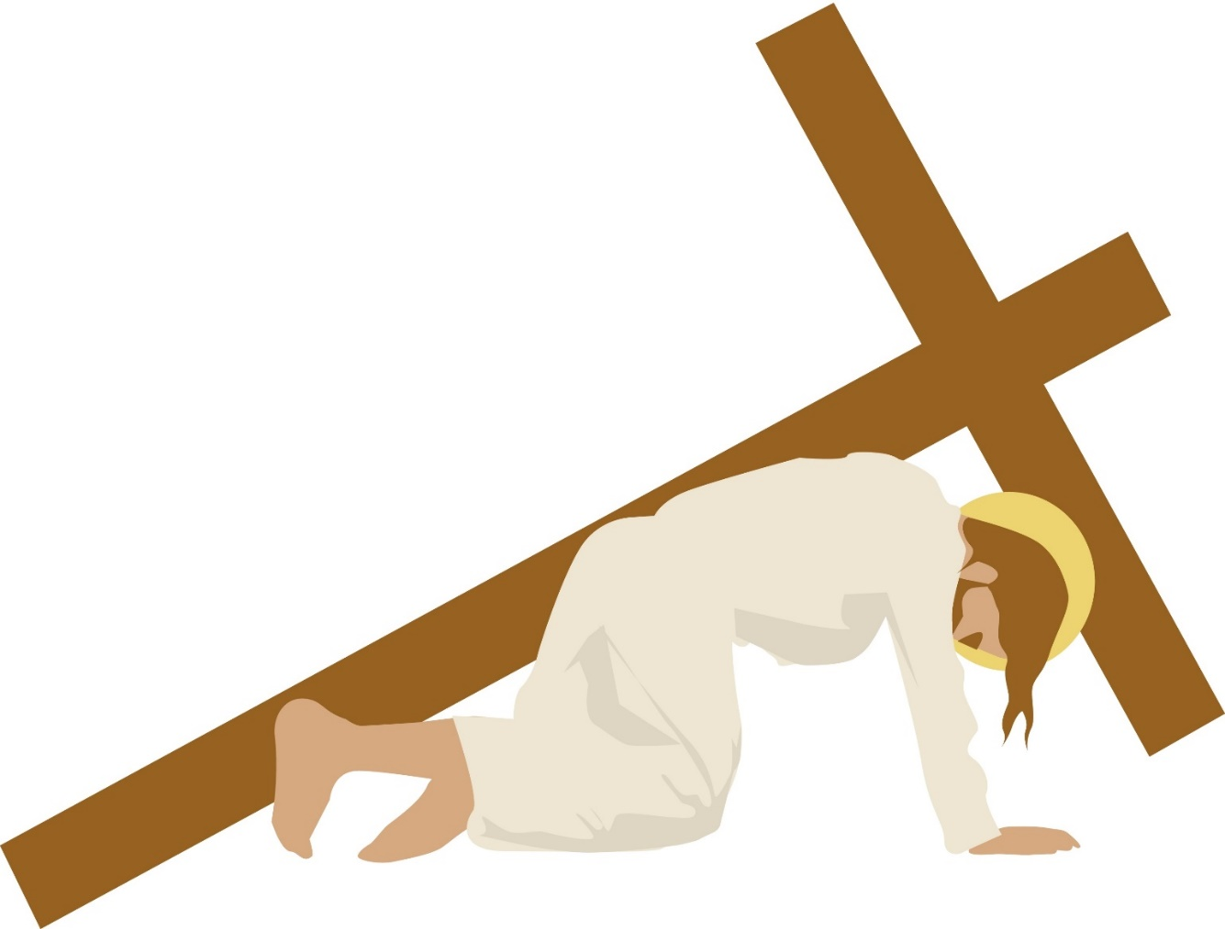
Station 7
Jesus falls the second time
We adore you, O Christ, and we praise you, because,
by your holy cross you have redeemed the world

Slide 9
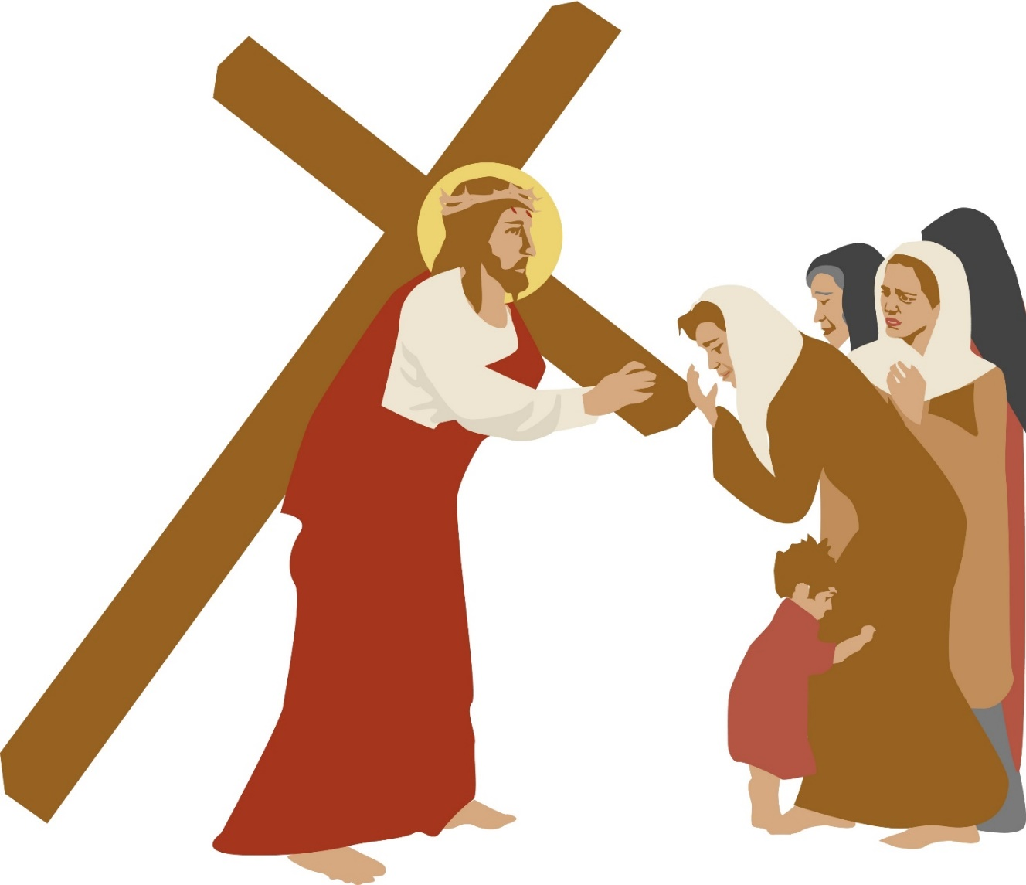
Station8
Jesus meets the women of Jerusalem
We adore you, O Christ, and we praise you, because,
by your holy cross you have redeemed the world

Slide 10
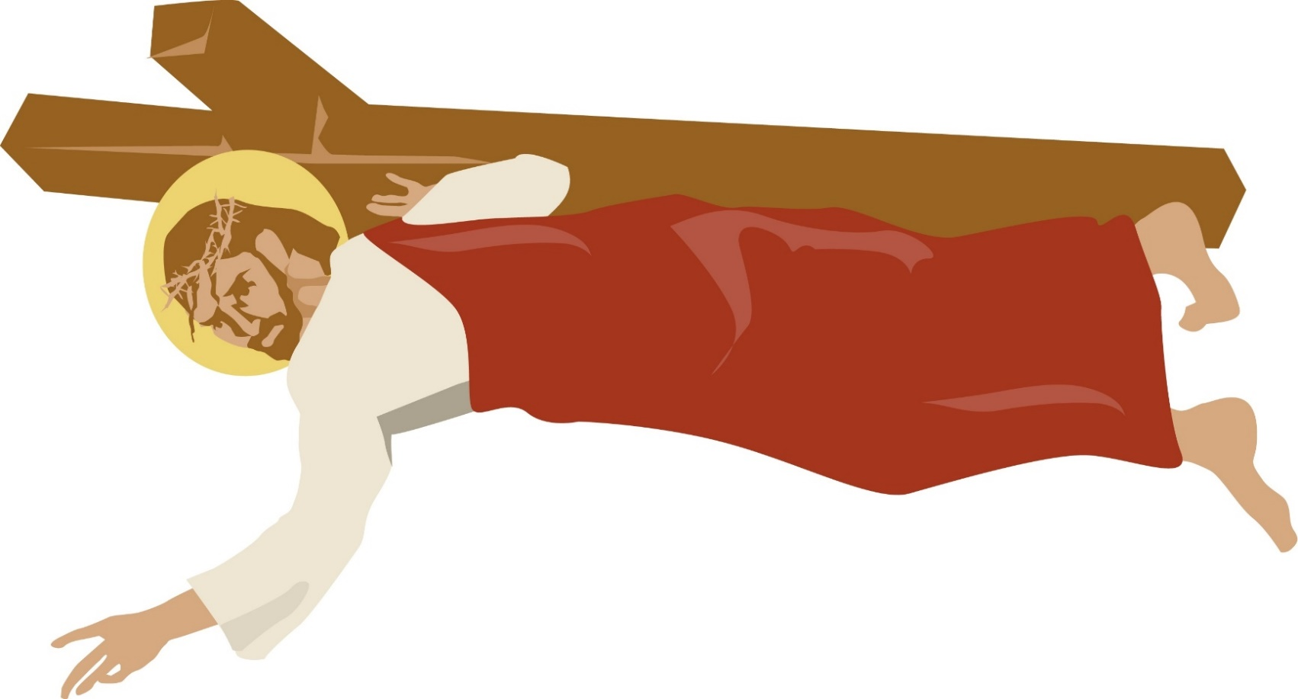
Station 9
Jesus falls the third time
We adore you, O Christ, and we praise you, because,
by your holy cross you have redeemed the world

Slide 11
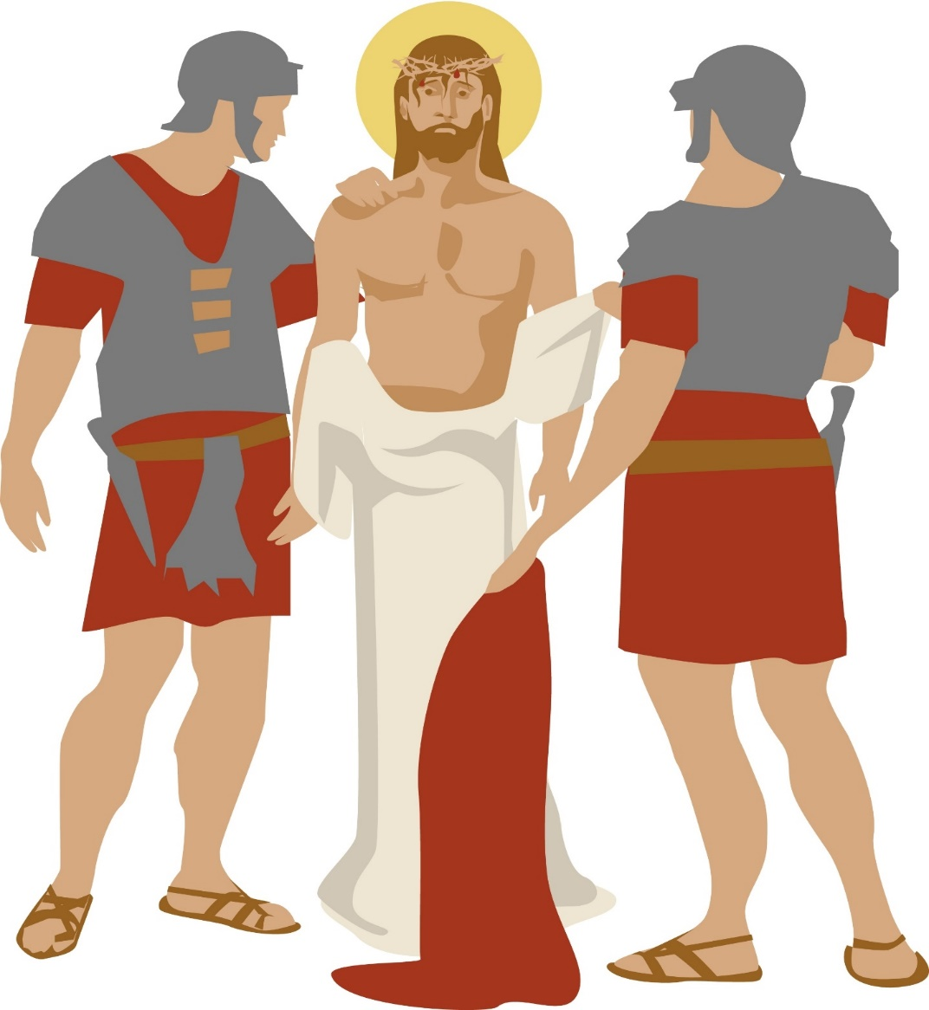
Station 10
Jesus is stripped of his clothing
We adore you, O Christ, and we praise you, because,
by your holy cross you have redeemed the world

Slide 12
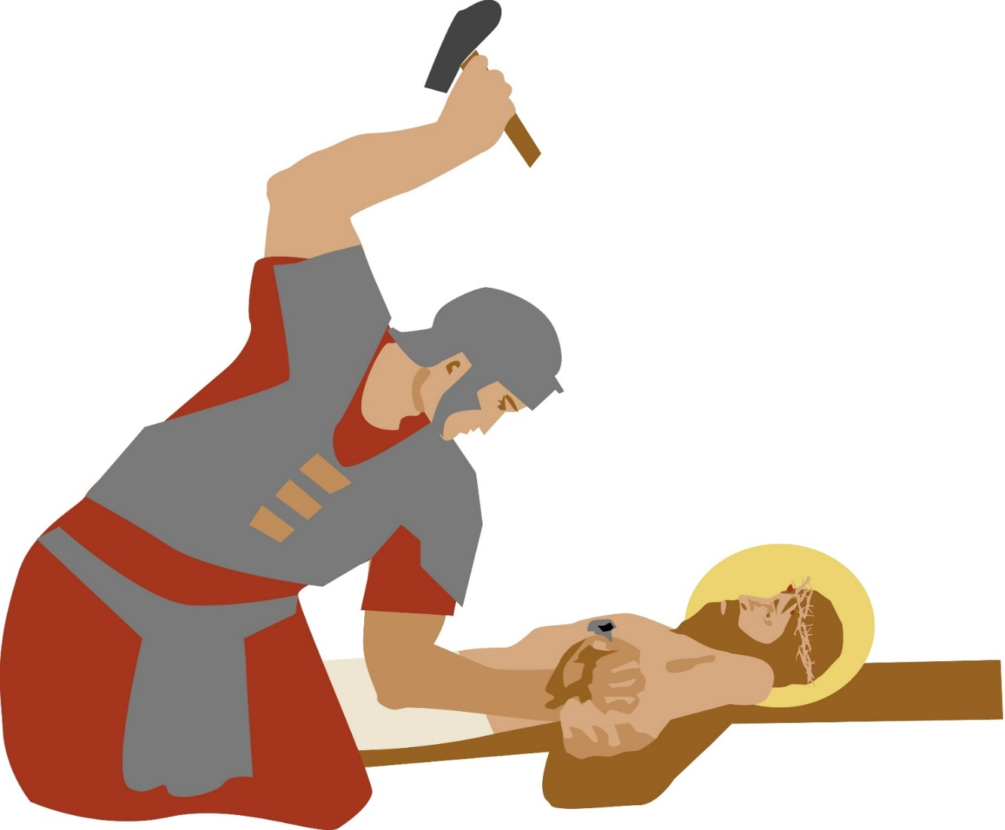
Station 11
Jesus is nailed to the cross
We adore you, O Christ, and we praise you, because,
by your holy cross you have redeemed the world

Slide 13
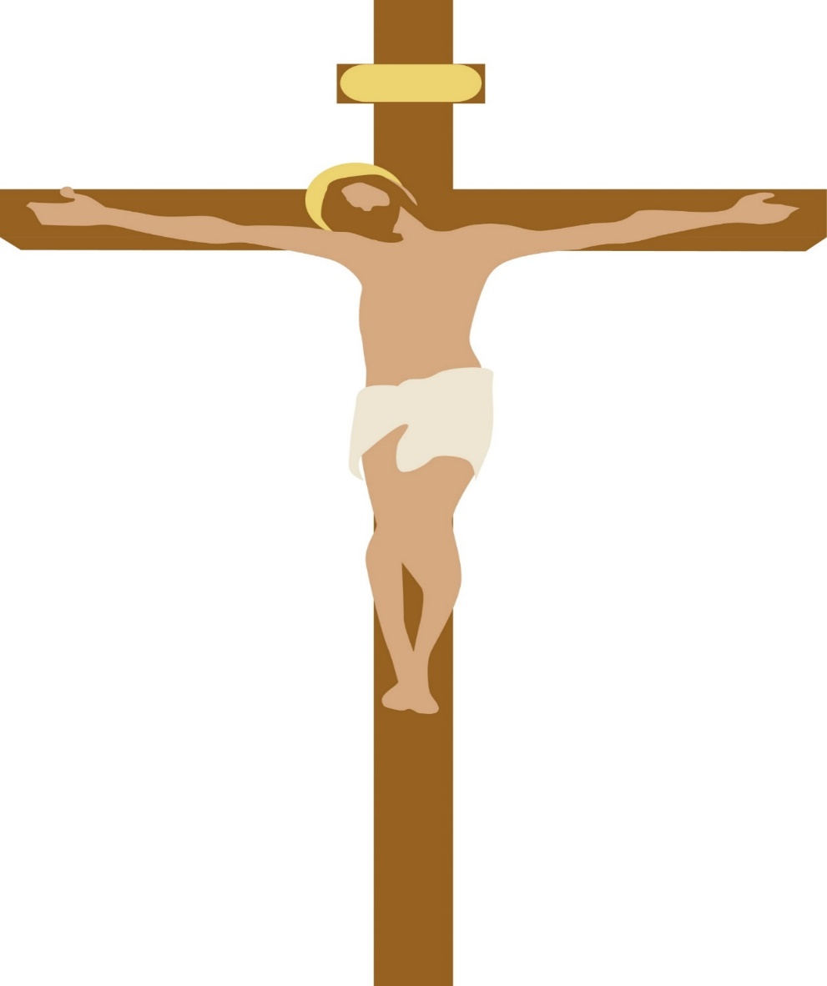
Station 12
Jesus Dies on the Cross
We adore you, O Christ, and we praise you, because,
by your holy cross you have redeemed the world

Slide 14
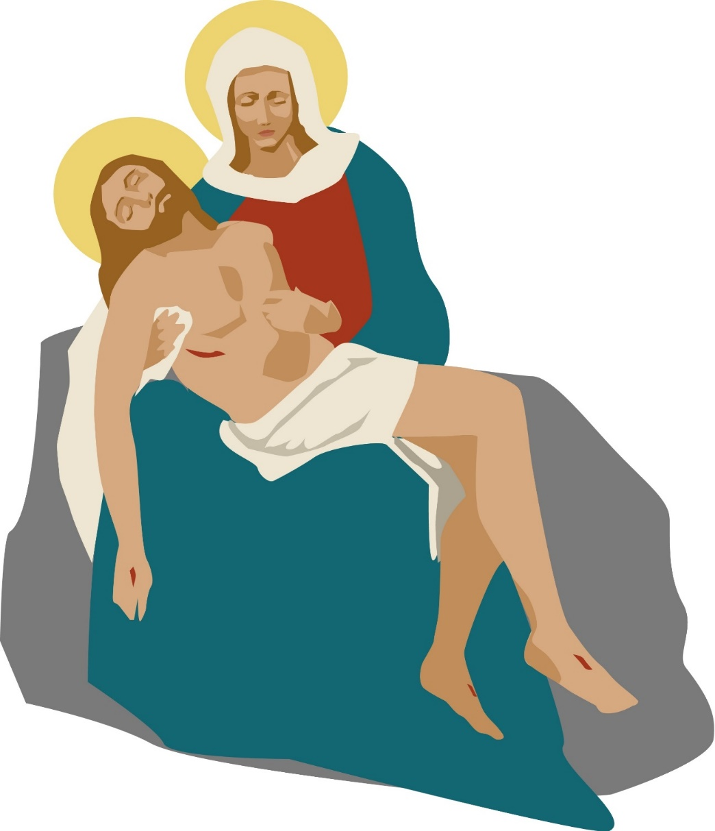
Station 13
Jesus is taken down from the Cross
We adore you, O Christ, and we praise you, because,
by your holy cross you have redeemed the world

Slide 15
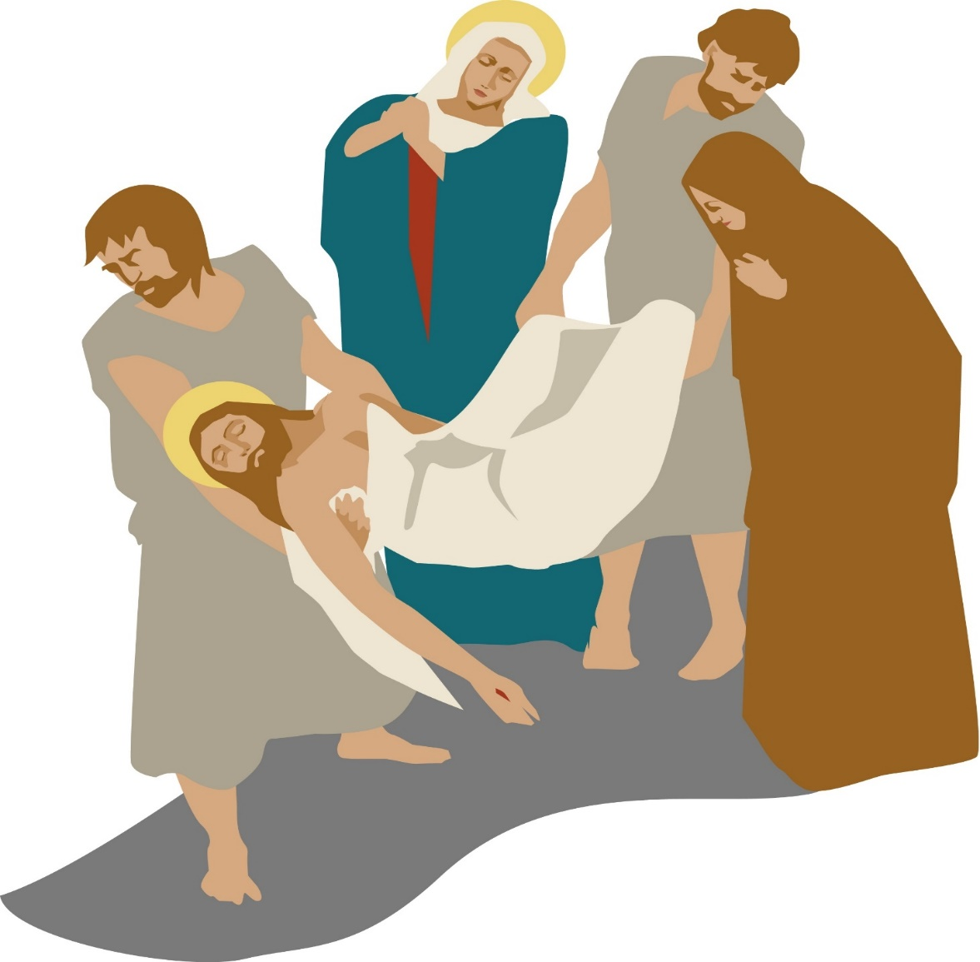
Station 14
Jesus is laid in the tomb
We adore you, O Christ, and we praise you, because,
by your holy cross you have redeemed the world

