Slide 1
First Reconciliation 2021
Preparing to Celebrate the Sacrament

Slide 2
A Prayer as We Teach Remotely
God of Wisdom be our source of creativity as we seek to find new ways to reach out to each and every student. Help us to rejoice in the successes and to be gentle with ourselves and others when things don’t go to plan.
God of Patience encourage us in our use of seesaw; google classrooms; padlet, emails or zoom. Give us an abundance of patience as we learn to engage with so many different tools so that we can meet the needs of our students. Help us to be patient with ourselves and those around us as well.

Slide 3
A Prayer as We Teach Remotely
God of Love how blessed we are to know that you love us beyond measure. Help us to radiate that love in all our interactions these days. Open our hearts to receive your blessings so that we might in turn be a blessing to others.
May your wisdom O God be our wisdom, your patience, our patience and your love, our love. Amen.
(Adapted from a Prayer by Sr Paula Damiano
https://spsmw.org/2020/08/19/a-prayer-for-teachers-during-this-pandemic/)

Slide 4
Proposal for 2021
Preparation using Grow in Love at school & at home
Diocesan Penitential Service Live streamed March 18 @19:30
  Preparing to celebrate the sacrament
Celebration of Sacrament in local parishes as soon as it is safe to do so
  Individually
  Small groups

Slide 5
First Reconciliation in Grow in Love
Grow in Love, the new Religious Education Programme for schools, suggests that the word ‘Reconciliation’ is used instead of ‘Confession’ or ‘Penance.’ The use of the word ‘Reconciliation’ puts the focus more on reuniting and reconciling with others and with God than on penitence and sin. This is a more helpful and fuller understanding of the sacrament particularly when working with younger children.
(Grow in Love; Second Class, Teacher Book p160)

Slide 6
Theme 5 Reconciliation
3 Lessons

Slide 7

At the End of the Theme the Children should be able to
Make the Sign of the Cross
Pray the Confiteor
Pray the Act of Sorrow
Retell the story of Zacchaeus
Differentiate between good & bad choices
Know that a bad choice is a sin
Know that God always forgives & always loves us
Know the 5 Steps to Reconciliation
Participate in the Penitential Service
Participate in celebrating the sacrament of reconciliation with the priest

Slide 8

An Approach to Teaching Remotely

Slide 9
Step 1
Understand that God always loves us and always forgives us
Explore the need to say sorry to God and to those we hurt
Explore good and bad choices
Know that when we do something that we know is wrong that this is called a sin
Begin to learn the Act of Sorrow
Make a Sorry Box

Slide 10
Step 2 know how Jesus shows that God always loves and forgives us
Listen, discuss and be able to retell the story of Zacchaeus
Use the Zacchaeus story to help them explore times when they have done something for which they need to say sorry
Understand that God always loves us and always forgives us
Begin to learn The Confiteor
Continue to pray the Act of Sorrow

Slide 11
Step 3
Know the 5 steps in celebrating the Sacrament of Reconciliation
Explore the 5 steps in celebrating the Sacrament of Reconciliation
Know what to say and do when they meet the priest in the Sacrament of Reconciliation
Be able to identify times when they have something wrong
Be prepared to participate in the Diocesan Penitential Service

Slide 12
Step 1:
Story: What Sweets? page 147
Discussion to include introduction of the word
  ‘sin’ when we know what we are doing is wrong and we do it anyway
Chatting Activity: What Would you Do? Page 149
The Greatest Commandment Story
https://app.growinlove.ie/en/user/lesson-resources/186
Discussion: Choices; Children’s Book page 28
Chatting: About sins p150
Teach the Act of Sorrow

Slide 13
Step 2
Story Zacchaeus page 154-155
https://app.growinlove.ie/en/user/lesson-resources/187
Children’s Book page 30
Chatting: page 156
https://app.growinlove.ie/en/user/lesson-resources/187
Teach: The Confiteor
Children’s Book page 31 (At Home)

Slide 14
Step 3
Vox Pop: ‘A time when I was sorry’
https://app.growinlove.ie/en/user/lesson-resources/188
Sacrament of Reconciliation 1
https://app.growinlove.ie/en/user/lesson-resources/188
  We bless ourselves
  We say: ‘bless me Father for I have sinned’
  We tell the priest about a time when we have sinned

Slide 15
Step 3
Sacrament of Reconciliation 2
https://app.growinlove.ie/en/user/lesson-resources/188
  The priest gives us something to do to show that we are sorry
  He asks us to pray the Act of Sorrow
  He prays the Prayer of Absolution
5 Steps page 161 Children’s Book p32
  1. I realise that I have done wrong and I feel sorry.
  2. I say sorry.
  3. I accept penance and pray the Act of Sorrow.
  4. I am forgiven.
  5. I try again.

Slide 16

Music
I’m Sorry page 165
  https://app.growinlove.ie/en/user/lesson-resources/188
The Lord he is my Shepherd (First Class page 159)
  https://app.growinlove.ie/en/user/lesson-resources/150
Lay your hands (page 89)
  https://app.growinlove.ie/en/user/lesson-resources/180

Slide 17

Save the Date
Diocesan Penitential Service
18 March @ 19:30

Slide 18
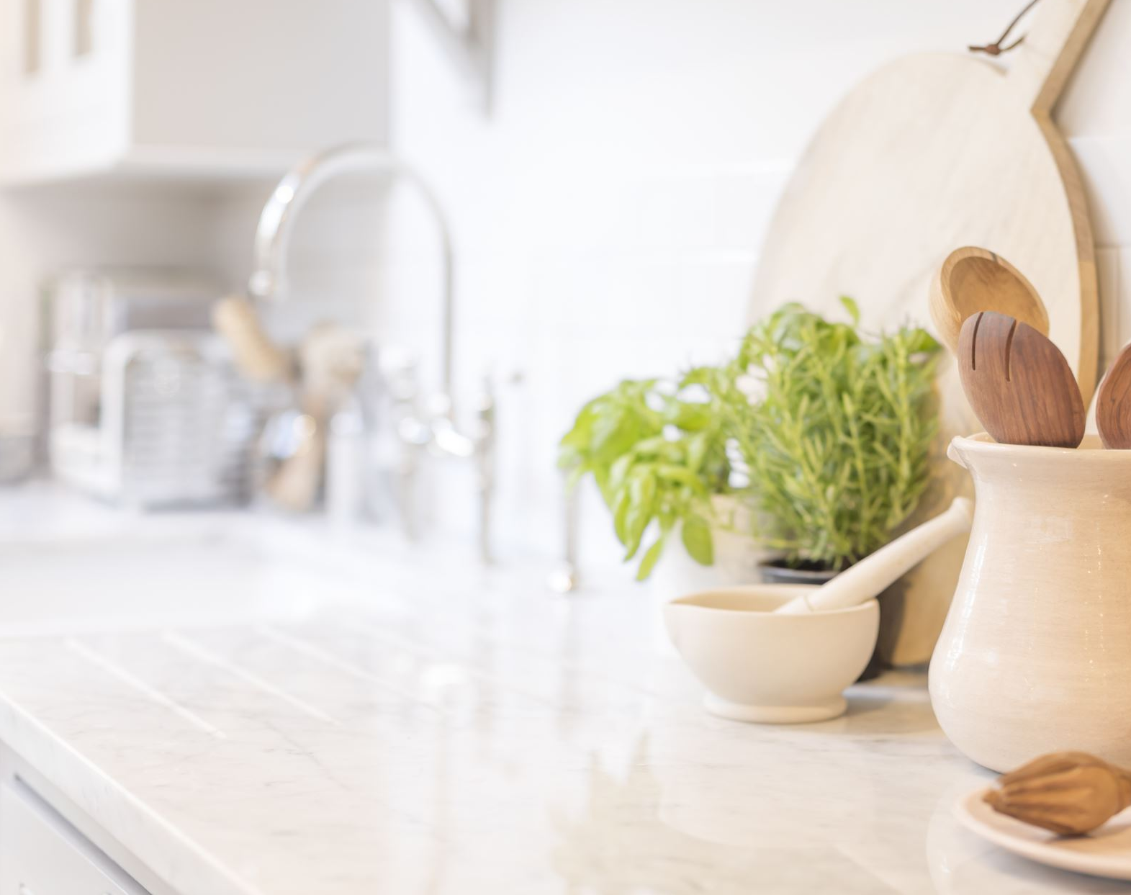
At Home
Watch Explanatory PowerPoint/Video
Read ‘Parent’s Guide’
Help learn Prayers & pray them
Make Sorry Box & discuss times when we do wrong, the five steps, Zacchaeus
Prepare for and Participate on March 18 @19:30

