Slide 1

Confirmation 2021
Preparing to Celebrate the Sacrament

Slide 2

A Prayer as We Teach Remotely
God of Wisdom be our source of creativity as we seek to find new ways to reach out to each and every student. Help us to rejoice in the successes and to be gentle with ourselves and others when things don’t go to plan.
God of Patience encourage us in our use of seesaw; google classrooms; padlet, emails or zoom. Give us an abundance of patience as we learn to engage with so many different tools so that we can meet the needs of our students. Help us to be patient with ourselves and those around us as well.

Slide 3
A Prayer as We Teach Remotely
God of Love how blessed we are to know that you love us beyond measure. Help us to radiate that love in all our interactions these days. Open our hearts to receive your blessings so that we might in turn be a blessing to others.
May your wisdom O God be our wisdom, your patience, our patience and your love, our love. Amen.
(Adapted from a Prayer by Sr Paula Damiano
https://spsmw.org/2020/08/19/a-prayer-for-teachers-during-this-pandemic/)

Slide 4

Proposal for 2021
Video from Bishop Denis
Invitation to Reflect on Readiness for Confirmation & Commitment being made
My Confirmation Promise
Preparation Home/School/Parish Approach
The Journey Begins 25 March 12:00

Slide 5

Celebration of Confirmation
What preparation?
How?
When?

Slide 6
What Preparation?
Home School Parish

Slide 7

Priority
Contact Details of Families
Sacramental Contact Form

Slide 8

Before March 25 the Candidates should
Have
watched Bishop Denis’s video, discussed the questions and completed & returned the My Confirmation Promise Form to the school/parish
Have
chosen their Confirmation Name & Sponsor
Be
prepared to participate in the Diocesan Celebration on 25 March

Slide 9

Before March 25 the Candidates should Know
Sacrament
Confirmation is one of Seven Sacraments
In Confirmation we confirm what happened at Baptism
In Confirmation we are anointed with the Oil of Chrism
In Confirmation we choose a new name and a sponsor to support us
The Holy Spirit
The Holy Spirit is a Helper and Guide and the third member of the Trinity
The Story of Pentecost
Symbols of the Holy Spirit
Prayer
Come Holy Spirit

Slide 10

Grow in Love

Slide 11

Journal for the Journey
Start a Confirmation Journal
Suggestions in Grow in Love

Slide 12
I: Sacrament
Confirmation is one of Seven Sacraments
Identify & name the seven Sacraments
Name the sacraments of Initiation
In Confirmation we are anointed with the Oil of Chrism
In Confirmation we choose a new name and a sponsor to support us in our faith journey
Page 90 Text Book (5th class)
Page 308 (5th class)
Chatting (page 313 5th class)
Sacraments of Initiation History (PDF)
P296-297 (5th Class)
Story of Jesus’ Baptism (P83 Text Book 5th Class)
My Baptism (PDF)
Key Words (Page 422 6th Class)
P310 (5th class)
Page 313-314 (5th class) (p92 Text Book 5th Class
& 111-112 6th Class)
  Project My Confirmation Name
  Invitation to Sponsor
In Confirmation we confirm what happened at Baptism

Slide 13
II: The Holy Spirit
The Holy Spirit is a Helper and Guide and the third member of the Trinity
The Story of Pentecost
Symbols of the Holy Spirit
Story: An Indian Legend
  Chatting, Brainstorm & Group Activity
  pp 293-296 (5th Class)
Pp406-407 (6th class) & p103(text book)
P311 Poem the Holy Spirit & p94 (text book) 5th class

Slide 14
III: Prayer
Come Holy Spirit Page 113 (Textbook 6th Class)
https://app.growinlove.ie/en/user/lesson-resources/404

Slide 15

Music
Spirit Anthem p324 (5th Class)
https://app.growinlove.ie/en/user/lesson-resources/405
Send Forth Your Spirit p440 (6th Class)
https://app.growinlove.ie/en/user/lesson-resources/517
Go Tell Everyone p323 (5th Class)
https://app.growinlove.ie/en/user/lesson-resources/404

Slide 16
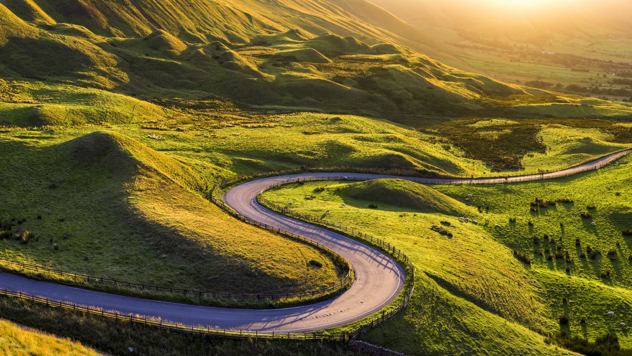
The Journey Begins
25 March 2021 12:00
Diocesan Celebration

Slide 17
Diocesan Celebration
Mark Formal Beginning of Confirmation Journey
Opportunity to reinforce what the children have learned
  Pentecost Story
  Oil of Chrism
  Questions
  Prayer

Slide 18

How?
Rite of Confirmation

Slide 19
When?
When it is safe to do so

Slide 20
Next Steps
Resources from this session, link to Bishop Denis’ video & accompanying material will be sent out early next week
Sacramental Contact Form
  School can distribute the form
  Parish set up contact database
Arrange meeting between parish team, RE Coordinators & teachers
  Decide on how material to home will be distributed & returned
  Consider ways of making and maintaining contact with families
    Setting up WhatsApp Group
    Email/Text
    If there is no contact from individual families
Further resources will be made available after Easter

