Slide 1
Stations of the Cross

Slide 2
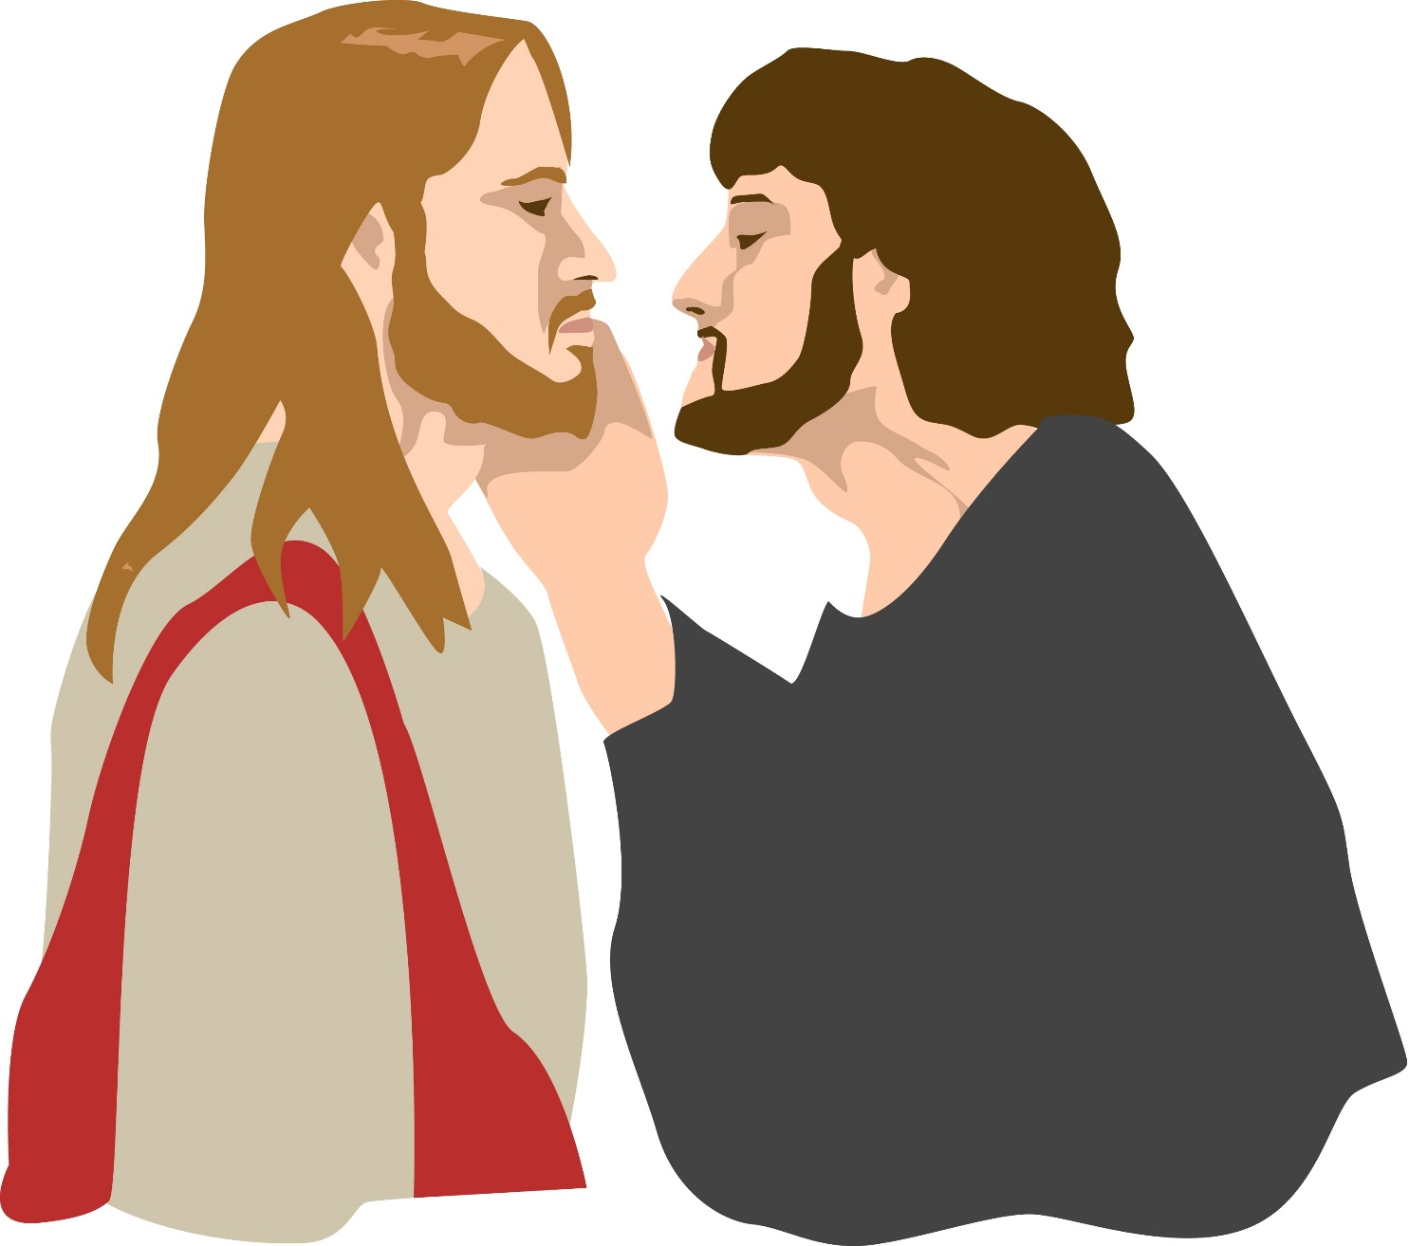
Station 1
Jesus is Condemned to Death

Slide 3
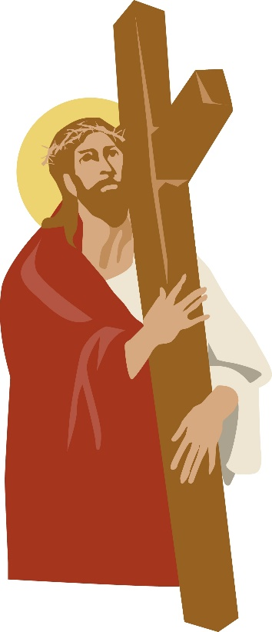
Station 2
Jesus Receives his Cross

Slide 4
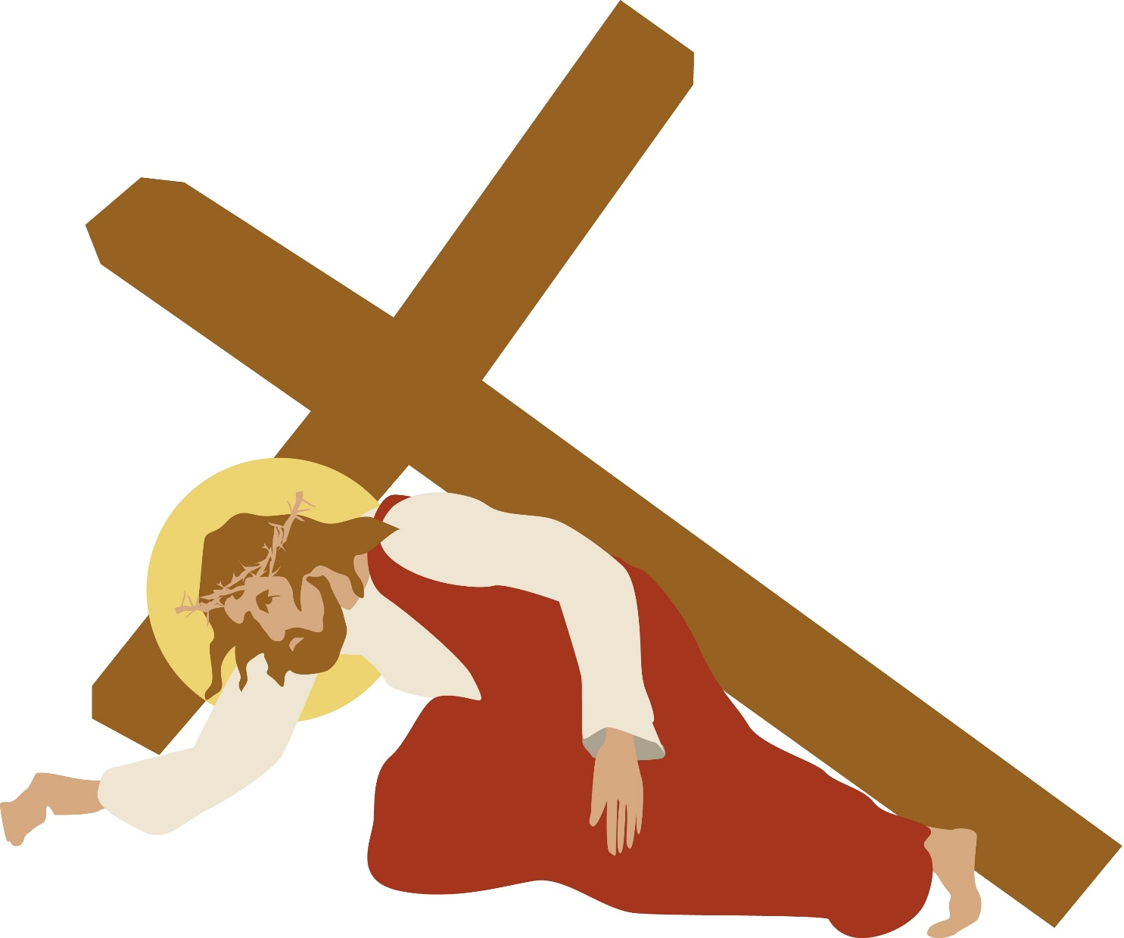
Station 3
Jesus Falls the First Time

Slide 5
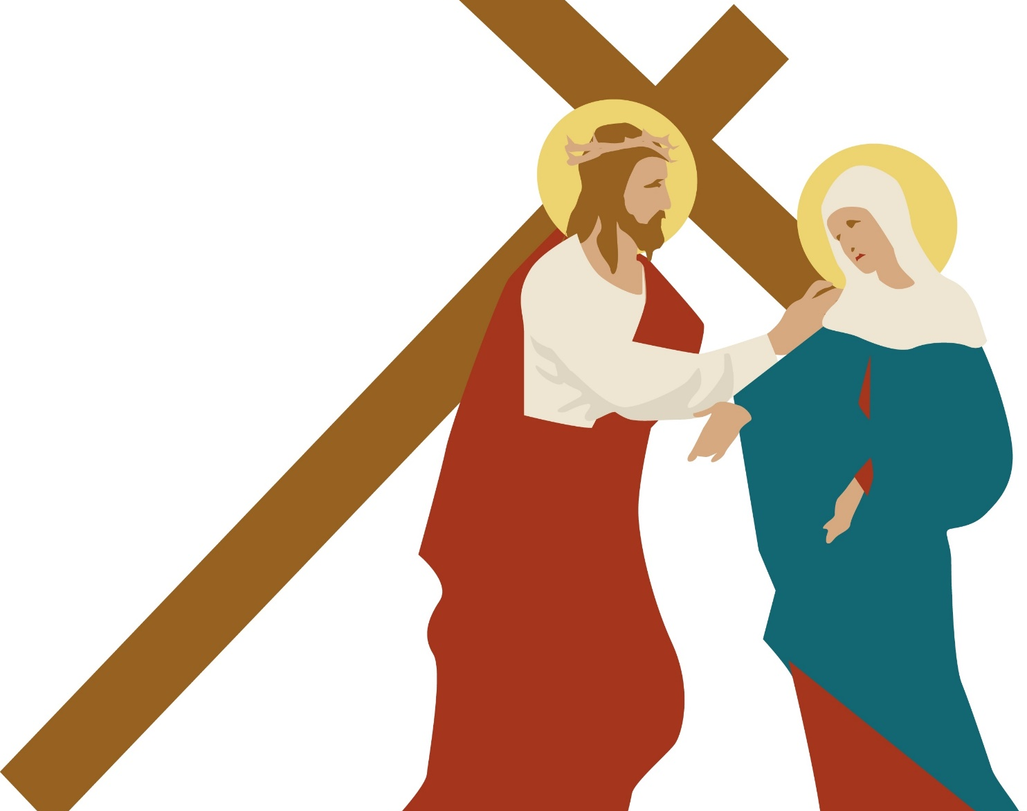
Station 4
Jesus meets his mother

Slide 6
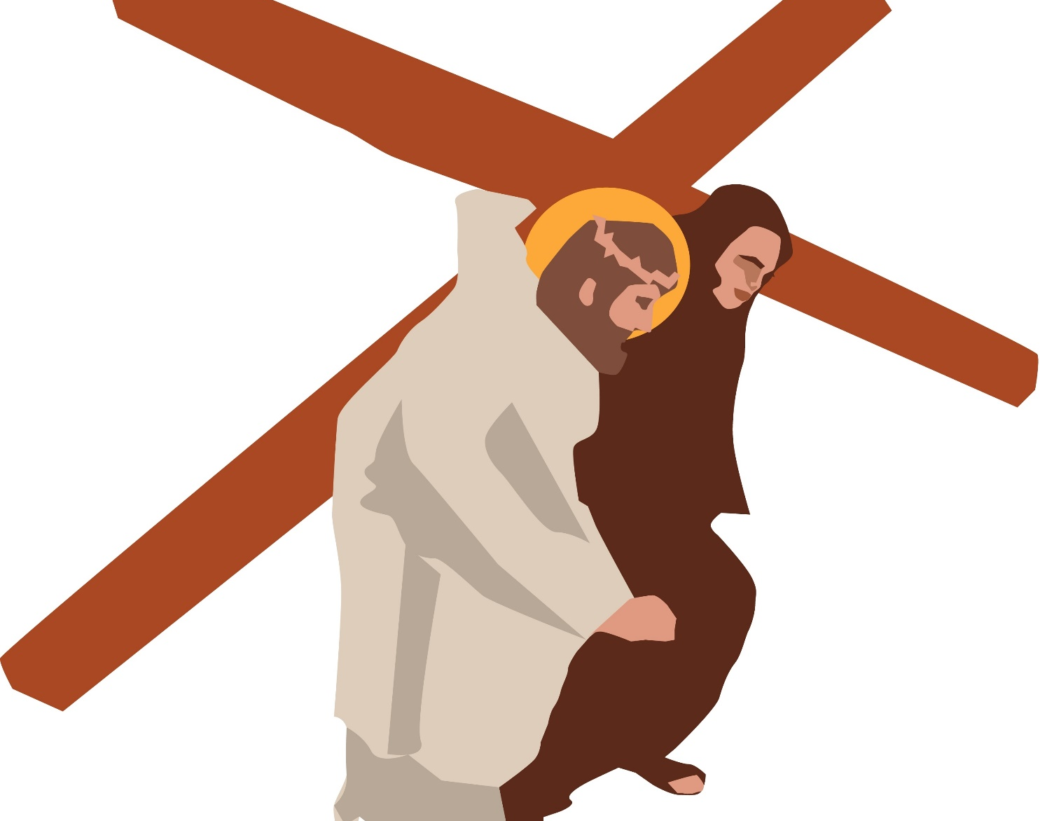
Station 5
Simon of Cyrene helps Jesus to carry his cross

Slide 7
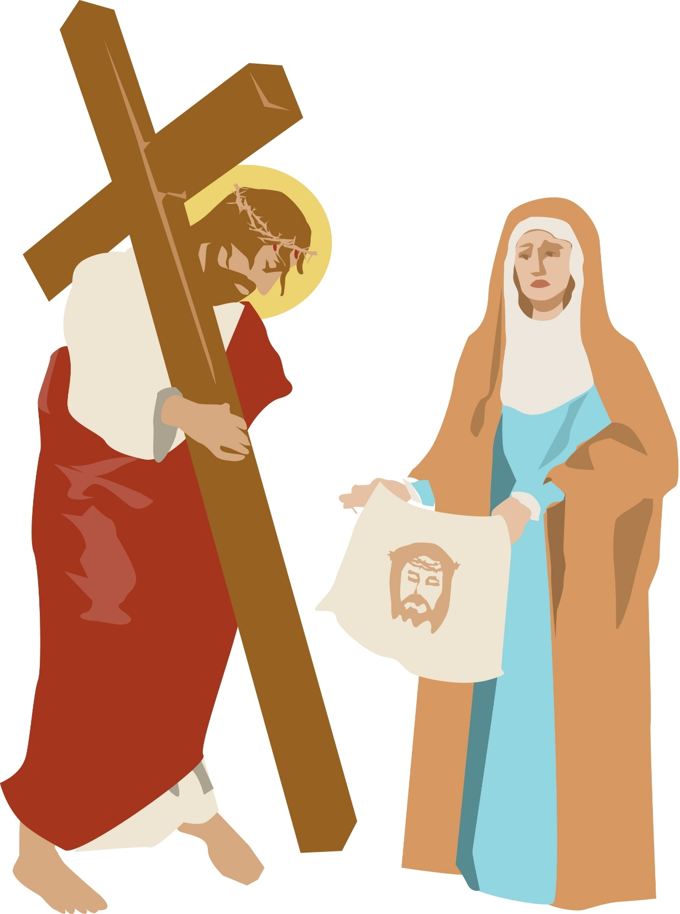
Station 6
Veronica wipes the face of Jesus

Slide 8
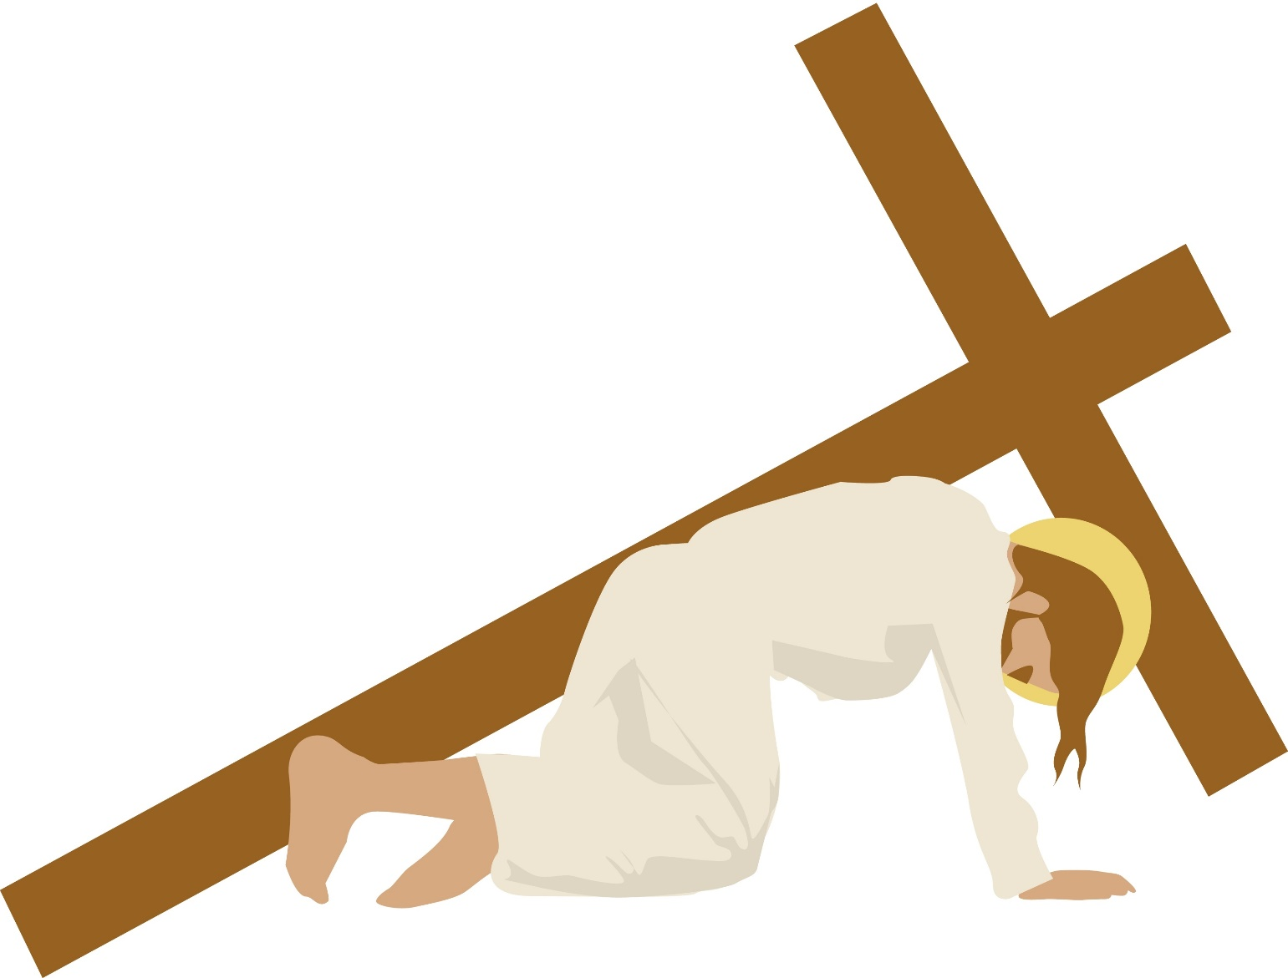
Station 7
Jesus falls the second time

Slide 9
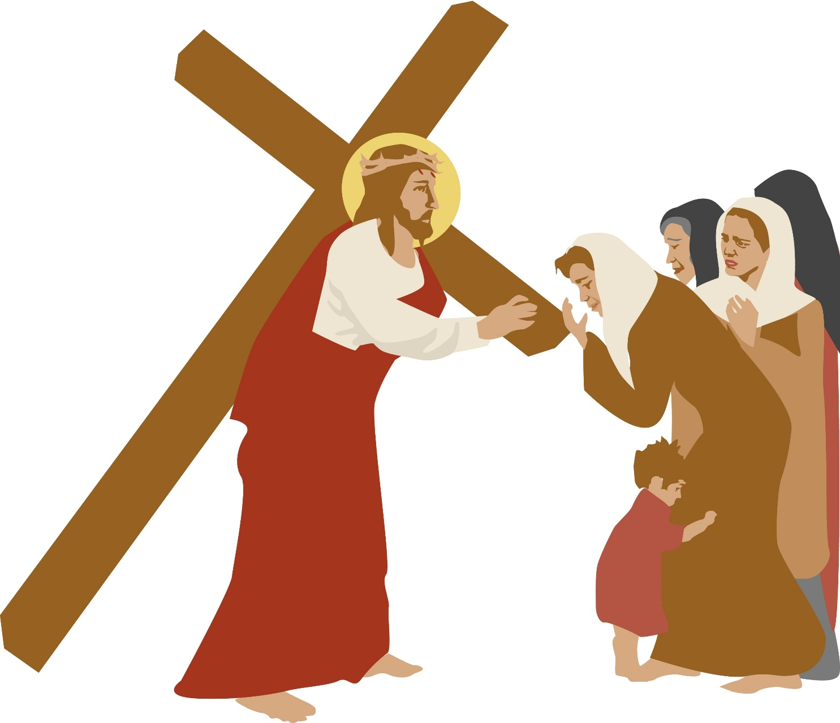
Station8
Jesus meets the women of Jerusalem

Slide 10
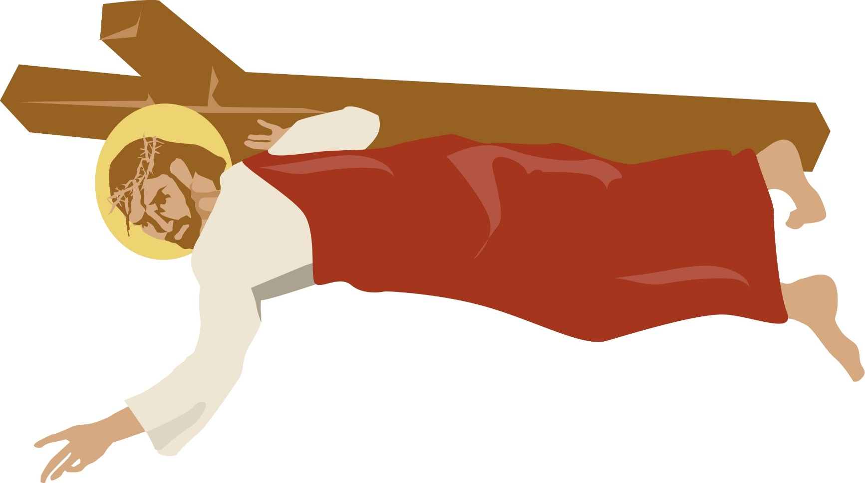
Station 9
Jesus falls the third time

Slide 11
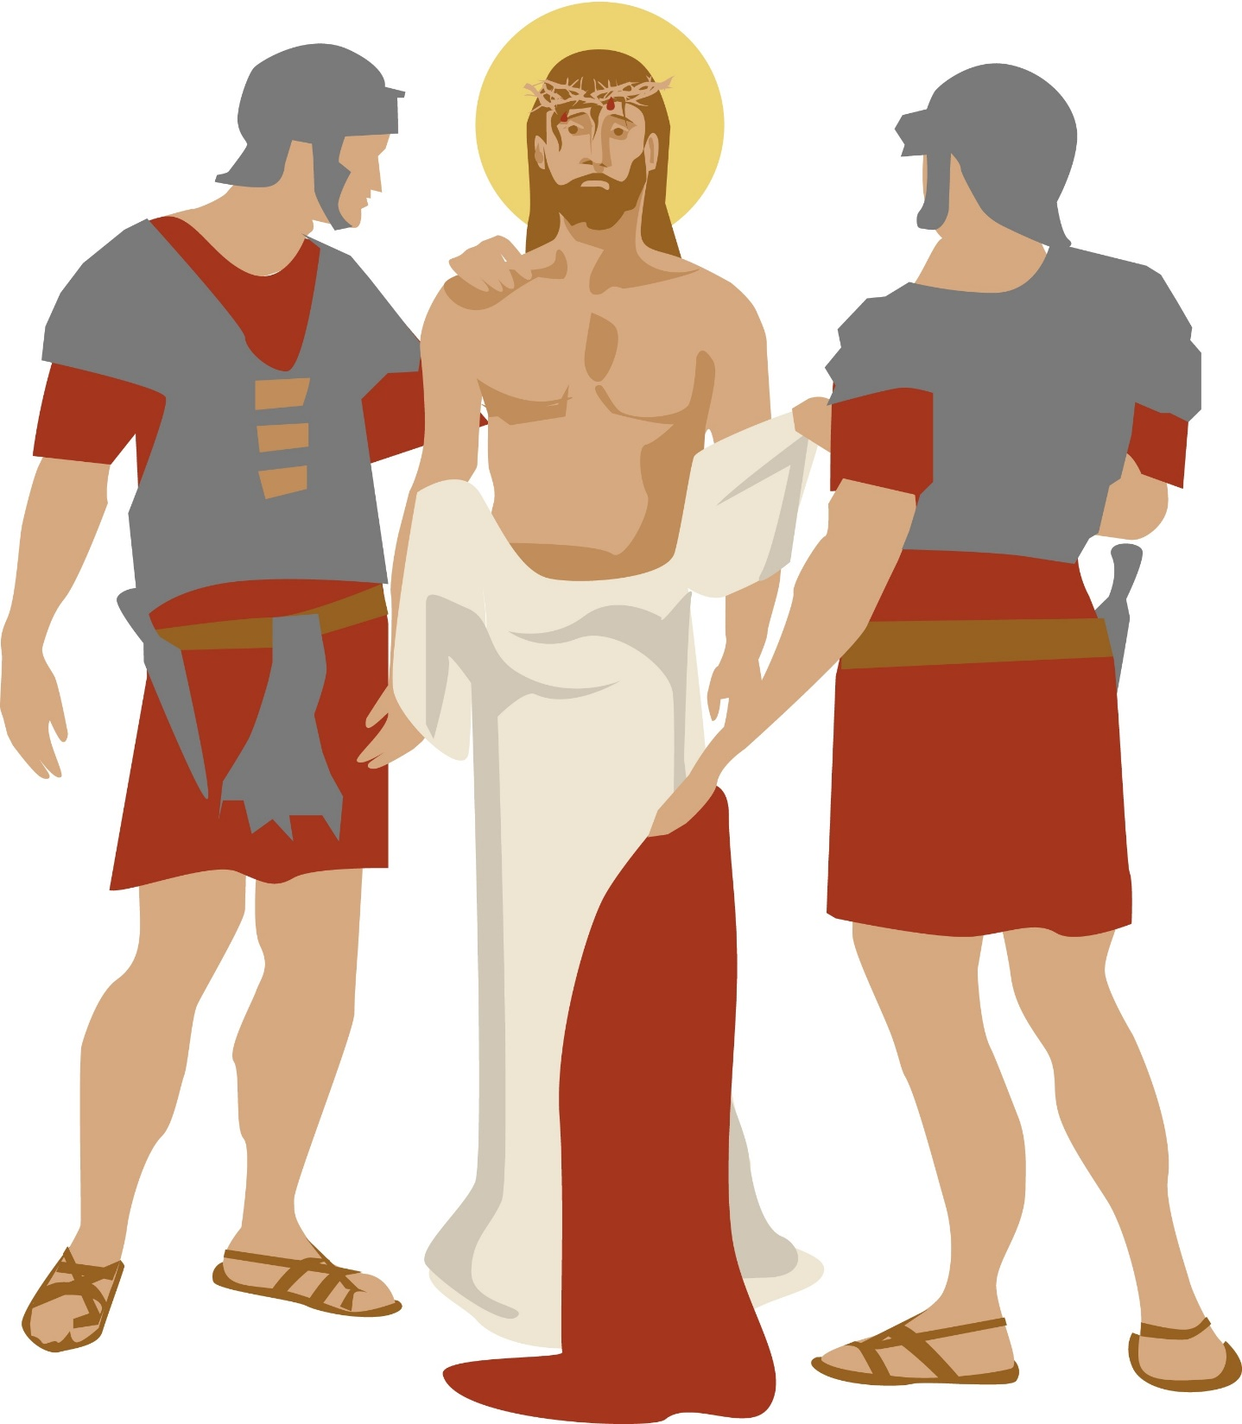
Station 10
Jesus is stripped of his clothing

Slide 12
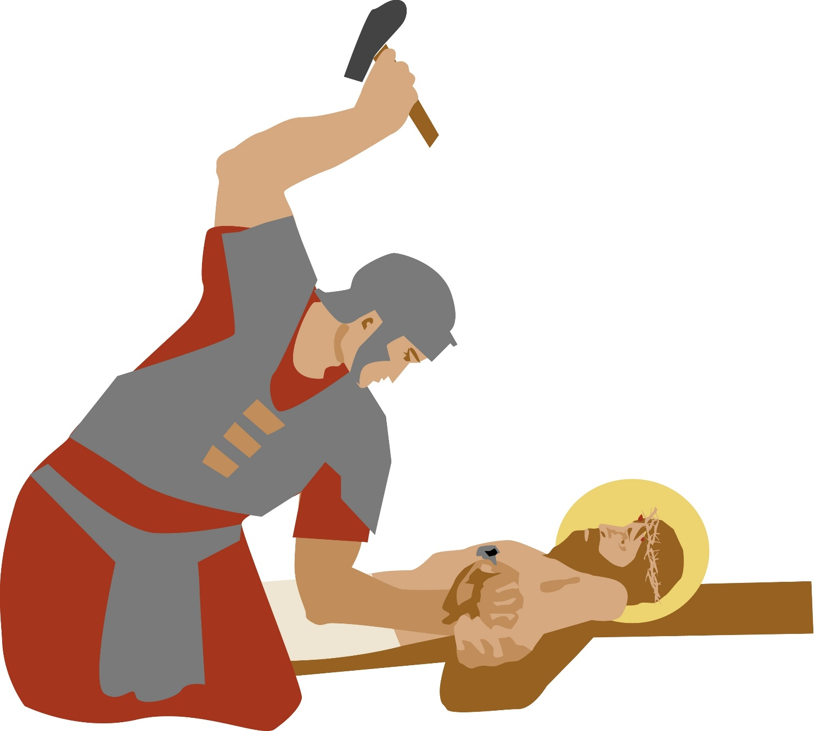
Station 11
Jesus is nailed to the cross

Slide 13
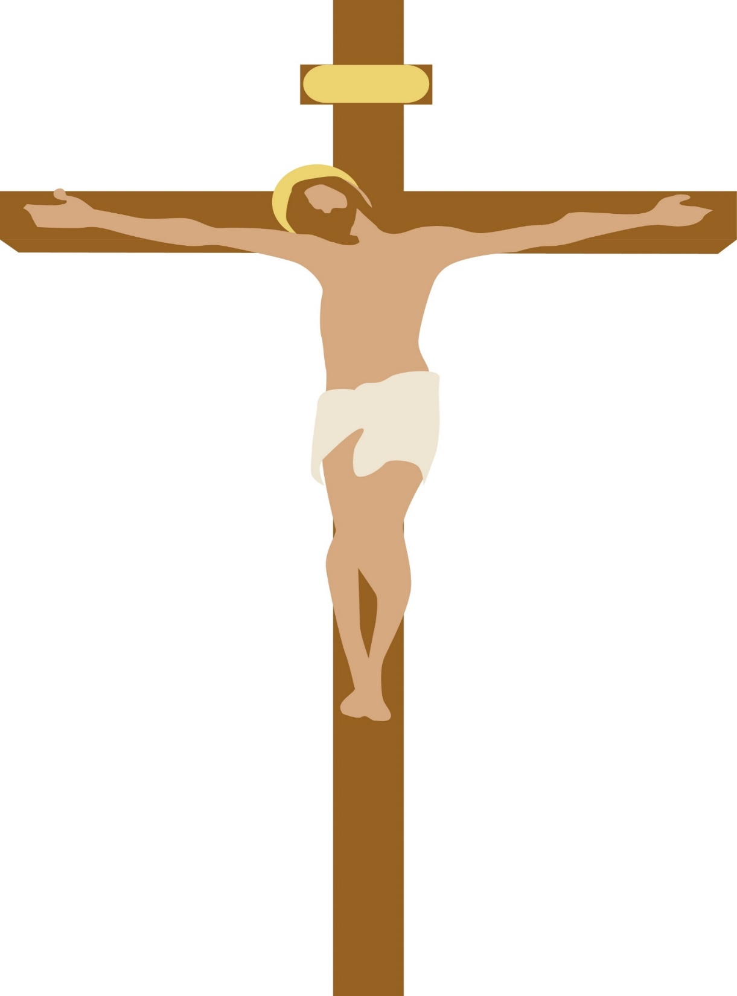
Station 12
Jesus Dies on the Cross

Slide 14
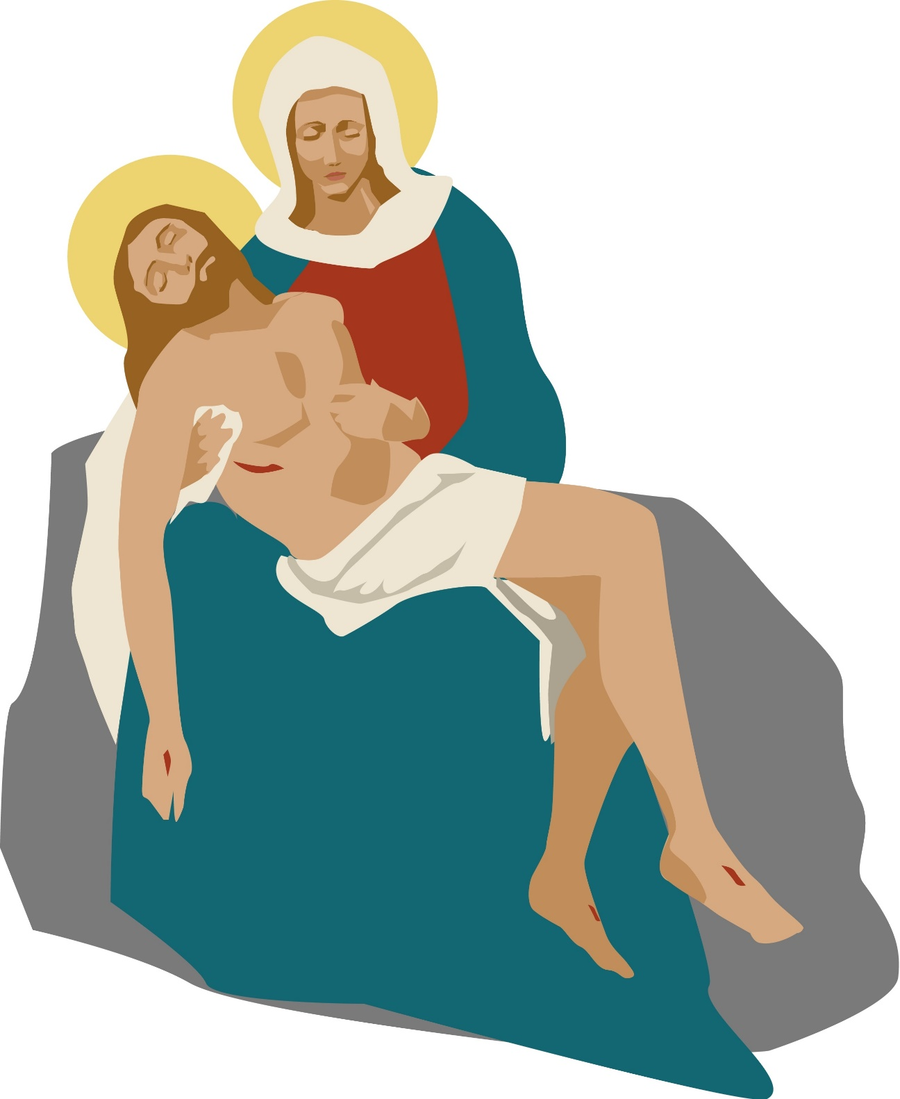
Station 13
Jesus is taken down from the Cross

Slide 15
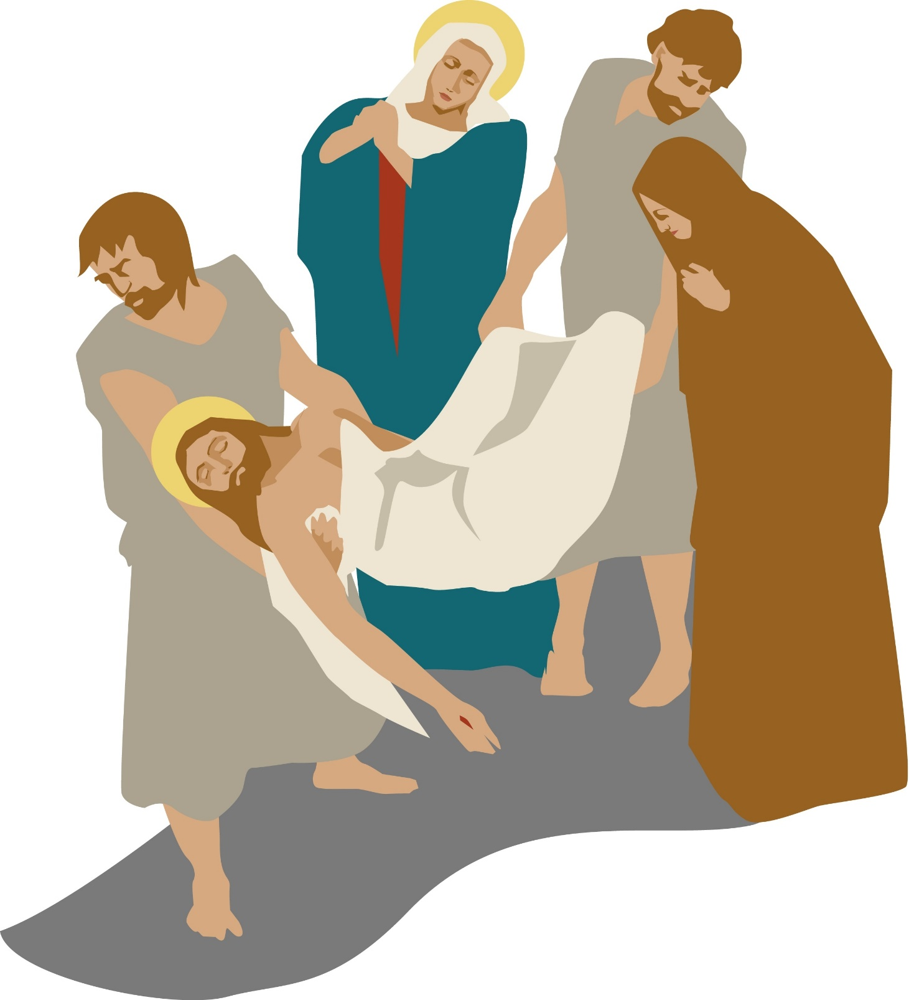
Station 14
Jesus is laid in the tomb

