Slide 1
Stations of the Cross

Slide 2
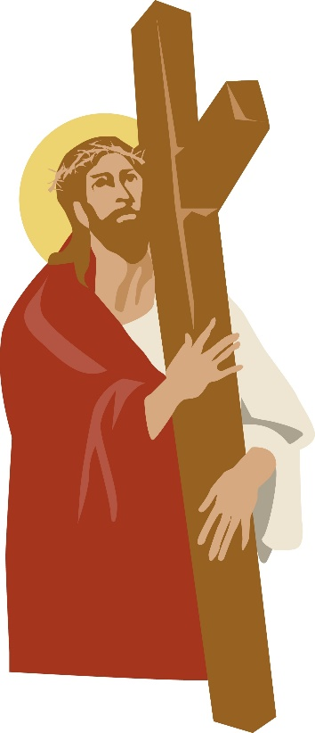
Station 2
Jesus Receives his Cross

Slide 3
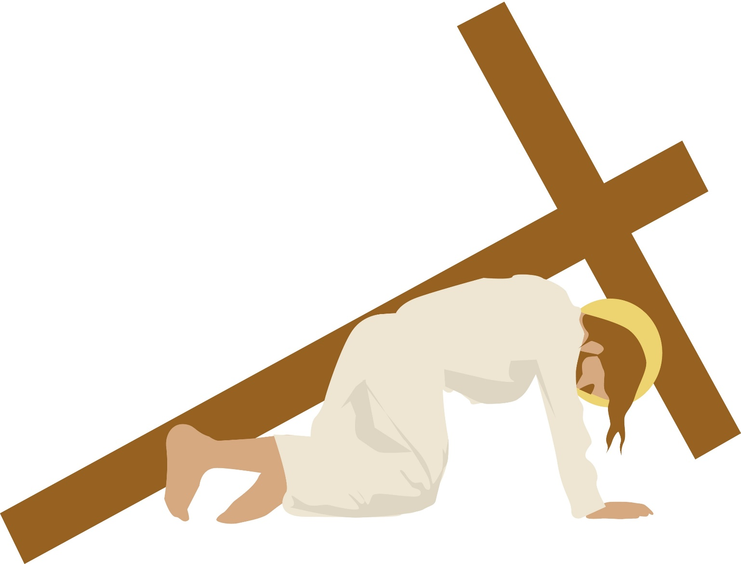
Station 3
Jesus Falls the First Time

Slide 4
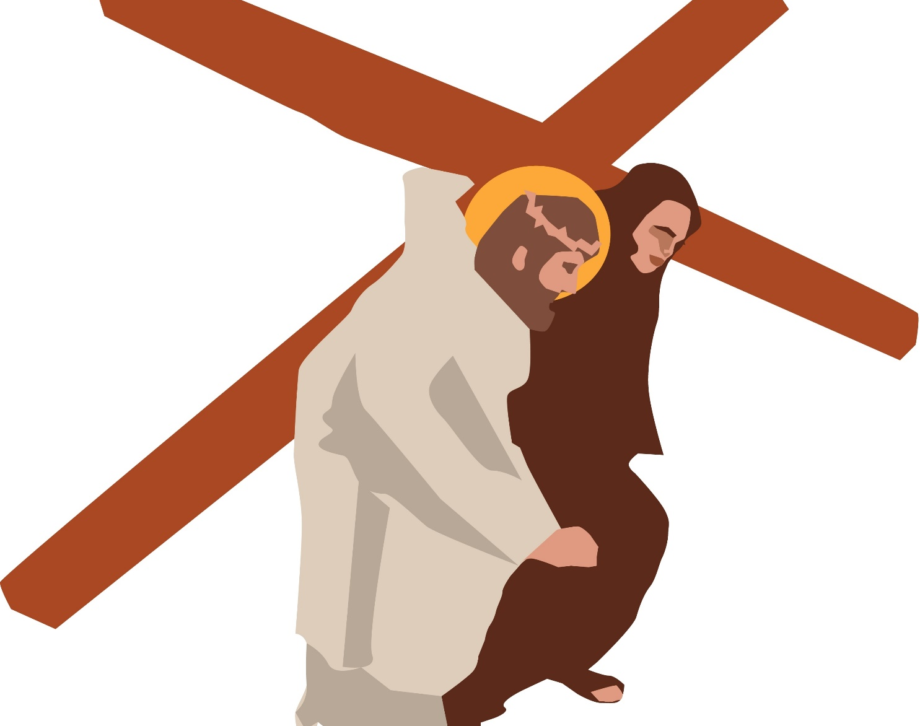
Station 5
Simon of Cyrene helps Jesus to carry his cross

Slide 5
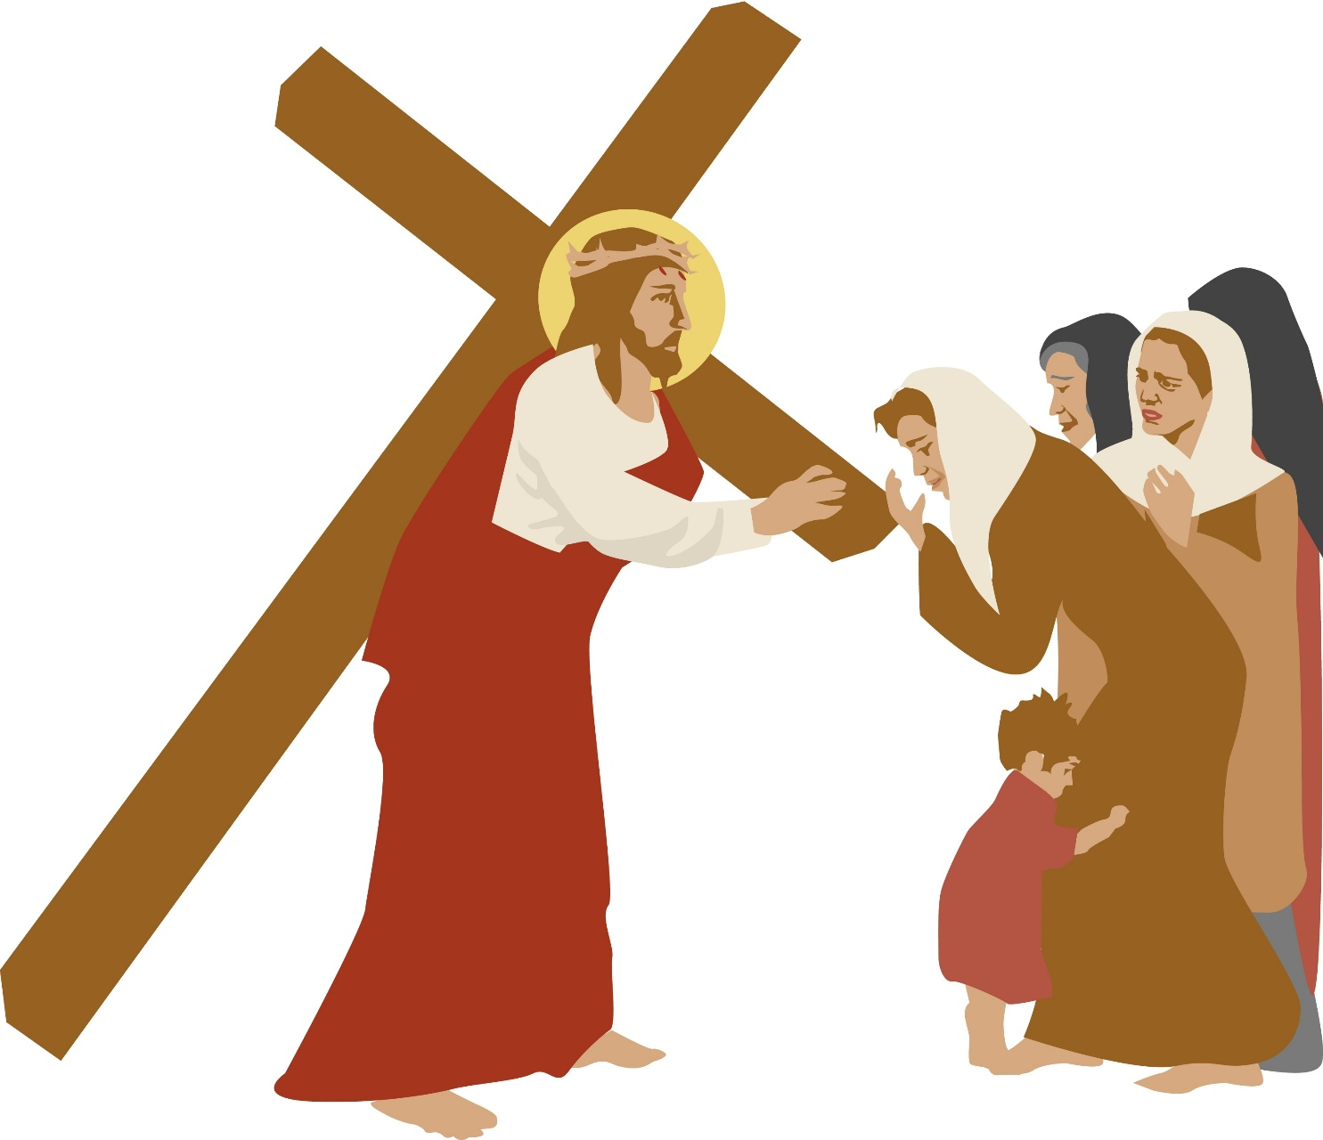
Station8
Jesus meets the Women of Jerusalem

Slide 6
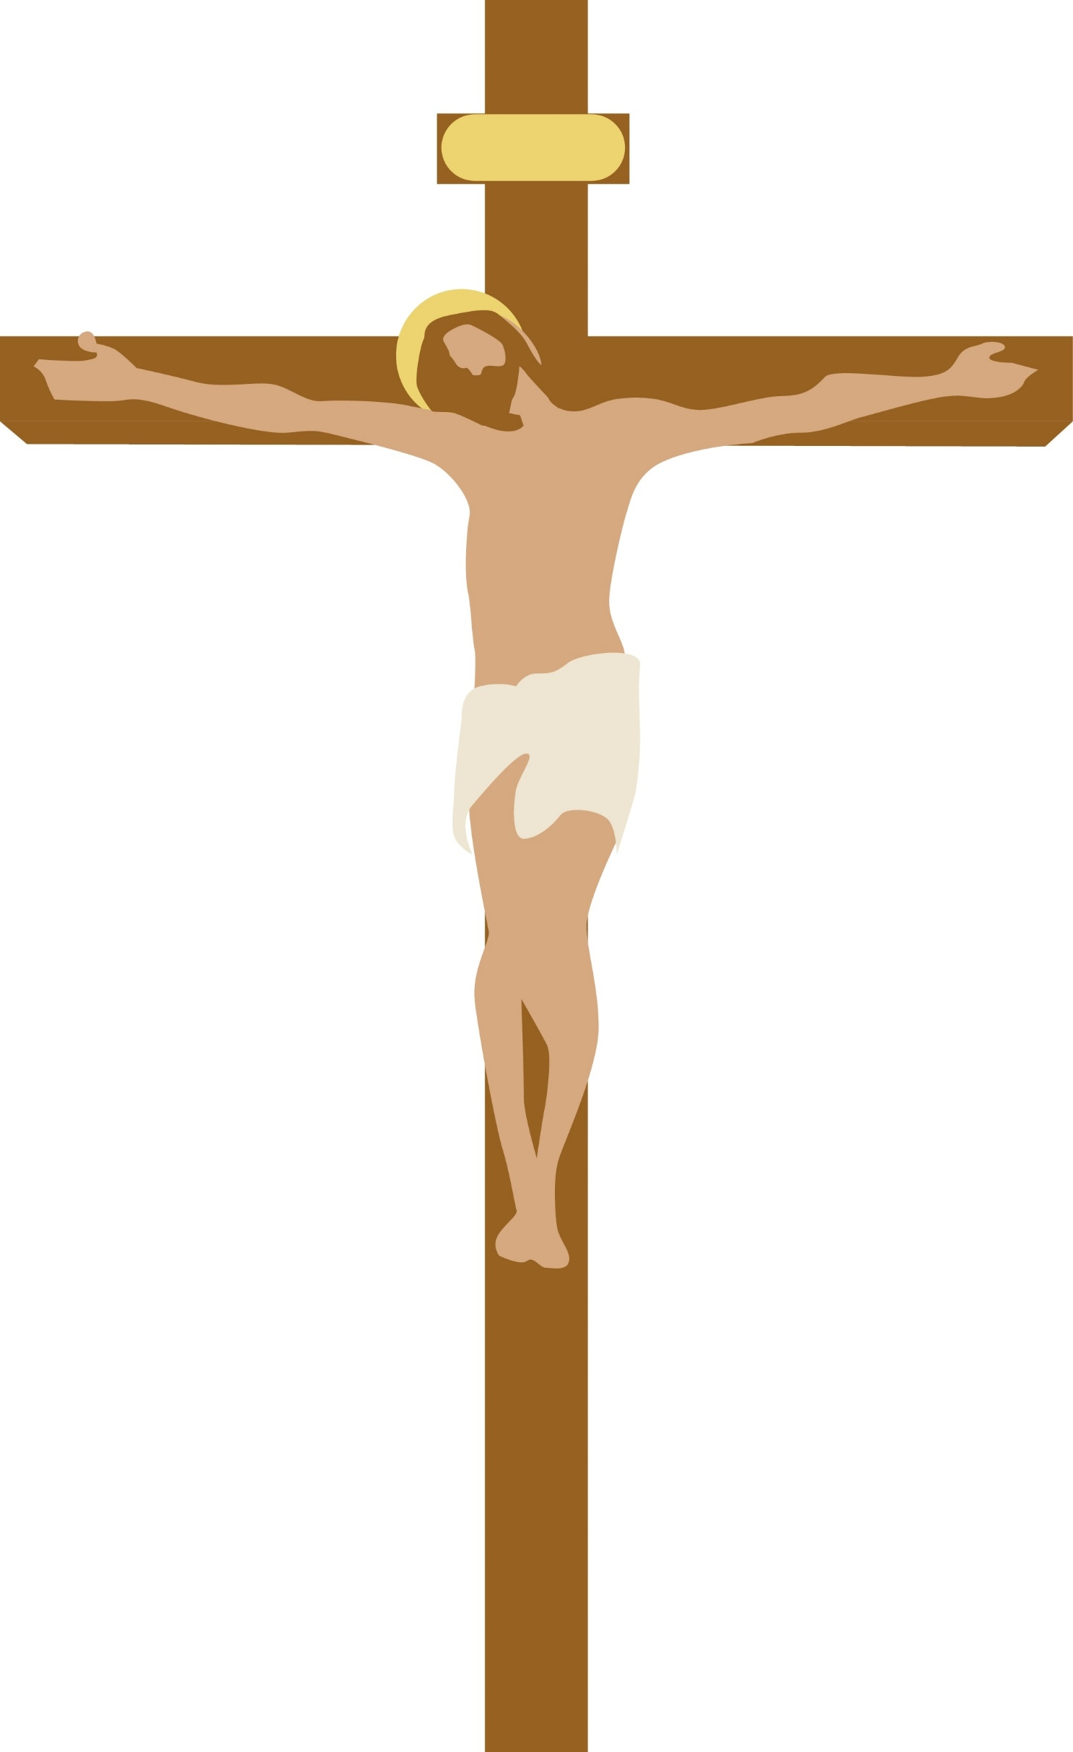
Station 12
Jesus Dies

Slide 7
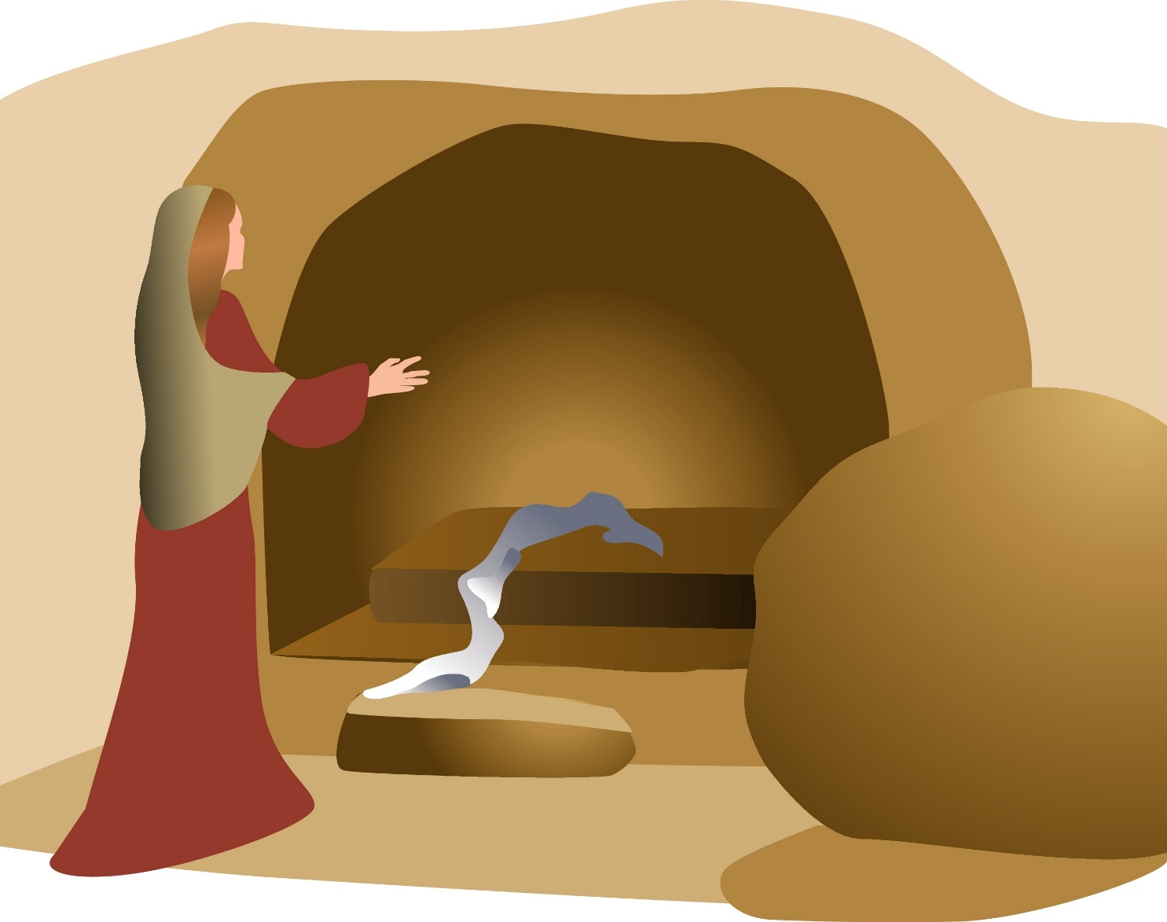
Station 15
Jesus is Risen

